Slide 1
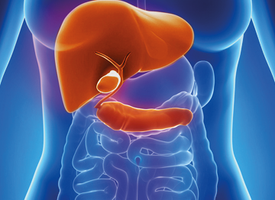
ROLE OF THE MACMILLAN HEPATOBILIARY (HPB)
CLINICAL NURSE SPECIALIST
Joanne Reynolds
Annette Redwood
What is a Macmillan HPB
Clinical Nurse Specialist?
An experienced nurse who works within the Wirral HPB Team, specialising in the care of inpatients and outpatients with disorders affecting the liver, pancreas, gall bladder and bile ducts, which are predominantly cancer related
Actively case manages the patients through diagnostic and treatment processes at WUTH and tertiary centres
Works closely with staff within WUTH, the community setting and tertiary centres which include University Hospital Aintree, Royal Liverpool University Hospital and Clatterbridge Cancer Centre
Employed by WUTH but adopted by Macmillan Cancer Support, a UK-wide charity supporting those affected by cancer
How many patients are referred?
In 2014, 326 patients were referred with suspected cancer, indeterminate or pre-cancerous lesions
How can we help patients?
Provide support to patients and families in a timely manner throughout their journey, identifying their main concerns and exploring how these might be addressed
Facilitate case discussion at the regional MDT where appropriate
Act as a point of contact
Provide clear communication and information to the extent required to patients/carers, and those involved in their care
Signposting and working in collaboration with other agencies including Maggie’s Centre, Macmillan Cancer Information Centre, CAB, DWP
Act as a conduit between health care professionals within the community, WUTH and tertiary centres
How can we be contacted?
Joanne Reynolds (Pancreas)
Tel: 0151 678 5111 Ext 2854
Email: joanne.reynolds7@nhs.net
Annette Redwood (Liver)
Tel: 0151 678 5111 Ext 7305
Email: annette.redwood@nhs.net

