Slide 1
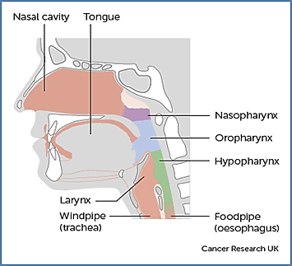
ROLE OF THE MACMILLAN HEAD & NECK
CLINICAL NURSE SPECIALIST
Kate Roberts
What is a Macmillan Head & Neck
Clinical Nurse Specialist?
An experienced nurse who works within the Cheshire & Merseyside network supporting patients during diagnosis and follow up. This includes those with thyroid cancer and oral cancers.
Actively case manages the patients through diagnostic and follow up processes.
Provides surgical voice restoration, tracheostomy and laryngectomy support.
Works closely with staff within WUTH, the community setting and tertiary centres which include University Hospital Aintree and Clatterbridge Cancer Centre.
Employed by WUTH but adopted by Macmillan Cancer Support, a UK-wide charity supporting those affected by cancer.
Head & Neck Squamous Cell Carcinoma’s are the 6th most common cancer worldwide
How can we help patients?
Provide information & support to Wirral patients , families & carers in a timely manner throughout their journey.
Facilitate case discussion at the regional MDT where appropriate.
Work in collaboration with Specialist Speech & Language Therapists.
Offer specialist support via a nurse led clinic for management of side effects of treatment.
Offer Holistic Needs Assessment to identify main causes of concern and begin care planning.
Signposting and working in collaboration other agencies including Maggie’s Centre, Macmillan Cancer Information Centre, CAB, DWP.
Liaise with health care professionals within the community, WUTH and tertiary centres to improve continuity of care.
How can we be contacted?
Kate Roberts
Tel: 0151 678 5111 Ext 8528
Email: kate.roberts14@nhs.net

