Slide 1
Leading Teams Programme
Cohort 3
Celebration & Pass-It-On Event
Monday 4th March 2024
Arrowe Park Hospital

Slide 3
Please welcome
Keris Bell
IT Senior Support Specialist
(Helpdesk Manager)

Slide 4
Streamlining and Improving the Service provided by DHT Helpdesk
Keris Bell
Senior IT Support Specialist (Helpdesk)
4th March 2024

Slide 5
1996 and beyond!
Wirral Grammar School – A Levels
Supervisor – Department store
WUTH - Medical Records / Clerical Officer
Team Leader – Women’s Services
DHT – Clinical Systems Analyst / Trainer
IT Senior Support Specialist – Helpdesk

Slide 6
2 Teams became 1 (2021)
Clinical and Technical Merged
Vision – 1st hand response
Working at home
Training & Skills
Staffing issues; Movement, Departed

Slide 7
Improvements
Processes – changed e.g., Trainee bookings
Accounts – All systems
2nd line clinical now 1st line
Staff – Banding, Birch, Fair rotation
Technical staff employed
Hub at APH

Slide 8
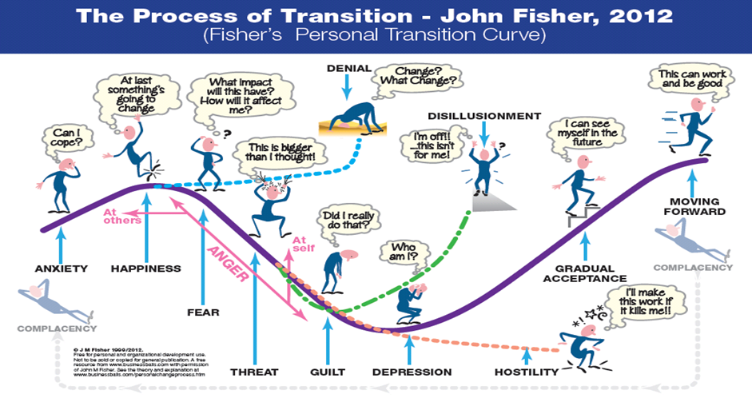
Our Journey
Excitement
Anxiety
Happiness
Depression
Hostile
Sickness
Progression

Slide 9
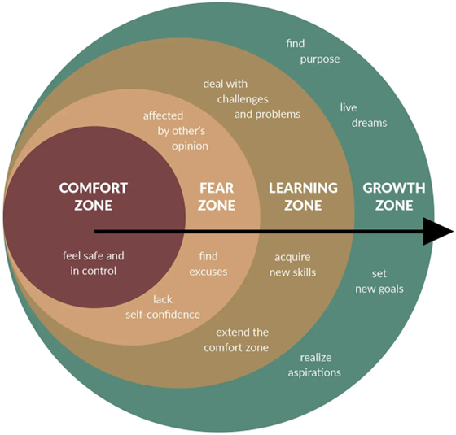
My Journey

Slide 10
Issues
Staffing – Temporary contracts
Accounts & Passwords – ward user, account security
Hub hours (8am – 5pm)
Call handlers; from 3 to 2
Emails
Self-service

Slide 11
Resolution
Remove email for WUTH staff (From Oct 2023)
Self-service – All staff
External requests –
Portal, email templates
Call handlers reduced

Slide 12
Benefits
Staff became a team
Staff morale
First contact resolution - 50%
Relationship with Trust staff
Telephone calls decreased
2nd line support tickets reduced

Slide 13
Current position & Challenges
Email switch off – HOTH Kiosk (SSO) issues
HOTH – Self-service awareness, training
External portal
Open-source system
Knowledge base

Slide 14
What’s next?
New Hub (with enhancements)
Email switch off for WUTH
HOTH – Self-service training
External portal
Open-source system
Knowledge base

Slide 15
Thank you!

Slide 17
Please welcome
Kayleigh Errington
Human Resources Business Partner

Slide 18
Improving People Practices at WUTH
Kayleigh Errington

Slide 19
The Future
CQC ‘well led’
Staff survey and People Pulse
Partnership working

Slide 20
The situation and challenges
Industrial Action
Resistance to change
Burnout and stress

Slide 21
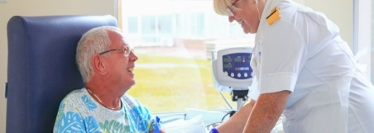
The idea and plan
After-action reflection
Staff side agreement
Governance structures and TOR
Ways of working
Head of HR
Staff Side
Executives / Directors
Commissioners / Regulators
Employees
Managers
HRBPs / HRMs / Workforce Colleagues

Slide 23
Please welcome
Jess Pickavance
Pharmacy Aseptics Team Leader
&
Laura Lewis
Lead Clinical Trials Pharmacy Technician

Slide 24
Transforming WUTH’s Pharmacy Aseptic Unit
Laura Lewis & Jess Pickavance
4th March 2024

Slide 25
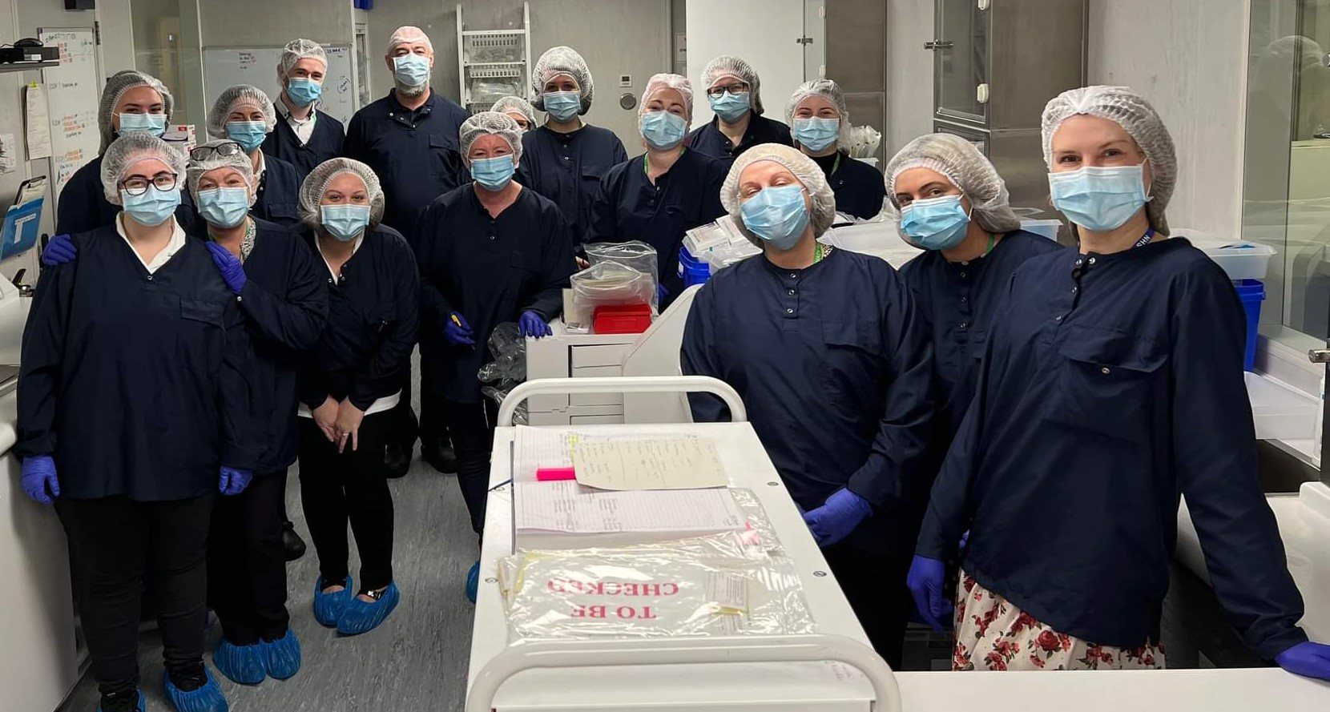
Introduction
Who are we?
Our team
What we do?
Notes:
Who are we – We are a team of ?? people housed in the main Pharmacy department on the Arrowe Park site. We are a none patient facing role. We manufacture aseptic products for a wide variety of patients.
Our team – Made up of housekeeper, support workers, technicians, scientists and pharmacists.
What we do – Provide high quality ready to inject medicine to most areas of the trust and across the UK. We are a crucial part of the trust as we free up nurse time so they can be by the bedside, rather than making up injectable medicine. We are responsible for keeping error rates low on the ward, and provide high quality medication made in a clean room environment to vulnerable people (chemotherapy patients/premature babies).
GET SOME STATS?
INTERNAL SUPPLY? NNU/HAEM/TPN/GENERAL PIP/TAZ PCAS (ANTIBIOTICS/ANALGESIAS)

Slide 26
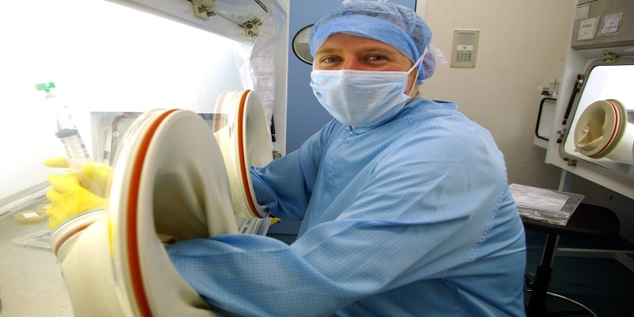
Ageing unit
Currently on the Risk register
Microbial risk
Changes introduced
- Observations
- Extra cleaning introduced
- Additional environmental monitoring
Notes:
Age of the unit – sits on the trust risk register.
Staff didn’t take it lightly – course helped develop having crucial conversations

Slide 27
Supply & Demand
Waiting list
Internal vs External demand
- Weekend working introduced Jan 24
-In a recruitment phase– agreed business case
- Looking at extending the working day
- Service review with Strategy team
Notes:
This map shows all of our current customers based all over the UK.
Challenges – Increased supply and demand for internal and external users.
We have had to create a waiting list for external supply due to the capacity limit we have here at WUTH.
Changes – introduced weekend working on a Saturday to extend our working week, which has alleviated some pressure.
Currently looking at extending our working day and introducing new staff who start earlier and work later.

Slide 28
Staff Morale
Support & Development of staff
Team building events
‘Down day’ – deliver Aseptic training sessions
Regular Check Ins
Notes:
One of the biggest challenges we face is our teams morale and motivation – we work in a very pressured busy environment which can take a toll on our staff’s productivity. Through our learning on the course, we have incorporated some changes to try and tackle this.
We want to support and develop our staff by providing them training opportunities. We have become aware of the various channels of support and education available through the trust, so we give the staff a chance to take advantage of these.
We recently held a team building event we did ourselves on the course, and found this to be very beneficial to the staff, by encouraging different people to work together and it gave a much needed break away from the working day – we got really good feedback from the staff around this.
We are now introducing down days – were we give the staff opportunity to read SOP’s, attend training sessions and catch up with their line managers to keep their knowledge up to date and talk about any issues or improvements they may have. We also keep up to date with regular staff check ins to help out staff both in and outside of work.
With the current changes we are facing, we want to avoid staff remaining in this “fear zone”, and encourage them to learn and grow by developing their knowledge, skills and well-being.

Slide 30
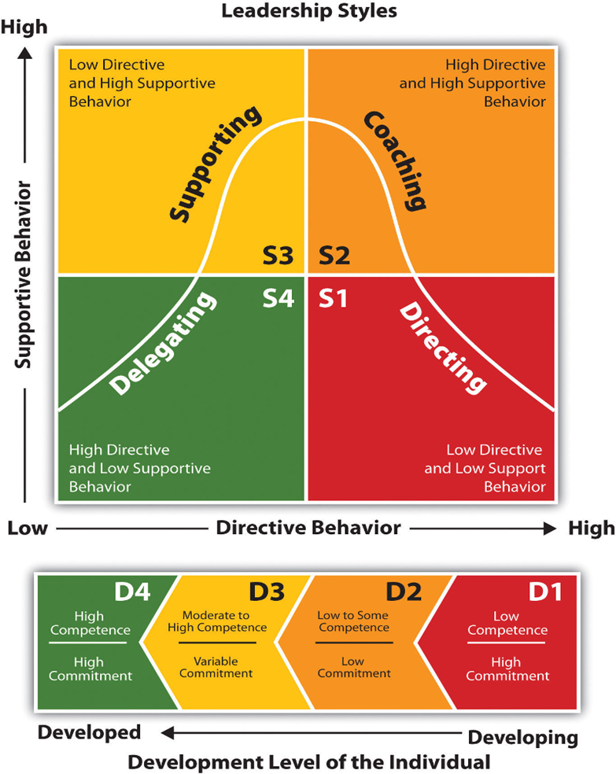
My different Leadership styles
Variety of different styles used
Change my approach based on situation/ staff member
360 Feedback tool
Notes:
I came across this leadership model during the course and found it very useful to reflect on my different leadership skills.
As you can see there are four different areas and then I adapt this based on the development of the individual, the amount of support they need in the task and the amount of direction they may need.
I am able to change my approach based on the different situations I come across and also based on the different staff members I manage.
We also completed a 360 feedback tool during the leading teams course which is something I’ve not done before but this was interesting in seeing how my colleagues view me as a manager and gave me areas in which I needed to improve. But overall I was pleased with the feedback I received.

Slide 31
WHAT YOU’VE LEARNT
Notes:
Since completing the Leading Teams course it has taught me a lot about how to be more resilient. I’ve looked at different models but I think this Robertson cooper model is well suited to my leadership style when thinking about resilience. I’ve recently had a promotion ……

Slide 32
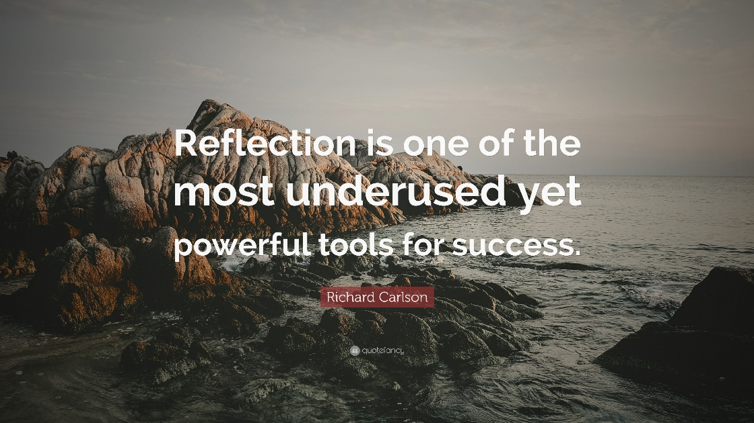
What I’ve learnt
-Reflection
-People strategy
-Conflict resolution/Crucial conversations
Notes:
-Firstly, I found that reflecting on my own practice is an extremely important part of being a leader. By thinking about how I can improve and by learning from mistakes I will in turn become more resilient and a well-rounded leader. Also getting feedback from my colleagues provides me with important information, I completed 360-degree feedback, which allowed me to see how my peers see me as a leader and gave me areas in which I need to look into.
-I found the WUTH’s people strategy really useful – as this really encapsulates our current position in our unit. We need to start by supporting a positive well-being culture, and creating a safe space for people to work and can speak up when they need too. Therefore, by transforming our processes and ways of working, we can streamline our service and continue to make the highest quality products for our patients. In turn, we are shaping our future, as hopefully we will achieve our end goal of having our own bespoke aseptic unit.
-The course has given me the tools I need to tackle conflict and difficult conversations head on, as I have taken on new roles in the trust, this is something I will have to do more and more, so I feel much more confident now in dealing with situations and trying to get the best outcome for everyone.

Slide 33
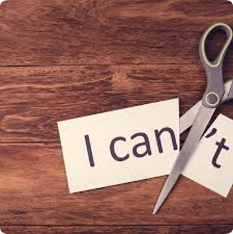
What’s next for me?
-New role
-Continue self-development
-Managers essentials
-Staff Development
-Coaching
Notes:
-I have recently been offered 2 new roles in my department, which will be a big step up for me, but I want to make the most of the opportunities I have been given and make a difference to the unit and my colleagues, the skills and knowledge I have gained from the course, not only helped me prep for my interview, but I will be able to take forward with me and make me the best leader I can be.
-I will continue to self-reflect regularly and think about what I do well and what I could do better. Now I am aware of the learning opportunities the trust offers, I will take full advantage and I have already enrolled on the managers essentials course.
-I found the coaching aspect of the course really interesting and is something I have already started to introduce in my practice. I want to really focus on my staff’s development so by coaching them through problems and various situations, instead of giving them solutions or taking it on myself. This will benefit myself and my colleagues, as it will encourage them to be more decisive and learn from seeing tasks through til the end.

Slide 36
Please welcome
Danielle Schoneveld
Team Leader for Specialist Nurses for Older Persons

Slide 37
Frailty moving forward
Danielle Schoneveld 4/3/24

Slide 38
Wirral and its population
Older people aged 65 years and over made up 22% of the population in Wirral in 2021. This compares to 18.5% in England overall and 18.8% in the North-West

Slide 41
Month and Year | Accepted | Rejected | Total | % Accepted
202301 | 84 | 8 | 92 | 91%
202302 | 157 | 10 | 167 | 94%
202303 | 232 | 57 | 289 | 80%
202304 | 171 | 56 | 227 | 75%
202305 | 230 | 68 | 298 | 77%
202306 | 210 | 79 | 289 | 73%
202307 | 297 | 38 | 335 | 89%
202308 | 442 | 21 | 463 | 95%
202309 | 551 | 27 | 578 | 95%
202310 | 587 | 5 | 592 | 99%
202311 | 586 | 18 | 604 | 97%
202312 | 513 | 45 | 558 | 92%
202401 | 553 | 28 | 581 | 95%
Grand Total | 4613 | 460 | 5073 | 91%

Slide 42
What we currently offer for front door frailty
Current services
Proposed service
VS
SNOP Team – nurses, HCA’s and therapists
Geriatrician at the front door
SDEC Area for frailty
Complete MDT approach

Slide 43
Main points
More complex patients being discharged, or LOS reduced with specialist geriatrician input early on in admission.
Better patient journey.
More holistic approach for family and patient.
CGA seems to be beneficial in the hospital medical setting for multiple health outcomes, with a high certainty of evidence. The evidence of benefits is less strong for the use of CGA in other settings (British geriatric society, Age and Ageing, Volume 51, Issue 5, May 2022, afac104,).

Slide 44
Trial week with geriatrician input at the front door
5 virtual ward referrals over space of 5 days
Prior to this average 1-2 in 5 days. (some of these complex – early ACP discussed).

Slide 45
Barriers to improvements for frailty patients
No medical/discharging clinician with the team. Currently we are dependent on bleeping medical specialities and teams or ED doctors to act upon our advice and plans.
We do not have full time HCA therefore have days with no HCA’s therefore complete out jobs/tasks ourselves.
Nurse movement daily to cover ED pressures

Slide 46
Summary
Improvement shown in 5 days with geriatrician input for discharging purposes.
Number of referrals to service continues to increase therefore more specialist support required for better outcomes for patients/better patient journey.

Slide 47
Action required
Protected specialist service
Specialist geriatrician input
More education for wider hospital on frailty syndromes / services than can be provided in the community to support our frailty patients

Slide 48
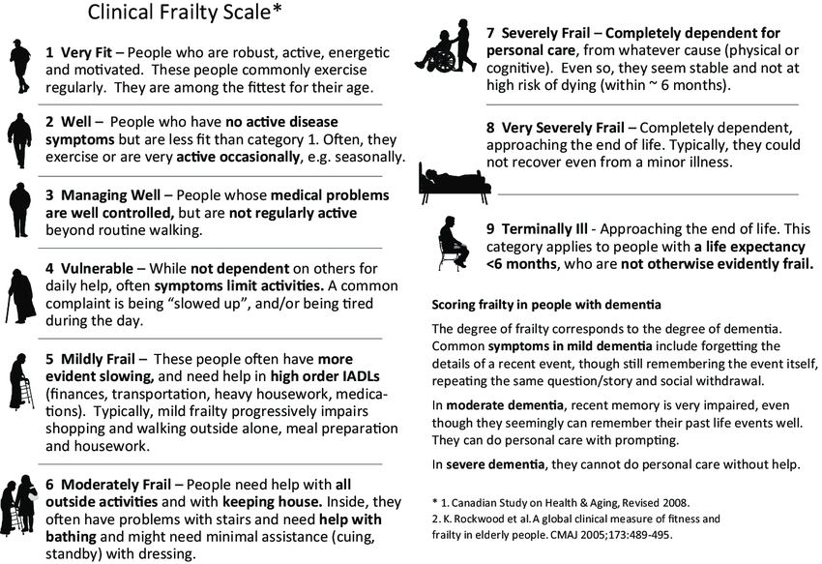
Thank you for listening ☺

Slide 49
Break

Slide 50
Please welcome
Jennifer Hough
X-Ray Imaging Manager

Slide 51
Creating paper free requests throughout radiology
Jennifer Hough
X-Ray Manager
Wirral University Teaching Hospital

Slide 52
Who am I?
- From Wirral
- Qualified from SHU in 2009 as Radiographer
- 2009 - First job - Norfolk and Norwich University Hospital
- 2010 – Sheffield Children’s Hospital – Paediatric Radiographer - Senior
- 2016 – SCH Trauma Lead / Deputy Principal lead
- Dec 2022 – WUTH – X-ray Imaging Manager
- Leading Teams course in pursuit of self-improvement

Slide 53
Current process
- All US/MRI/CT requests throughout trust are electronic
- Throughout most of trust X-Ray requests are electronic
- Within Fracture/Orthopaedic clinic we are still use paper requests for X-Ray
Radiographer check both paper AND electronic request
Extra time needed for radiographers who have to check both the original paper request and that the input to Cerner is correct.
Dr/Nurse fills in request
Prior to arrival boxes ticked, cons then signs forms
X-Ray taken – details finalised on Cerner – Paper stored
Patient hands form to reception
Paper requests are then boxed up and stored and kept – 7 years for adult and 25 years for children.
Clerical team input onto Cerner
Clerical team are not clinicians and can make errors on inputting.
If electronic all details will be mandatory for filling in.
Clerical staff name put against request
If electronic, less need for clerical team and time could be better used for booking appts etc

Slide 54
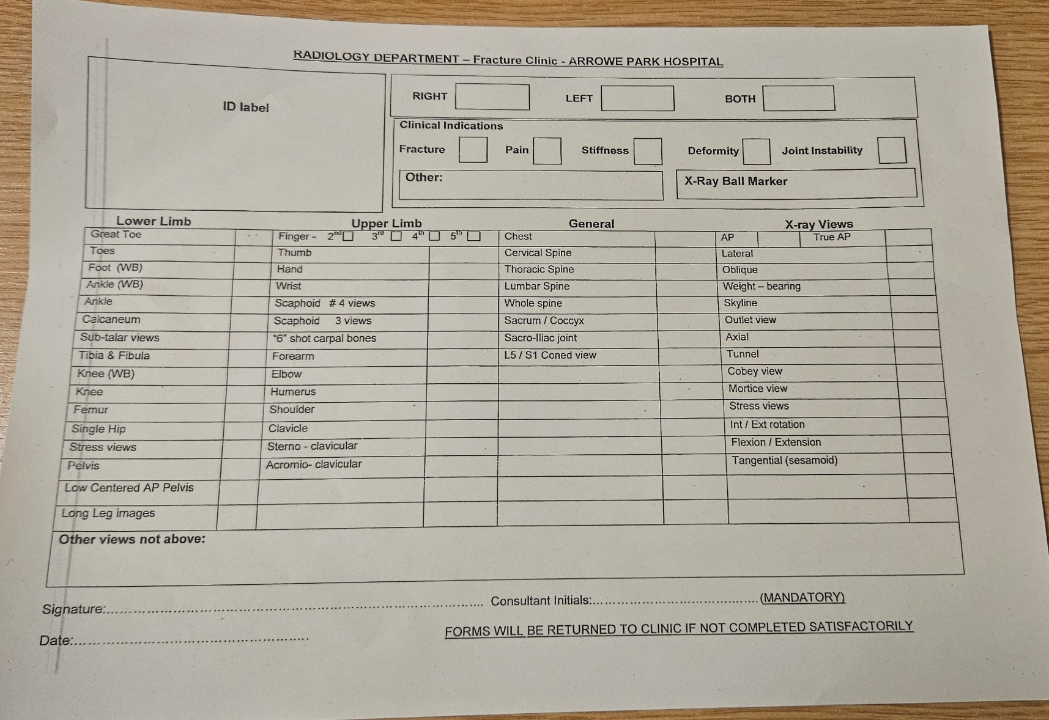
- Only very basic patient information
- No guarantee who has ticked the boxes
- Easy to incorrectly tick leading to errors
- Only place within trust using paper is within Fracture & Orthopaedic clinics – all clinicians within clinics request electronically in all other areas

Slide 55
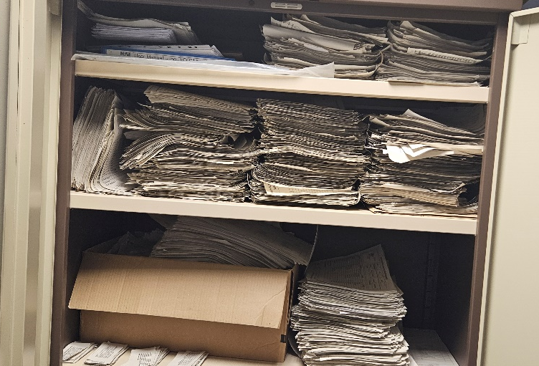
Why paper free?
Errors
Legislation
- Errors made with details, wrong stickers
- Reception desk copying/typing errors
- Multiple incidents coming through
- Minimum details given – tick boxes non-specific to patients
- Should be filled in, dated and signed by same staff member NOT multiple
- RCR recommend electronic requests
Storage
WAVE
Outliers
- Storing old paper requests, 7years adults, 25 years under 16’s
- Fire Risk
- Infection Control
- IG
- Zero Waste culture
- Improve efficiency
- Hospital wide flow
- Technology – reducing reliance on paper-based processes
- Everywhere else within radiology is paper-free
- Pharmacy / OPD no longer accept paper referrals
-Most other trusts are purely electronic or have CRIS/RIS systems whereby requests can be scanned on

Slide 56
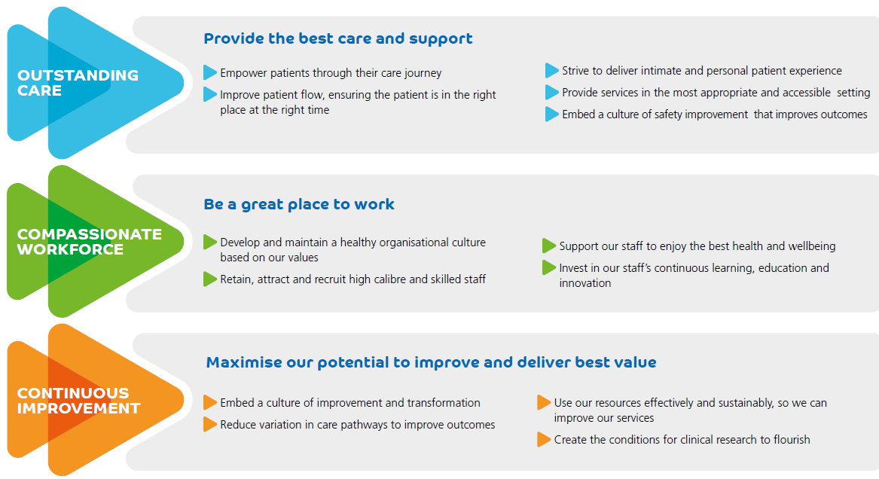
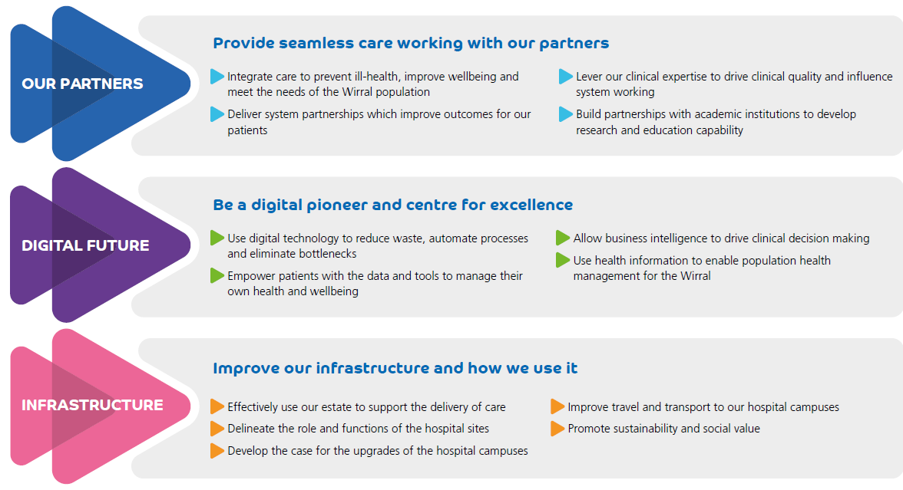
Trust strategies
- Continuous Improvement – moving forward. Reduce variation throughout radiology. Use resources effectively and efficiently.
- Digital Pioneer – reduce waste, automate processes. Allow for research and data to be pulled more accurately.

Slide 57
Challenges
“We don’t have the time”
“Good Luck!”
“Multiple managers tried and failed”
- Enquiries from Radiology have been on-going since 2015 regarding moving to electronic referrals – Told by orthopaedics at this stage they were “fully committed to developing the trust’s IT systems and are planning to progress towards paperless.”
- Issues raised were switching between Cerner to input request and other programmes was increasing clinic time needed and therefore would slow efficiency too much – paper easier for them.
- In 2020 during/post covid when clinics were smaller radiology reached out again to suggest trailing electronic requests whilst the throughput was smaller – no movement
- In 2021 we requested it be put on the risk register regarding risk of errors made via inputting. Seems to be misunderstanding as to whose risk – radiology vs surgery
- 2022 Radiology informed that CDDA (Clinical Digital Design Authority) had asked the surgical division that this practise stop – again no movement away from paper.
- 2023 – Now – Radiology still logging incidents regarding mistakes made by paper requests – New manager (me!) regularly meeting with orthopaedics and pushing the issue
“You’re knocking at a closed door!”

Slide 58
How to get there
Support
NMR
Set date
Radiology team need support from all divisions to move forward to paperless
If Cerner is the issue – IT support to try and simplify train staff to increase speed
Radiographers' morale low, increase workload and CSW staff assisting inputting requests not with patient cares. Already working with 20+ year old kit-no funds for new equipment, no movement forward
Could be affecting recruitment, we cannot claim to be fully digital – We are working well behind other trusts in both equipment and practise
Other trusts/areas within WUTH use nurse practitioners to act as requests to assist in submitting electronic requests
Fracture clinic nurses supportive of electronic requests and want to move towards this practise themselves.
NMR Policy will allow training to specific nursing staff to allow them to add X-Ray requests to the system to relieve some pressure from Drs.
IR(ME)R training is being added to ESR to allow this to move forward – Fracture clinic nurses have been encouraged to start these modules ahead so that when NMR published, we can start to move towards it
Other areas within trust set a deadline of being compliant
Ideally, we would publish and implement the NMR policy, then set a date (3-6 months) whereby after which we no longer accept paper requests.
During this period the nurses have chance to undertake the IR(ME)R training, and then for any patient whereby it states on notes for X-Ray on arrival at next appt they could request the X-Ray themselves, and the Drs would only need to input requests which were being made whilst seeing the patient – which is the process they currently would have to use to request US/CT/MRI so is a known practise.

Slide 59
How have I used the course
Self reflection
Service Improvement
- Management style – try to be more reflective as well as action focused
- Keep an open mind – Appreciate the perspective from the other teams
- Work with purpose and presence – not always reactive
- Link up with trust strategies
- Capture baseline – data as to why do the change
- Perform initial scoping and then a plan for delivery
- Implement & test it – then sustain it
- Feedback results to keep motivation
Building a high performing team
Well-being
- keeping staff motivated – radiology moving forward
- Shared goals across both dept and trust
- Looking at efficiency through radiology
- Well-being for both staff and patients
- Enabling people – radiology staff to
Feel we are supported to improve and make
Changes.
- Outcome focused and transformational

Slide 60
Conclusion
- Looked at issues for both radiology and clinics limiting the moving forward.
- Considered patients journey and experiences and how can we make it better
- Aligned my own theories with the trust's strategies and used course to further my knowledge
- Looked at what can we do to support and provide to other depts to help achieve it
- Set out a goal and hope to achieve and move forward.
Thank you

Slide 62
Please welcome
Hollie Courtney
&
Paula Redmond
Neonatal Unit Team Leaders

Slide 63
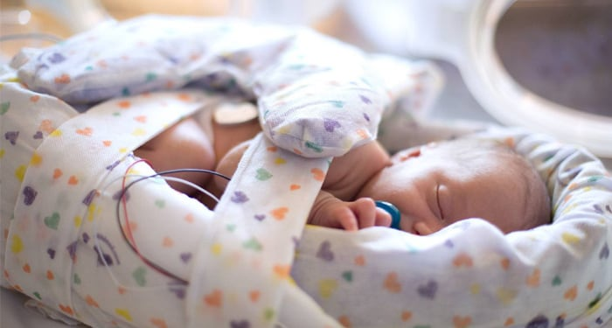
Improving safety on NNU
Hollie Courtney – Neonatal Team Leader
Paula Redmond – Neonatal Team Leader

Slide 64
Our Aim
All Newborn Life Support (NLS) Trained staff to be confident in resuscitation of the Newborn.
All NLS staff to be confident in using emergency equipment.
Notes:
ALL neonatal staff complete NLS as soon as resonably possible meaning in theory they can attend high risk deliveries.

Slide 65
Our Starting Point
Shift Leader held the red bleep
Shift leader carried out emergency safety checks at the beginning of the shift.
Wider team were lacking in confidence.
Notes:
Currently shift leader attends all high risk/emergency deliveries
Part of shift leader checks equipment – can be delegated
Equipment that is vital to resusitation of the newborn
Staff Lacking confidence – raised during appraisals

Slide 66
Our Leadership Journey
360 feedback
Coaching conversations
Leadership styles
4 Principles of Our Peoples Strategy
Notes:
We have received feedback which has made us look at how we come across in our roles as team leaders and what we need to work on.
We have developed our skills to improve our staffs experience of appraisals and get the best out of them which in turn made us more aware of the fact that some staff did not feel confident in attending deliveries.
We have tried to have coaching conversations to help say what they need and what we can do about it.
We also looked at the 4 principles of Our Peoples Strategy.

Slide 67
Our Vision
All NLS staff to feel confident in resuscitation of the newborn.
All NLS staff to be confident in carrying out emergency checks.
Notes:
1 ) All nnu Staff complete NLS as soon as possible and refresh this every 3 years
2) Emergency checks include the lifestart – trolley to aid resuscitation of the newborn whilst enabling DCC and keeping the baby as close to mum, parents can see baby during initial resuscitation.
Also includes resus trolley with emergency equipment and transport inc
All equipment vital for sufficient resuscitation

Slide 68
Our Idea
Junior NLS trained staff to hold a trainer bleep.
Junior NLS staff to be responsible for emergency equipment checks.
Notes:
Same bleep number as SL – Attend deliveries with SL till confident
SL to let junior staff take the lead as nurse but there to support and offer guidance
Bleep/Check rotation system – form that staff sign to say attended delivery/carried out checks

Slide 69
Our Process
Identified need for change.
Discussed with senior management and finance.
Communicated with staff.
Allocated appropriately and fairly.
Feedback from staff.
Notes:
Communicated with staff via email, Facebook page, safety huddle.
Communicated the need for change and how it will improve practice and outcomes for patients and staff
Opportunity to raise concerns
Rota of who has held the bleep, if a delivery was attended and safety checks carried out
Feedback – how confident they now feel after attending 3 deliveries.
Feedback forms, appraisals and check ins

Slide 70
Our Strategy
Notes:
Four principles of our people strategy
*Looking after ourselves and each other- identified lack of confidence which can lead to stress, we wanted to change this to support wellbeing
*Belonging at WUTH- want to ensure everyone feels a vauled part of the team
*Transforming ways of working- embrace new way of working with trainer bleep to enable others to achieve their potential
*Shaping our future- improve skills of staff which will improve outcomes for our patients.

Slide 71
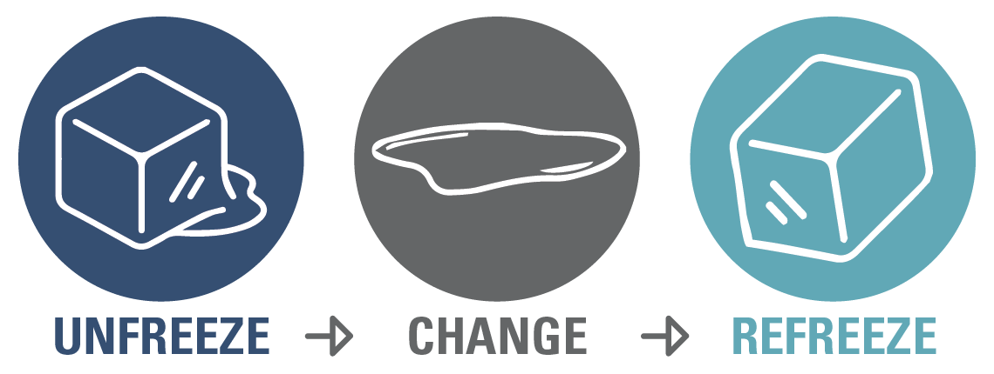
Our Chosen Model
Notes:
Lewins model of change
Unfreeze – recognized the need for change – consulted staff (what, when, why, who, how)
Change – Implement, support staff, use of coaching techniques, regular feedback to staff
Refreeze – currently in process – obtained staff feedback, celebrate success – positive feedback to staff

Slide 72
Our Results
Trainer bleep allocated on rotational system.
Improved staff confidence.
Positive feedback from staff.
Notes:
Staff showing increased confidence in holding bleep and attending deliveries
Feedback reflects this, they feel more supported.

Slide 73
Our Feeback
"I am always try to carry it whenever I'm in the shift, and definitely it makes more confident and more comfortable to attend deliveries with an experienced senior staff...I personally believe it's an amazing opportunity for the juniors like me to build up the confidence" - Junior Band 6
"I've had it on shift today, I was able to attend deliveries and gain more experience prior to my QIS, love the idea of us having one so we are able to attend more deliveries." - Junior Band 5

Slide 76
Any Questions?

