Slide 1
Leading Teams Programme
Project Presentations Cohort 2

Slide 3
Team Approach working
Leading Teams Programme
December 2023

Slide 5
Background to the team
Single nurse working
Risk of cancelled clinics
Risk of failing service
Breakdown in patient/family support
Risk of increased hospital admissions

Slide 6
Trust vision, Values & Strategies

Slide 7
Four principles of our people strategy

Slide 8
Vision
Team working approach including out MDT
All able to support patients and families
Develop own strengths and to listen to each other
Support each other as a team- open communication
Use ongoing skills and experience to develop
Support the service to ensure minimal disruption

Slide 9
Leadership within the team
Open to talk to nurses (Check-Ins)
Create safe supportive environment
Improve staff own personal development
Opportunity to support patients

Slide 10
Growth mindset and leadership styles
Leadership styles
Support and guide through change
Being aware of your own strengths
GROW model

Slide 12
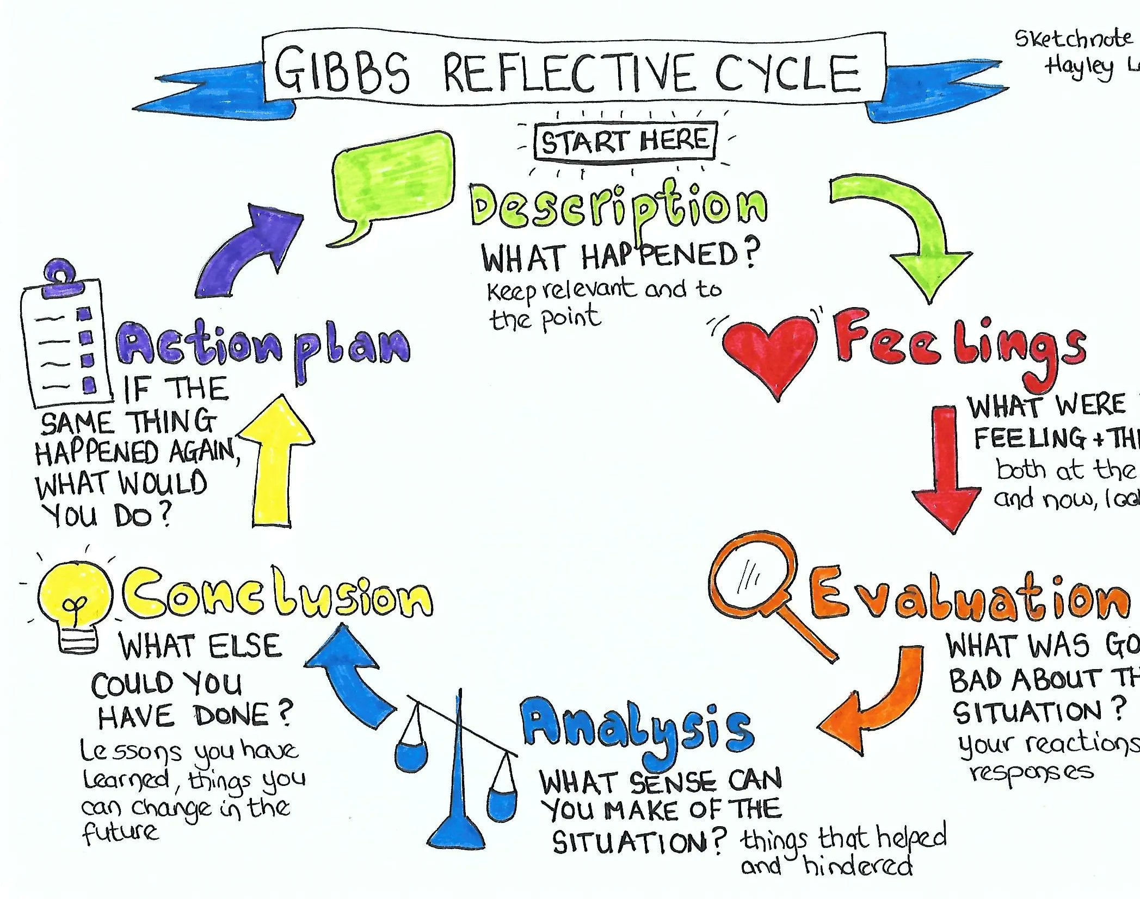
Reflection
What has worked well?
What were the challenges?
How did we overcome them?
What was the outcomes?
What are you pleased with?

Slide 13
Our vision

Slide 14
WHAT’S next for the team?
To continue to work as team
Growth within the team
Personal development for all
Safe, positive and open environment to work in

Slide 15
Next for me?

Slide 17
Improving Scheduling of Antenatal Growth Scans.
Angela Berry
Obstetrics and Gynaecology Outpatients Clerical Team Leader.

Slide 18
Working History
Joined NHS 1991 – Student Nurse
RLUHT – Head and Neck surgical ward
Warrington – Colorectal surgical ward
John Radcliffe – Endoscopy department
Warrington – Colorectal surgical ward
Warrington - Radiology clerical department
WUTH – May 2015
ANC Clerk, Gynae Clerk, TCI.
Clerical Team Leader
J

Slide 19
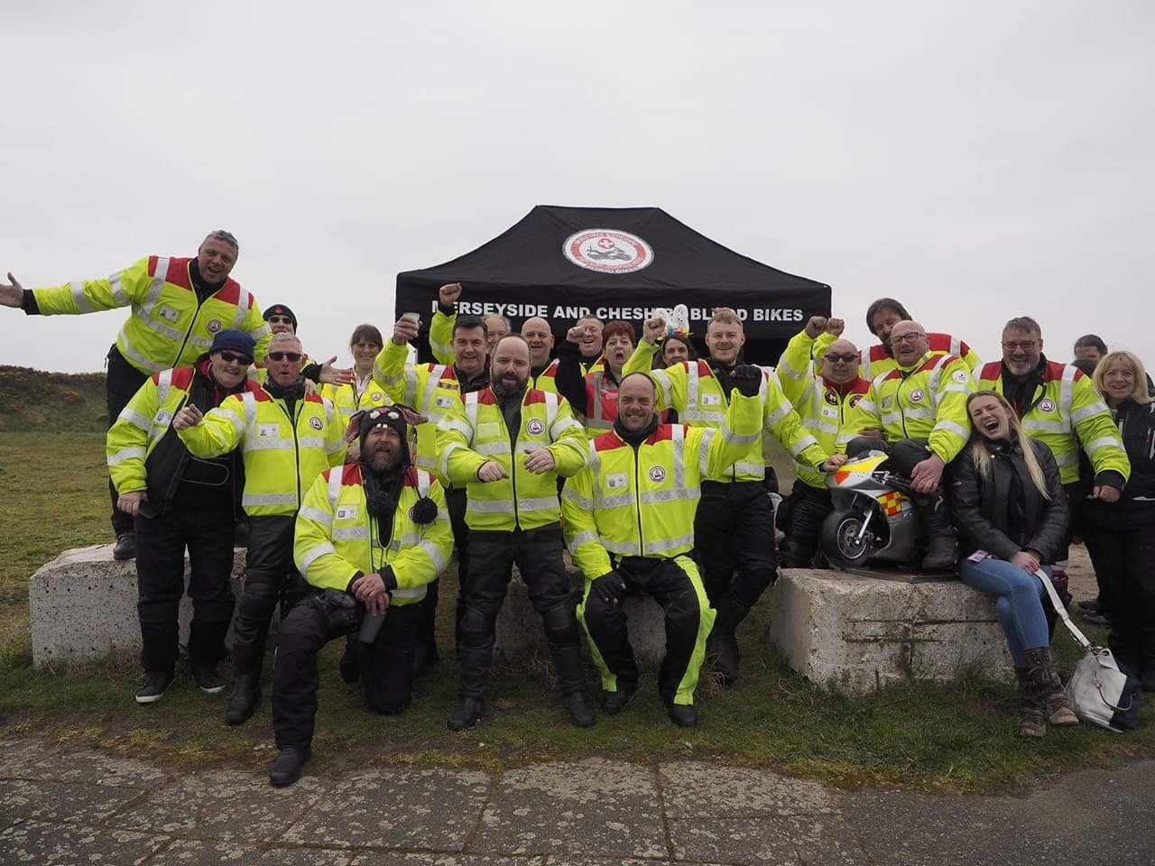
Volunteer for Merseyside and Cheshire Blood Bikes

Slide 20
Improving Scheduling of Antenatal Growth Scans.
Patients attending for dating scans at 12 weeks were asked to go to reception to make all their antenatal appointments after their first scan.
The average number of appointments required to be made were 7.
3 of which were growth scans.

Slide 21
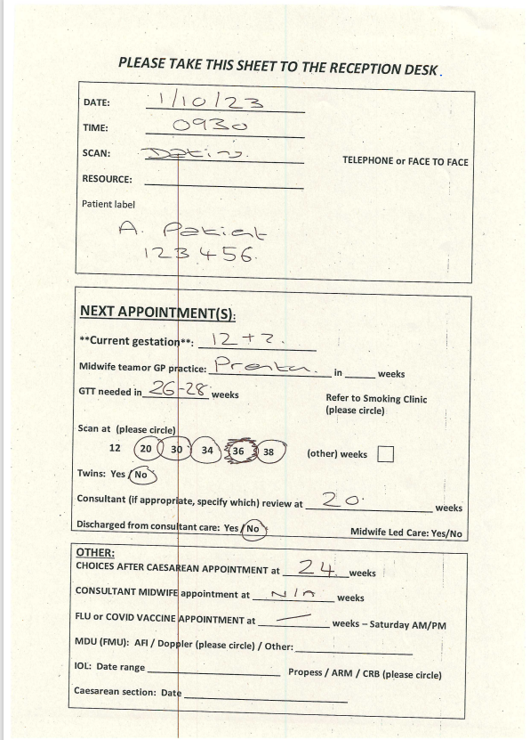
Example of front sheet.

Slide 22
Issues raised
Increased waiting times checking patients in/out.
Appointments being made up to 6 months in advance. – scan slot availability – rescheduling/sonographer annual leave.
DNA’s, Duplicates, Cancellations

Slide 23
Issues raised
Standard 30,34, 38-week Growth Scans booked at 12 weeks.
Growth increase/decrease - change of multiple appointments.
Growths duplicated in FMU, following anatomy scan.

Slide 24
Problem solving.
Discussions with clinic/community midwives, PNMH, Substance Use Midwife and Smoking Cessation team.
Review of previous attendance documentation.
Why do all appointments need to be made at 12 weeks?
ANC Team discussion
Fail safes – Communication & Documentation.
Flexibility for patients.
Roll out.

Slide 25
Challenges.
Resistance to change.
Appointments could be missed.
High risk patients
Scan slot availability
Consistent documentation from ANC clerks

Slide 26
Outcomes
Growth scans to be made one at time.
Start date 1/11/23
Reinforce importance of attendance.
Reduces need to reschedule 3 consecutive appointments.
Reduced DNA, duplicate appointments, lost letters and phone calls to department.

Slide 27
Personal Development
1 year in current Leadership role
Reflective Practice – Journal
Pre-Leadership for all course – Rescuing situations, how to do it.
Working on promoting a Coaching Style Leadership – providing support, development,
Encouraging innovation.
360 feedback – Positive.
Improved confidence in leading my team.

Slide 28
Developing In Service Training (IST) within OT Orthopaedics Team
By Rosie King
Clinical Lead OT Orthopaedics.

Slide 29
In Service Training (IST)
In service training provides the opportunity to share knowledge and skills within the team.
Although a lot of learning can be done on the job and with support of colleagues it is valuable to be able to have the opportunity to share knowledge and skill with others and to be able to learn from each other.
Physio colleagues have regular IST every couple of weeks and the time is protected.
Gives each member of staff the opportunity to deliver and to develop their skills – choosing a topic, producing and delivering the presentation and contributes to service development if coming up with new ideas etc.

Slide 30
Develop In Service Training Programme
Team is made up of static staff with varying levels of knowledge, experience and expertise within orthopaedics team. There are also junior staff who rotate onto the team some of whom may be completely new to the trust.
Want to develop a programme and ensure the time is protected to give staff the time to share knowledge and skills.
Important to have the staff involved in developing the programme so that they feel valued and will take ownership of IST.
Spoke to other teams regarding their IST to get an idea of how theirs is delivered.

Slide 31
How often do you have IST?
Every fortnight. Every fortnight and alternate days so part time staff are included
Is the time protected or does it get cancelled at short notice due to staffing or ward pressures?
Try to keep it although at times has been cancelled due to staffing.
Has come to a bit of a standstill with lack of staff and work pressures
Do you have IST for the whole team i.e. including physio or do you just have it for OT’s and Assistants?
Whole team. Assistants are expected to deliver IST. Band 7’s don’t tend to do it as often as other members of the team. If specific training we do individual professions but this is rare.
Do you provide staff with a certificate for their CPD file or have a record of attendance for them?
Yes we provide a certificate and complete a record of attendance.
No staff are expected to document in their CPD file.
Who leads the IST/ does everyone take turns to decide on a topic and present?
List of topics and take it in turns to deliver. Also invite external speakers.
One member of staff is responsible for running the IST. Topics are decided by the individual although sometimes there are suggestions.

Slide 32
Date | Topic | Presenter | Location | Completed
12th Dec | Case Study | B5 OT’s | 1st Floor Office
2nd Jan | CPD/ Reflections | All | 1st Floor Office
23rd Jan | THR/ TKR | B6 OT | 1st Floor Office
13th Feb | Spinal Fractures and Collars/ Braces | B6 OT | Education Centre
An example of IST programme.

Slide 33
Examples of Attendance Record and Certificate.
Date | Topic | Attended | Comments
12/12/23 | Case Study | Yes | Certificate in CPD file
02/01/24 | CPD/ Reflections | Yes | See Reflection dated 02/01/24 in CPD file
23/01/24 | THR/TKR | Yes | Presentation in CPD file.
Discussed with OT colleagues about sort of topics they would like to include and how they can include IST in their CPD files.
Record of attendance and a Certificate to include in CPD files as evidence of attending, presenting and contributing to the IST programme.
Certificate of Attendance – IST
This is to certify that………(Name)…………………………..
Has attended the IST on ……(Topic)…………………….
Date……………….
Signed ………(Presenter)…………………………

Slide 34
Leading Teams Course
Service Improvement
360 Review
Coaching Skills
New Role as a Clinical Lead
Action Learning
Leadership Styles
Reflections

Slide 35
Reflection
Valuable course – helped me to develop confidence within my role.
Skills that can be taught to others within the team to help them to develop for example using coaching techniques within supervision.
Insight into how staff within my team see me as a leader and has given me areas to focus on developing to improve within my role .

Slide 36
CT Service Improvement
Community Diagnostic Centre – Redesigning the workflow
Nathan Patrick
CT Principal Lead Radiographer
Wirral University Teaching Hospitals

Slide 37
Why the change?
In 2021 the government put in plans for 40 new community diagnostic centres within the UK.
The new centres will provide capacity for 9 million tests, checks and scans by 2025.
(gov.uk)
By 2025 there will be 160 centres open costing around 2.3 billion pounds.

Slide 38
The Goal
The CDCs will help achieve the following ambitions:
To improve population health outcomes by diagnosing health conditions earlier, faster and more accurately
To increase capacity in the diagnostic service by investing in new facilities, equipment and training new staff, contributing to recovery from COVID-19 and reducing pressure on acute hospital sites
To improve productivity and efficiency and help in redesigning clinical pathways to reduce unnecessary steps, tests or duplication
To contribute to reducing health inequalities by ensuring everyone has the same access to care and the same health outcomes
To deliver a better diagnostic service and more personalised experience by providing a single point of access to a range of services in the community
To support more joined-up care across primary, community and secondary care
(Health Education England)

Slide 39
Diagnostic Centre build
Birch house
Physio Dept

Slide 40
CDC Layout

Slide 41
Reasons for Change
Improve patient experience
Maintain patient dignity during invasive examinations
Decrease wait times for urgent cancer referrals
Increase capacity at APH for inpatient scans
Overall decrease wait times for routine/urgent scans for improved patient flow

Slide 42
How we are using the CDC (CT)
Will be used as a ‘cold’ site for routine/urgent outpatient scan appointments
Used in the morning for CT virtual colonography lists
Increases capacity for ED/ Inpatient scans at APH. Less Outpatients attending main site. Larger scope to concentrate on acutely unwell patients .
The newly designed CDC CT layout will allow for a better patient experience, allowing patients to have immediate access to shower/toilet facilities with exiting the scan room into a busy department.

Slide 43
The Data
Covid-19 Impact creating skewed data for financial year 2019/20 and 2020/21
Financial Year | CT Examinations | Inpatients/ED Patient
2016/17 | 32,241 | 17,561
2017/18 | 35,096 | 18,143
2018/19 | 38,124 | 20,083
2019/20 | 37,608 | 19,706
2020/21 | 34,437 | 19,479
2021/22 | 40,527 | 21,867
2022/23 | 42,213 | 21,692
+9%
+9%
-1%
-9%
+18%
+4%
+31%
+24%

Slide 44
What we plan to see in the next few years
Increase in CT referrals
Decreased TAT for CT inpatients (quicker request to report)
Improved patient experience
Safer working practice

Slide 45
How the journey has helped
Helped me address the changes with staff
Enabled me to understand any concerns that might arise with such changes
Physiological impacts
Design & plan – how doing it right first time is vital.
(Having a clear aim)

Slide 46
References
40 community diagnostic centres launching across England - GOV.UK (www.gov.uk)
Government to deliver 160 community diagnostic centres a year early - GOV.UK (www.gov.uk)
Community Diagnostic Centres (CDC) | Health Education England (hee.nhs.uk)

Slide 47
Day Case Endoscopy Patient to becoming an Inpatient Making a difference
Presented by Audrey Billingsley Deputy Ward Manager Ward 33 Gastroenterology

Slide 48
Leading Teams Programme
Taking part in quality and service improvement can help develop important professional and leadership skills, as well as improve care. Effective improvement relies on collaborative working, effective communication, productive working relationships and above all enthusiasm, perseverance and good project management skills, all of which are excellent team leader skills.
To support your personal and professional development, everyone will complete a short improvement project using the WUTH model of improvement. This is an opportunity to gain specific tools, assistance and tailored support whilst you build confidence and learn new skills.
Please rest assured, the chosen project should be something manageable and achievable – it is an opportunity to flex leadership and project management skills in a supportive and developmental environment.

Slide 49
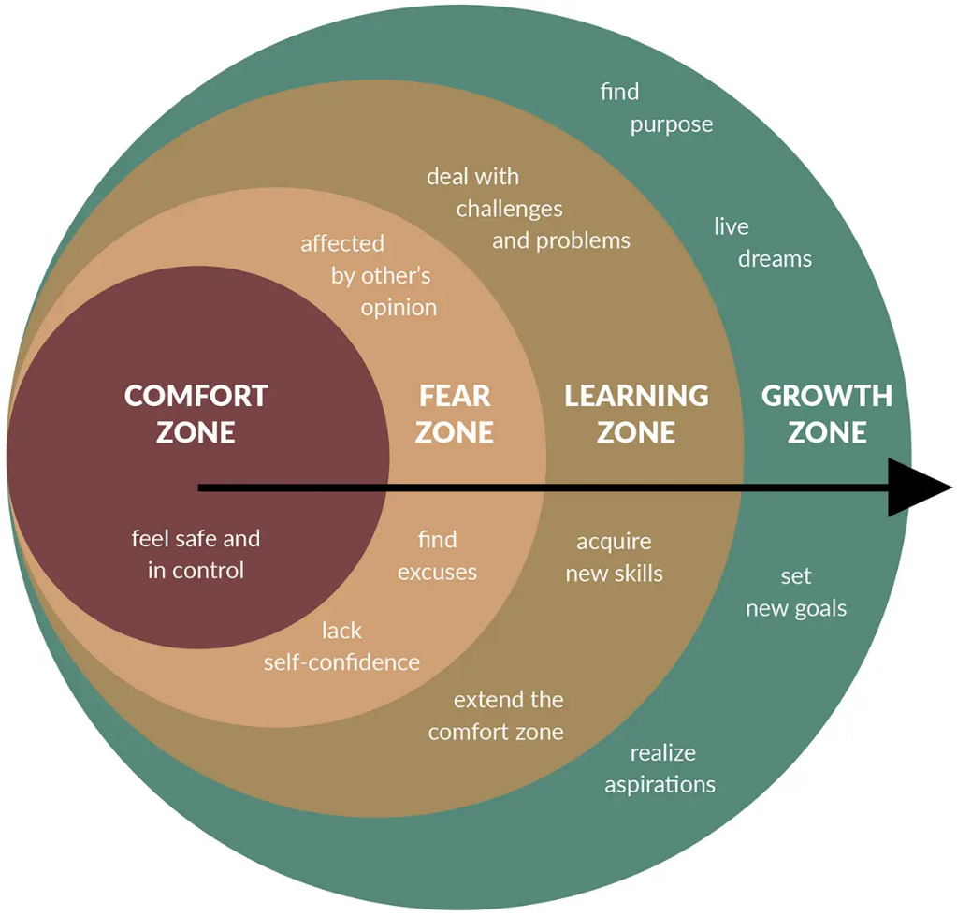
Moving out of your comfort zone…

Slide 50
The four principles of our people strategy

Slide 51
Day Case Endoscopy Patients
OGD-camara inserted into the mouth, down the oesophagus into the stomach
Colonoscopy/Flex-sigmoidoscopy-camara inserted in the rectum along into the bowel
ERCP-Endoscopic retrograde cholangiopancreatography-camara inserted through the mouth, into the oesophagus, the stomach, the duodenum (here they can view the common bile duct and pancreatic duct)

Slide 52
Reasons Patient may need to stay in hospital
OGD-is the most common procedure where patients are required to become inpatient, could be from simple to serious:
They have had sedation, live alone, and need observing overnight.
Active or high risk of bleed-from ulcers, varices-bulging veins in the oesophagus or a tear.
Need further investigations from unexpected findings-biopsies taken.
Need a blood or blood products transfused.

Slide 53
Reasons Patient may need to stay in hospital
Colonoscopy/ Flex sigmoidoscopy- Again, live alone and had sedation and need observing overnight.
Inflammation of the bowel-medications needed/bloods taken/further investigations.
Ulcers in the bowel-medications/bloods/further investigations

Slide 54
Reasons Patient may need to stay in hospital
ERCP-again lives alone, for overnight observations.
Pain-requires pain relief and observing.
Perforation-close observations/Intravenous antibiotics/pain relief/bloods
MRI/CT/USS
Repeat-as unsuccessful

Slide 55
Difficulties experienced when transferring patients
Ward staff having to bleep Dr on-call
Medications not prescribed-whether new or regular
USS/CT/MRI request delays
Patient at times being clerked in late at night
Usually, F1 on call having to clerk in

Slide 56
3 month Data collected
From July to September 2023 there have been 38 patients who were transferred from our endoscopy unit to various other wards across the Trust.
A breakdown of the wards where these patients went

Slide 57
14 wards across the Trust were required for after care
Ward 36 (now ward 33 Gastro) 12
Acute Medical Unit 6
Ward 37/38= 8
Surgical Emergency Unit 2
Medical Short Stay Ward 2
Ward 27 1
Intensive Treatment Unit 1
Ward 33 1 General Medicine
Urgent Medical Acute Care 1
Ward 20/21/24/26= 4

Slide 58
As you can see, that’s approx.
12/13 patients a month
=2-3 patients a week
=approximately an hour a week for the junior Dr to be away from the ward.
I looked at the 12 patients who were transferred to ward 36, out of that 12,:
2 patients had been clerked in before 17.00hrs
10 patients were clerked in by F1 on-call Doctors between 19.00-23.00hrs

Slide 59
My Proposal of Change
All patients who do require to become an inpatient are clerked in by Gastro Drs-whether this be a consultant or a junior Gastro ward Dr
Medications are prescribed and management plan put into place
Endoscopy, not to discharge the patient from their unit, but to leave on Capman and ward they are transferring to will complete the transfer as we do if arrived through A&E

Slide 60
For the Patient this will improve
Communication, by being updated and informed information
Medications are prescribed and given when required in a timely manner
Receiving ward have a clear plan for the next 24hrs
Patient overall experience improved

Slide 61
How this will be achieved, work done so far and next steps
Discussed with consultant-who listened and supported me having me direction on who to speak, and who can help achieve my vision.
Communication between Myself, Consultant and IT-Teams meeting with Consultant and IT-discussion-day case to inpatient without a new episode occurring.
3-month Data collected, and 12 patients looked at regarding Clerking in and timings.
Discussion with bed management regarding the transferring of patients to other wards.
Standards Operating Form-in process of being completed and sent to consultant overlooking Endoscopy Unit- the to be discussed with Endoscopy Team-if agrees, form will be signed off.
Plan to begin new process soon

Slide 62
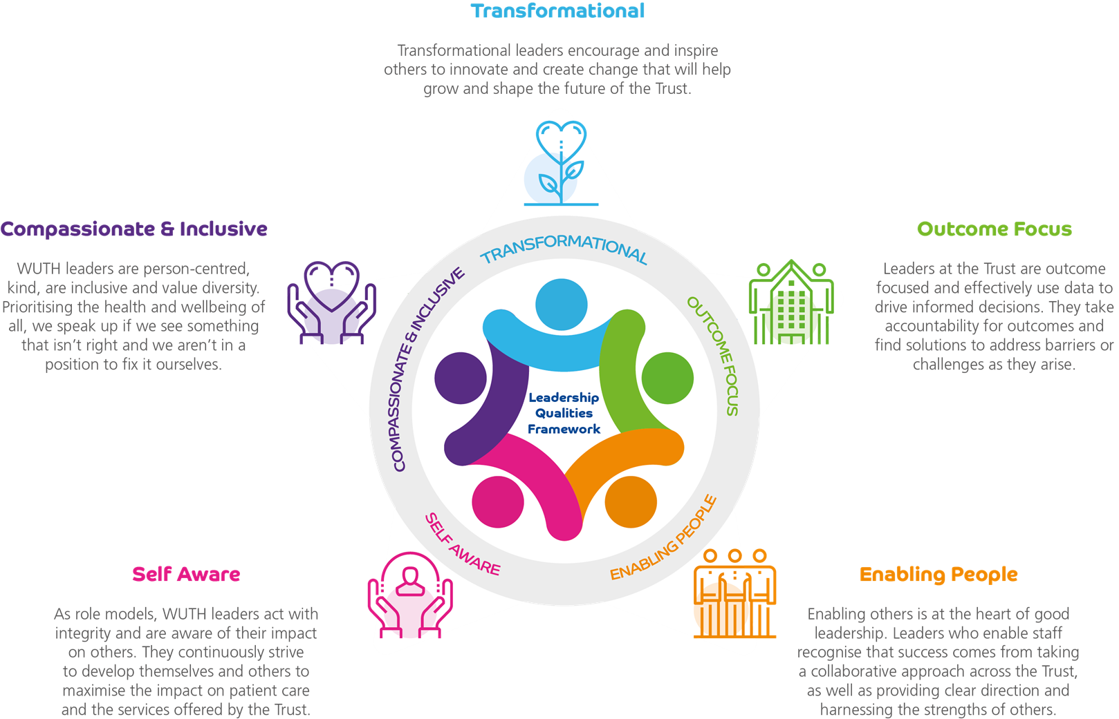
How does it fit with the LQF?
Outcome focused – looking at data and making changes
Compassionate & inclusive – putting patients first
Transformational – improving services, can be small things as well as big.
Self Aware - confidence has improved
Enabling people - other departments have come together to support this project

Slide 63
What am I Proud of? What would I do Differently?
I'm proud of the communication between the different departments and their support and help they’ve given me
I would have persuaded others to try this a long time ago

Slide 64
Implementing a Physiotherapy Skills Passport
Presented by
Lucy Mahon

Slide 65
Introduction
Physiotherapy Skills Passport is an initiative developed by the Cheshire and Merseyside Allied Health Professions Faculty.
The passport is a competency pack that breaks down all skills across different areas of physiotherapy practice.
At WUTH, embedding this passport for our physiotherapy staff would allow for more standardised competencies to work towards and progress within throughout their rotational and static positions.

Slide 66
Aims of the project
To formulate a working group to support with the implementation of the physiotherapy skills passport at WUTH.
To embed the skills passport for physiotherapy rotational staff to utilise for their development.
To feedback good practice and challenges with implementation to other NHS organisations who are implementing the passport and the Allied Health Professions faculty.

Slide 67
Reflections from the start
Leadership Qualities Framework
Compassionate and Inclusive
Self Aware
Enabling People
Outcome Focus
Transformational

Slide 68
During the project
Working group was established.
Aimed for representation from each setting and across the bandings.
Passport was reviewed and amended.
Electronic system was identified for use of the passport.
Launched within 2 teams.
Next steps to evaluate and review usage ready to launch more widely.

Slide 69
What went well?
The working group was well attended, and people were on board with the project.
There were teams who volunteered to implement first and be the pilot.
Some of the band 5 colleagues were able to use this opportunity as a talking point in interviews for more senor roles and be successful.
The work that was done in the project was able to be fed back to the faculty who created along with other organisations.

Slide 70
What was challenging
Not all areas were represented in the group which meant we had to move forward without them.
There were some challenges with the passport itself and ensuring it was user friendly.
People being able to prioritise actions was sometimes a challenge.
Ensuring my own credibility to implement something for another profession.

Slide 71
Conclusions and Next Steps
The project allowed me to develop my own leadership skills in being a chair and implementation lead for this project.
We need to evaluate and try and roll out more widely.
It has opened an opportunity to work with the faculty on the Occupational Therapy Skills Passport.

Slide 72
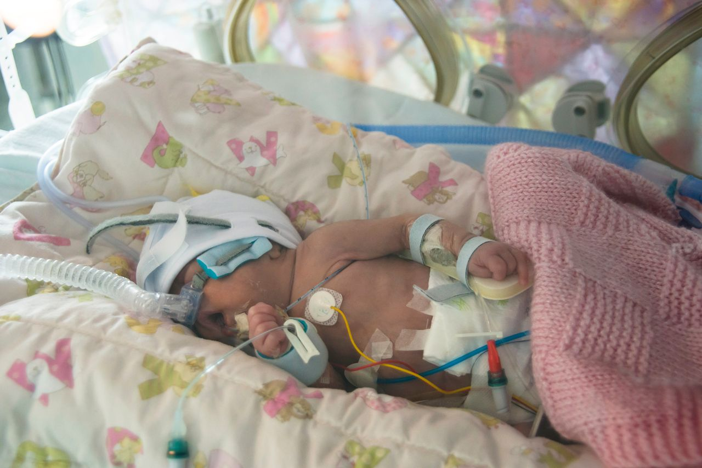
Safe staffing levels on NNU
By Hannah Harper and Lynsey Wileman

Slide 73
The problem
Unsafe staffing levels due to problems during summer holidays and Christmas period.

Slide 74
Patient experience strategy

Slide 75
Patient experience strategy

Slide 76
Process
Survey monkey
Request sheet
Fairness
Skill mix
Balanced staffing numbers
Policy reference 139
Disclaimer
Roster approval
Staff feedback froms

Slide 77
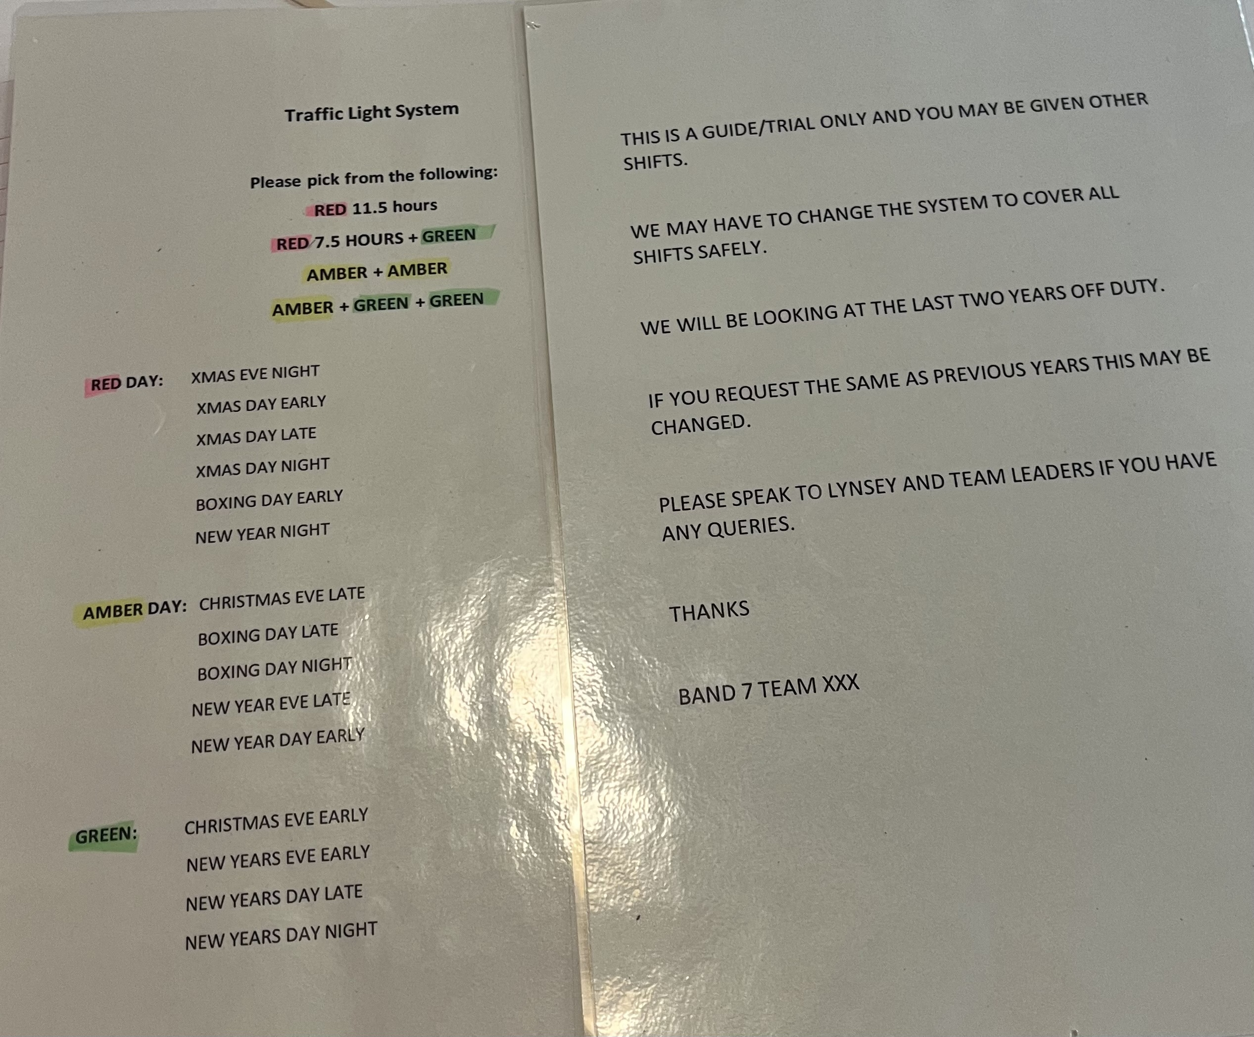
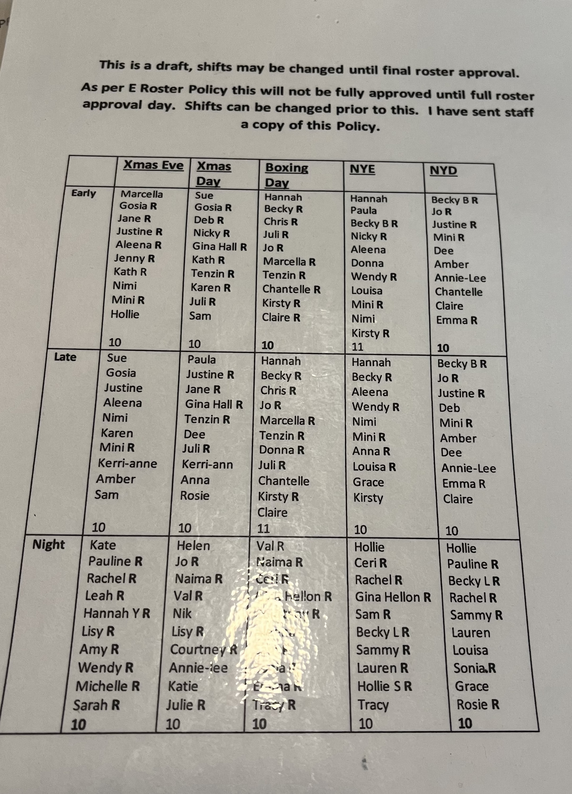
Christmas off duty

Slide 78
Annual leave
The problem:
Change in management
Percentages
Unfamiliar with policy

Slide 79
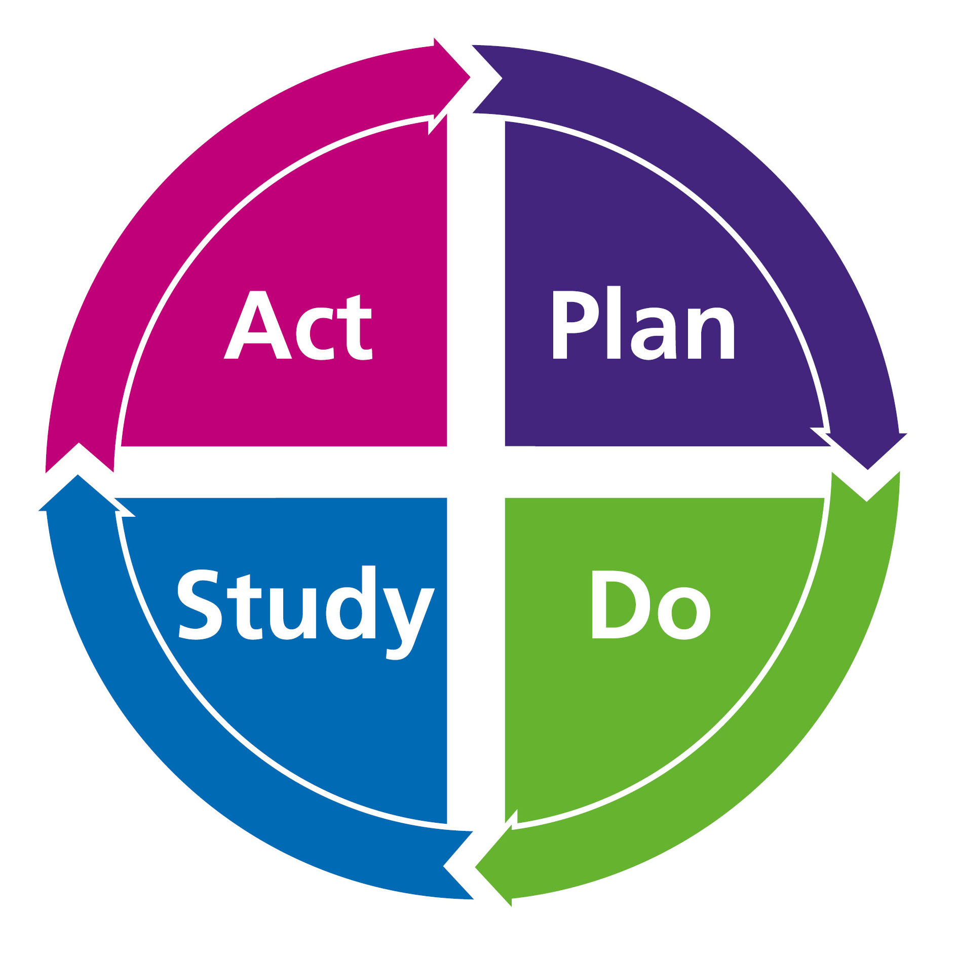
Process
Policy
Survey monkey
Request period
Evaluation
Alternatives
Agreed leave
Policy reminder

Slide 80
Conclusion
Patient safety
Be a great place to work
Inclusion

Slide 81
“Only by making Our People Promise a reality will the NHS become the best place to work for all – where we are part of one team that brings out the very best in each other.”

Slide 82
Kiddies Corner in Phlebotomy
LEADING TEAMS PRESENTED BY
SONIA GRIFFITHS & DEBBIE DOLAN
11TH DECEMBER 2023

Slide 83
NERVOUS?
Some people are nervous coming in for a blood test. It can cause a lot of anxiety for adults and especially children.

Slide 84
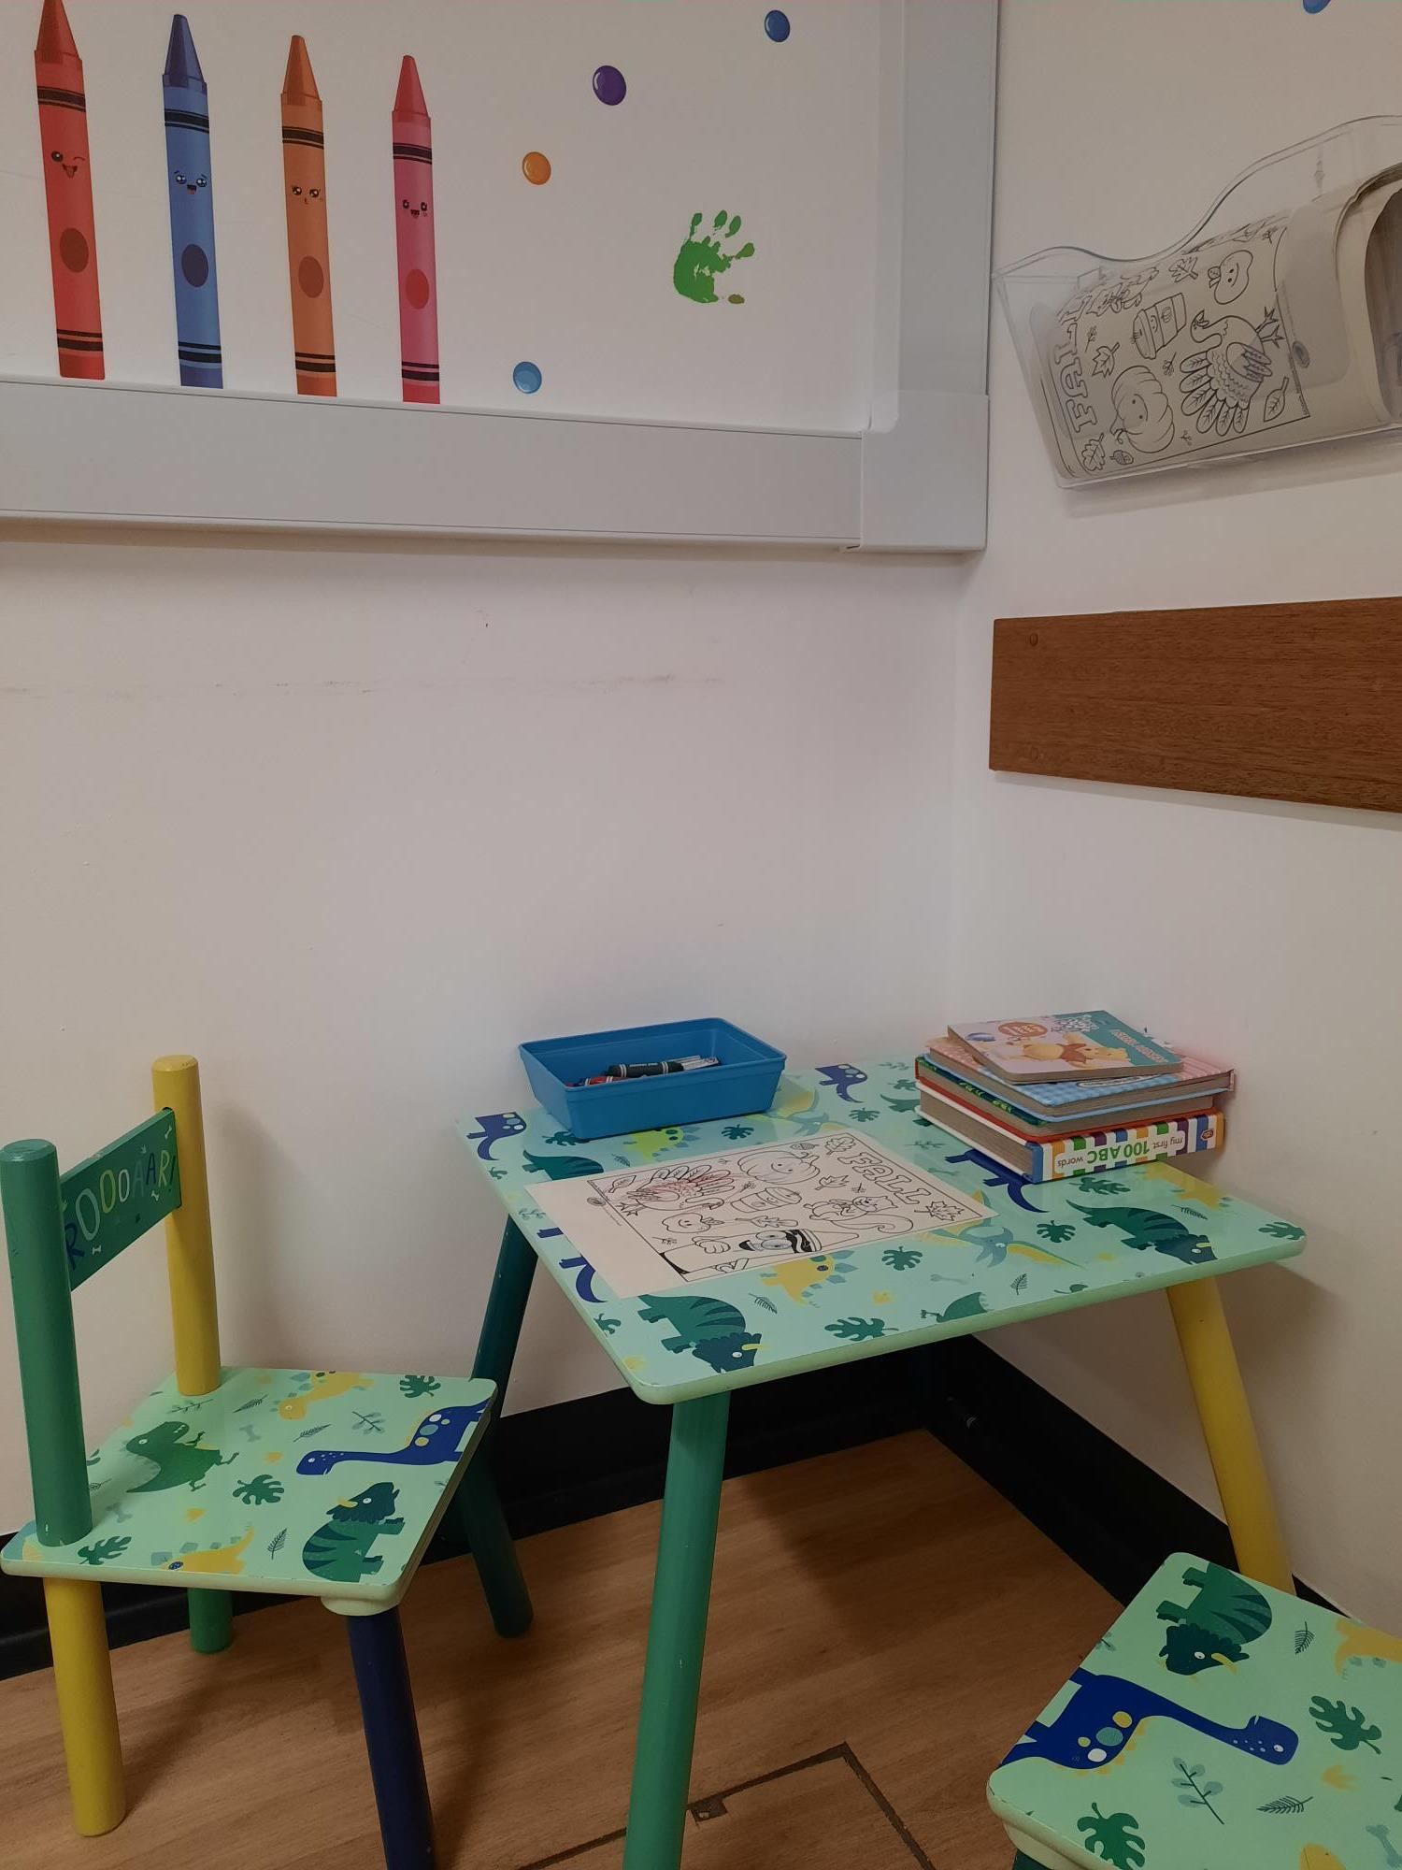
We were donated a small children’s table and chairs by another parent.
We located some books, printed some colouring pages and then added non toxic crayons.

Slide 85
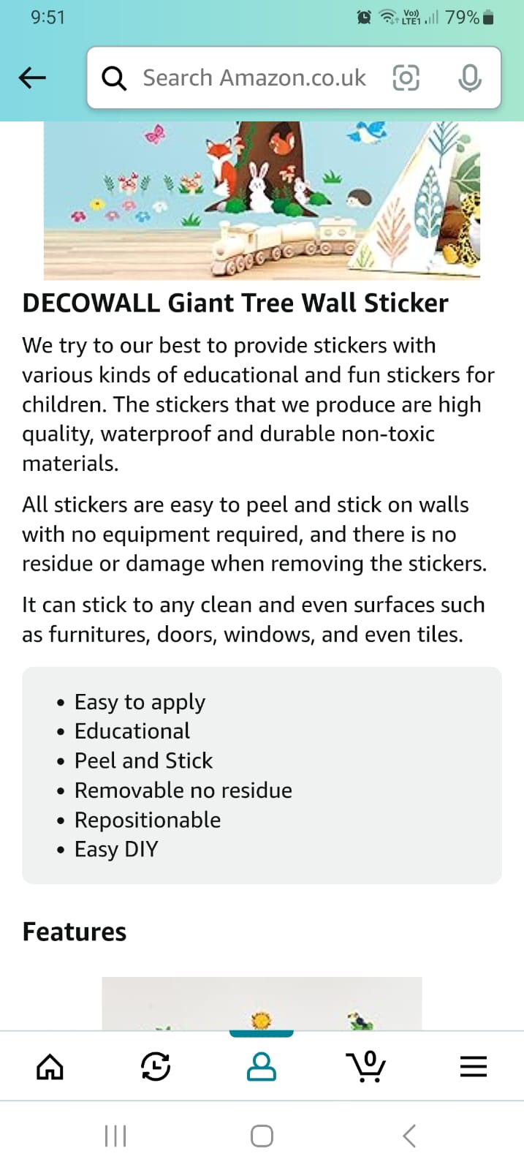
WALL STICKERS
FUN
COLOURFUL
INTERACTIVE
NON TOXIC
WIPEABLE

Slide 86
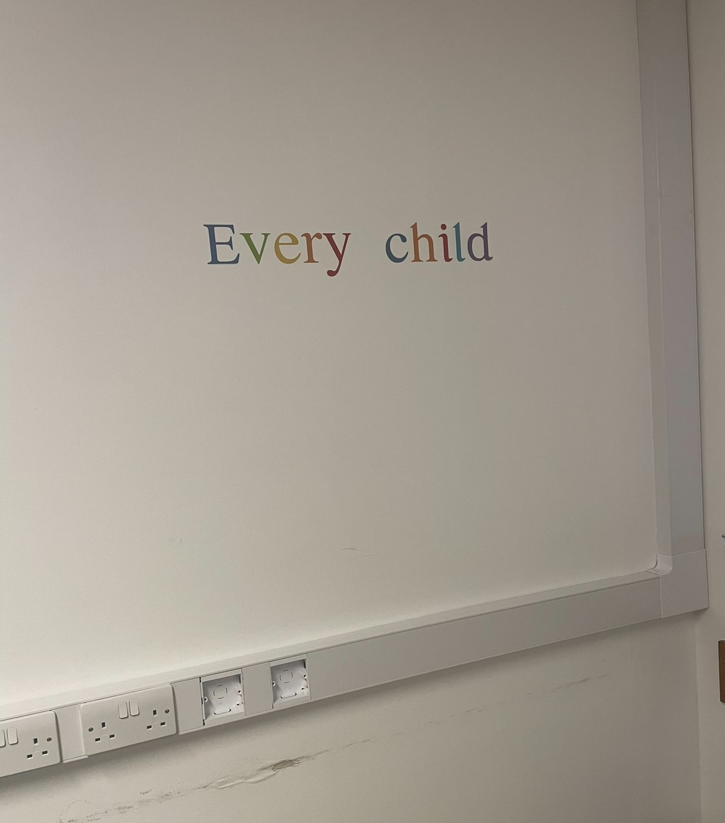
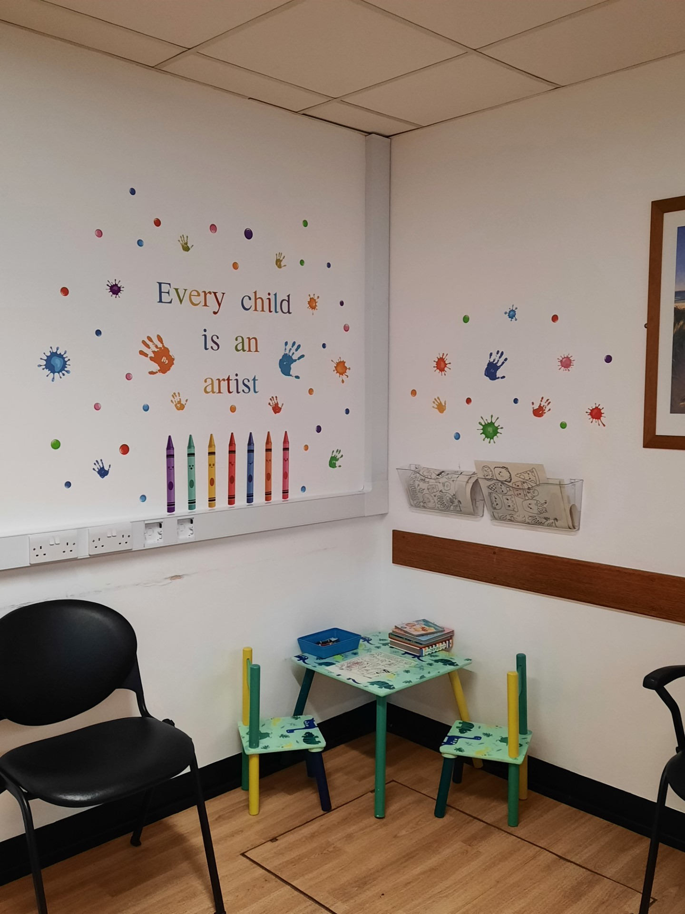
WAITING ROOM
BEFORE
AFTER

Slide 87
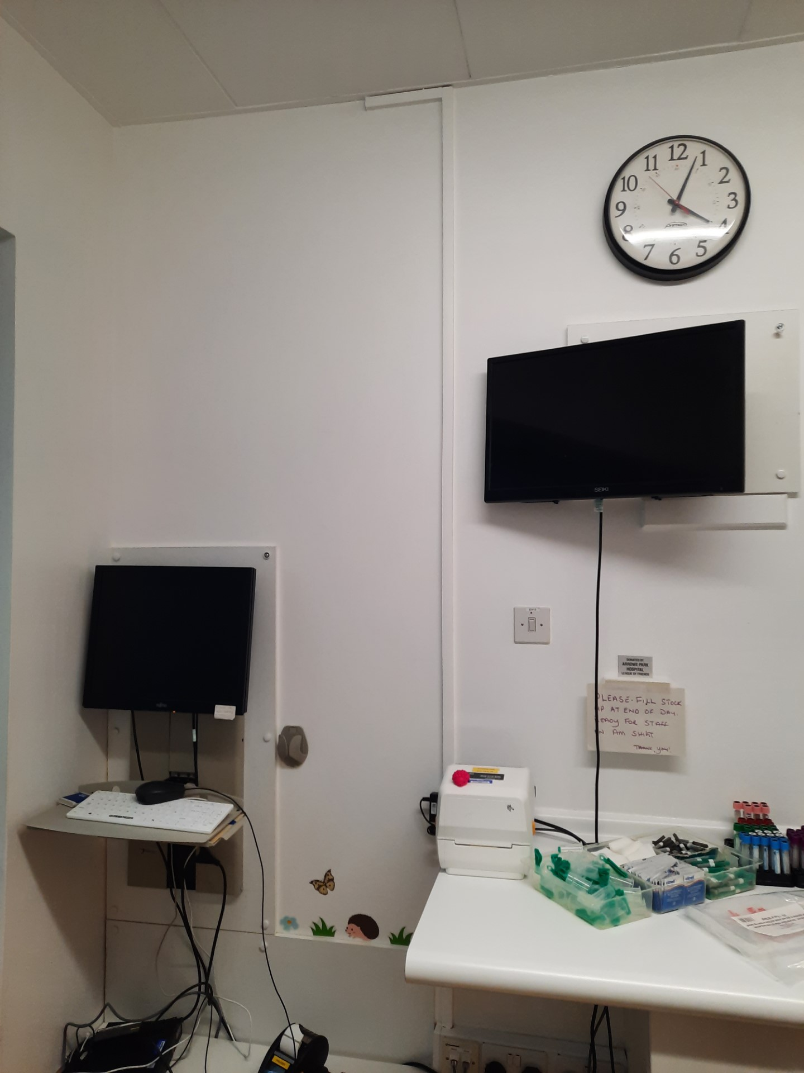
CLINIC ROOM BEFORE

Slide 88
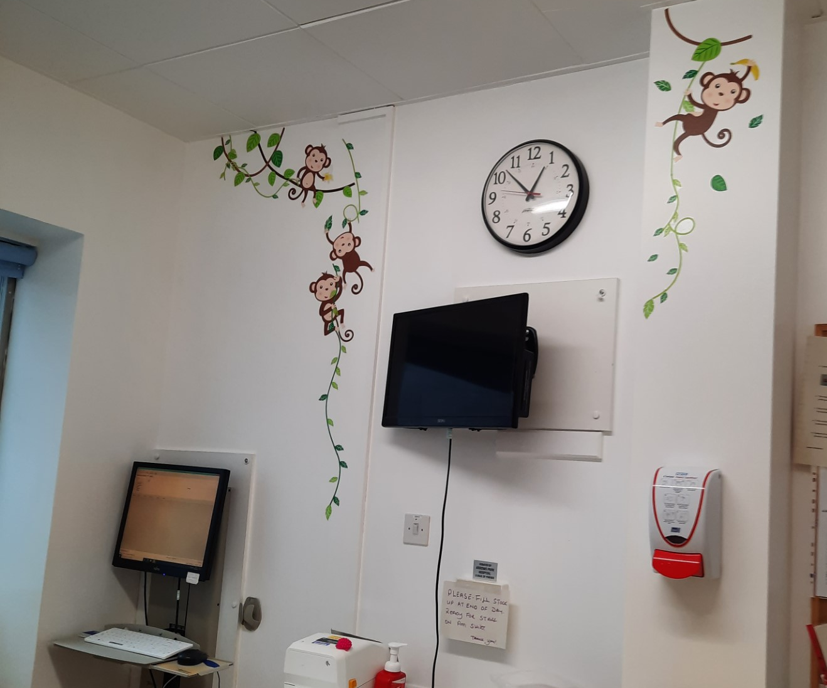
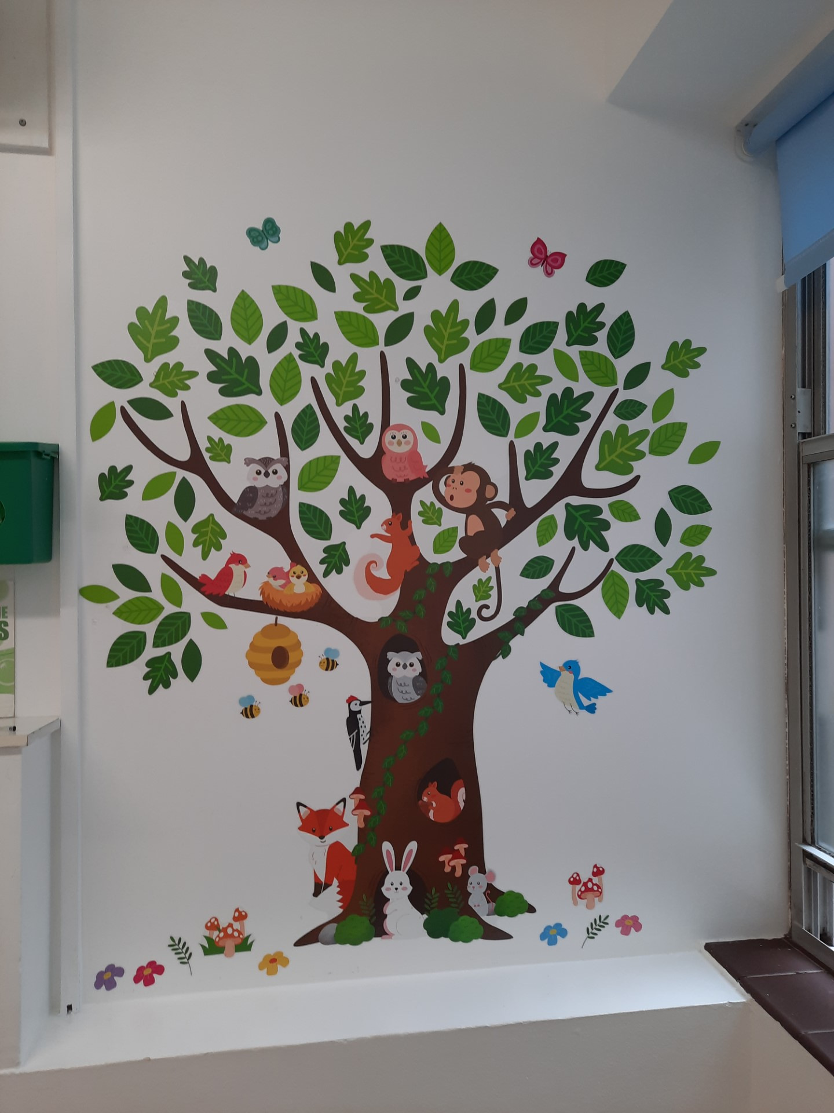
CLINIC ROOM AFTER

Slide 89
DISTRACTIONS

Slide 90
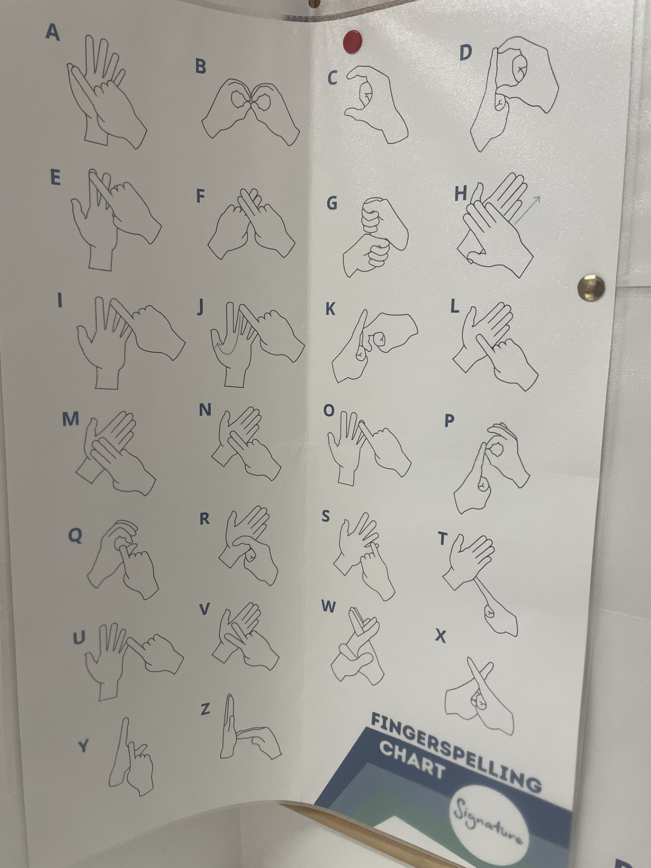
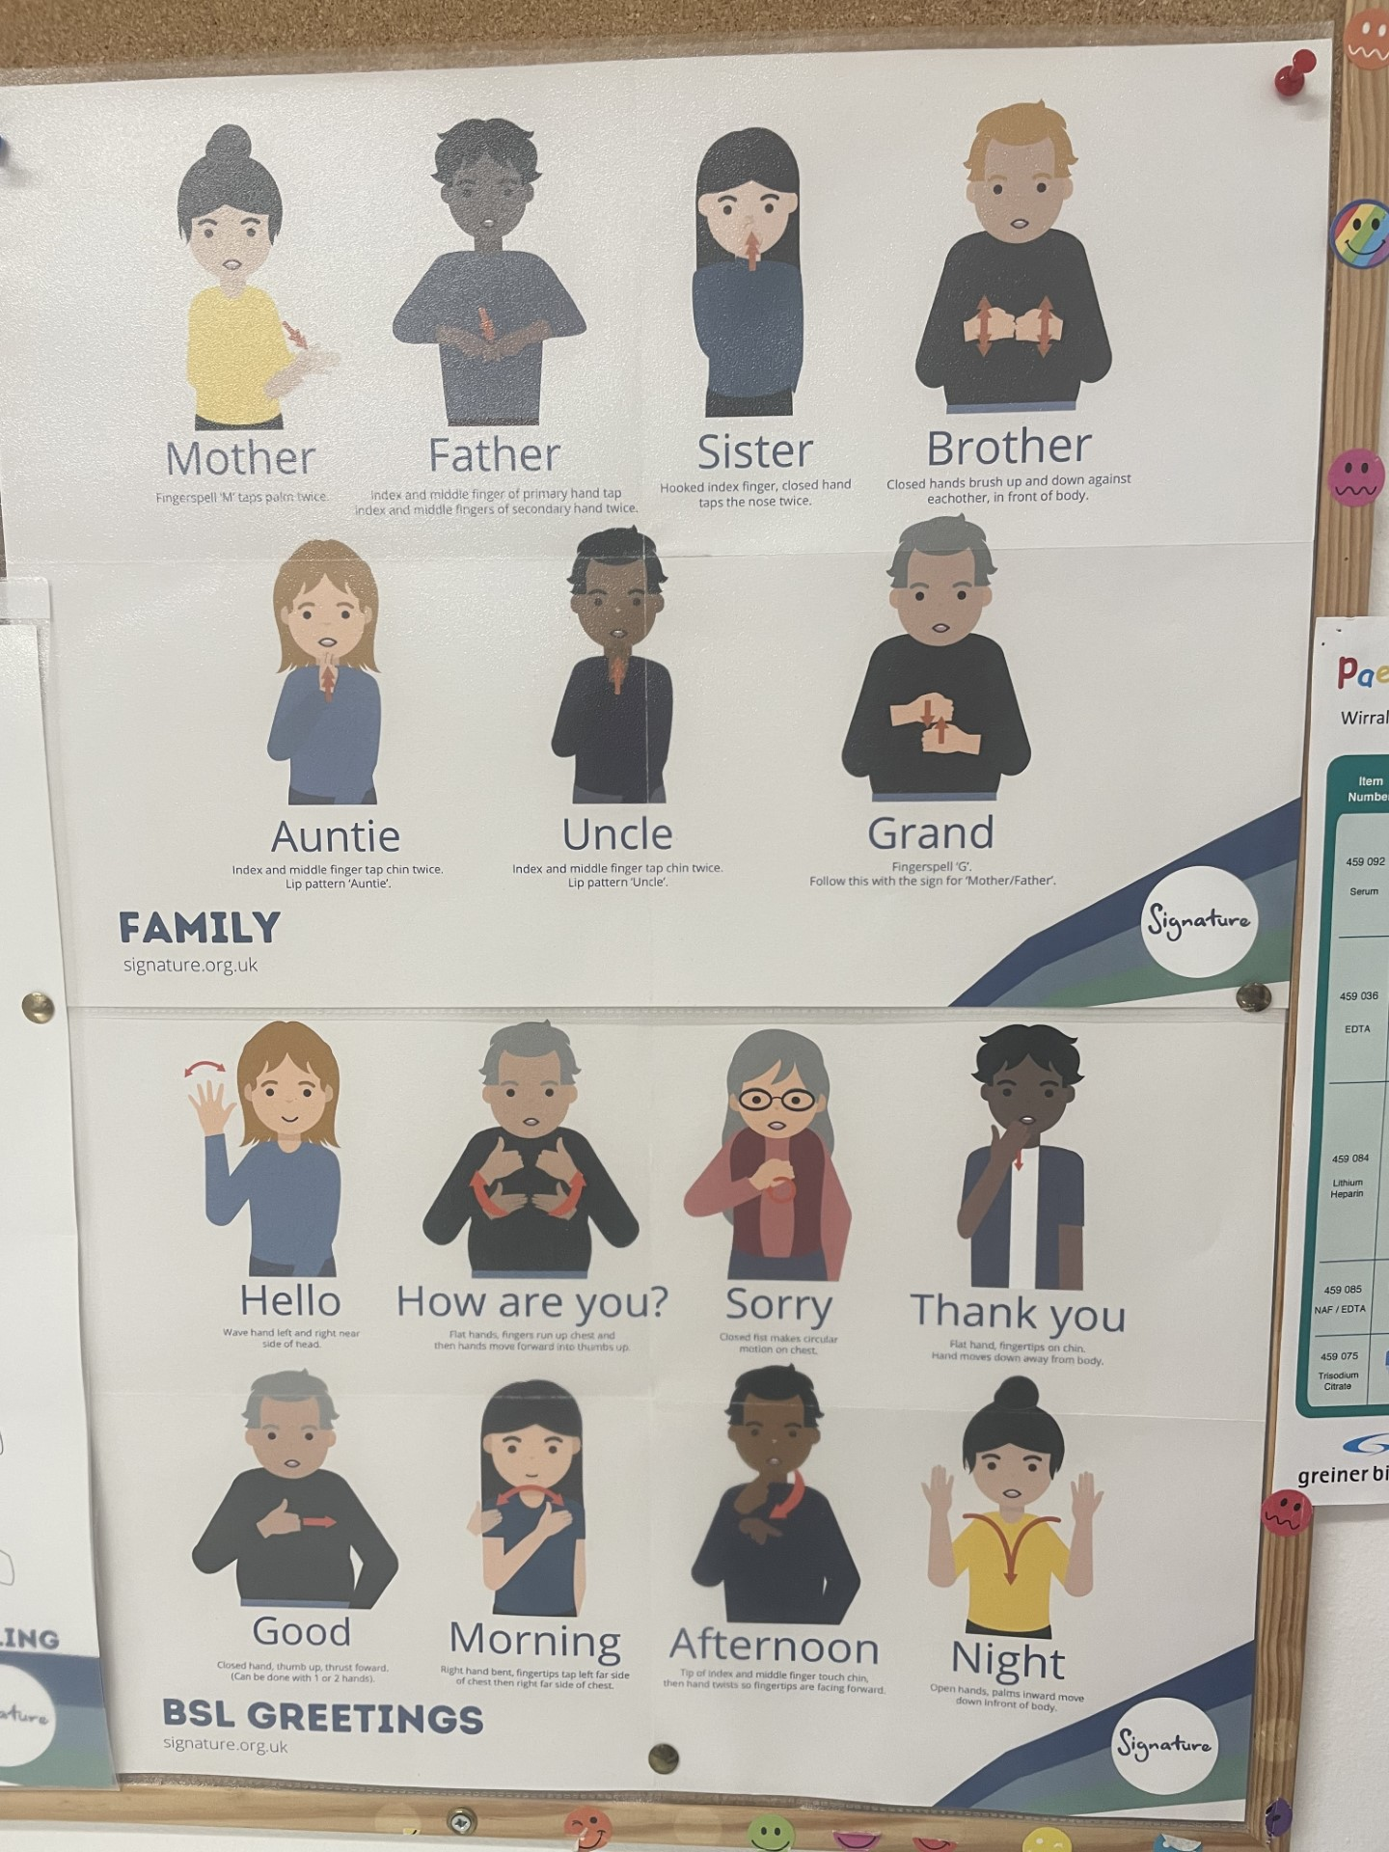
DEAF AWARENESS

Slide 91
STILL TO DO …..
MEET OUR TEAM
TODAY YOUR PHLEBOTOMIST IS….
WHAT TO EXPECT AT YOUR APPOINTMENT
DO YOU WANT TO BECOME A PHLEBOTOMIST?

Slide 92
WHAT HAVE WE LEARNT?
WHAT WILL WE TAKE WITH US?
WOULD WE RECOMMEND THE COURSE ?

Slide 93
NHS LEADING TEAMS QUALITY AND SERVICE IMPROVEMENT PROJECT
HOW CAN WE IMPROVE PATIENT SAFETY IN RELATION TO FALLS IDENTIFICATION IN THE EMERGENCY DEPARTMENT?

Slide 94
ABOUT ME
GRAEME SAULT
WORKED FOR WUTH FOR 21 YEARS
QUALIFIED NURSE FOR 16 YEARS
WORKED IN ED FOR 10 YEARS
SENIOR CHARGE NURSE/SHIFT LEADER FOR 4 YEARS
ATTENDED THE COURSE TO HELP MYSELF DEVELOP AS A LEADER
DECIDED TO FOCUS ON FALLS AFTER WISE ACCREDITATION RESULTS SHOWED THAT WE WERE NOT TAKING ENOUGH ACTION TO MITIGATE THE RISK OF FALLS IN THE DEPARTMENT

Slide 95
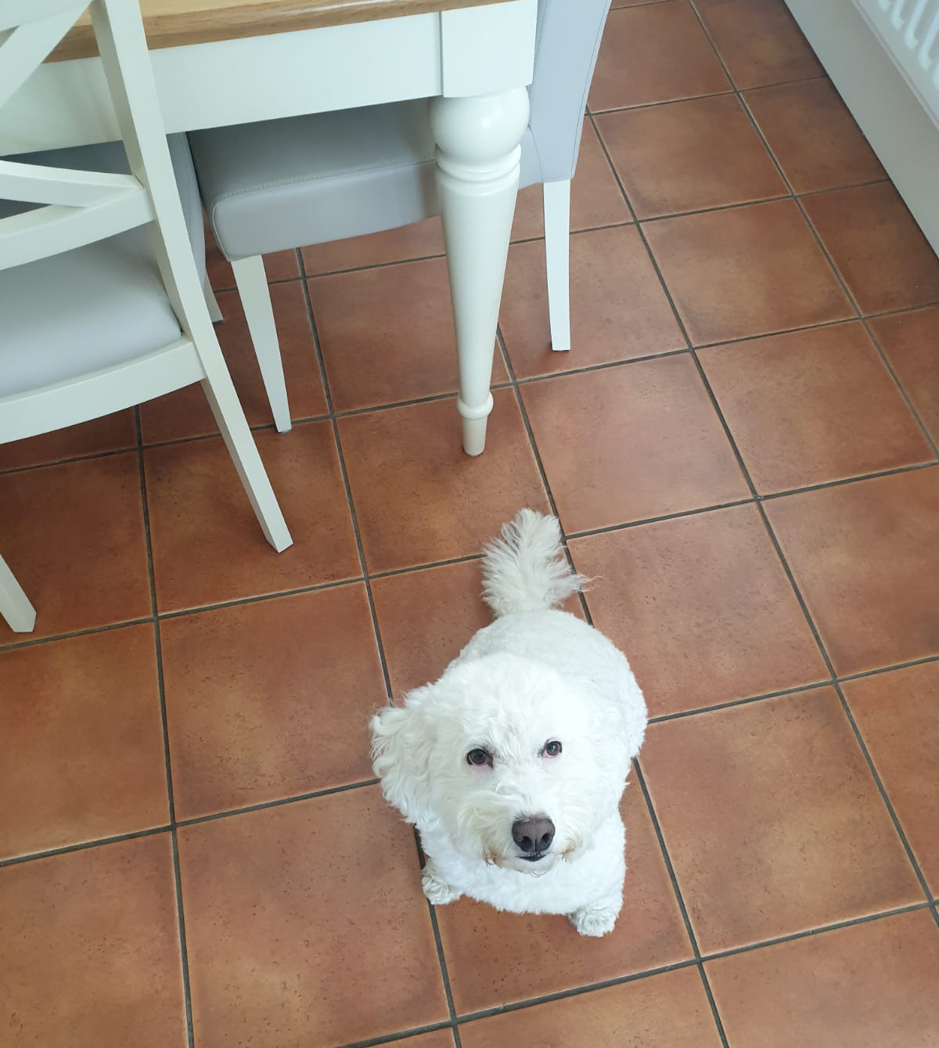
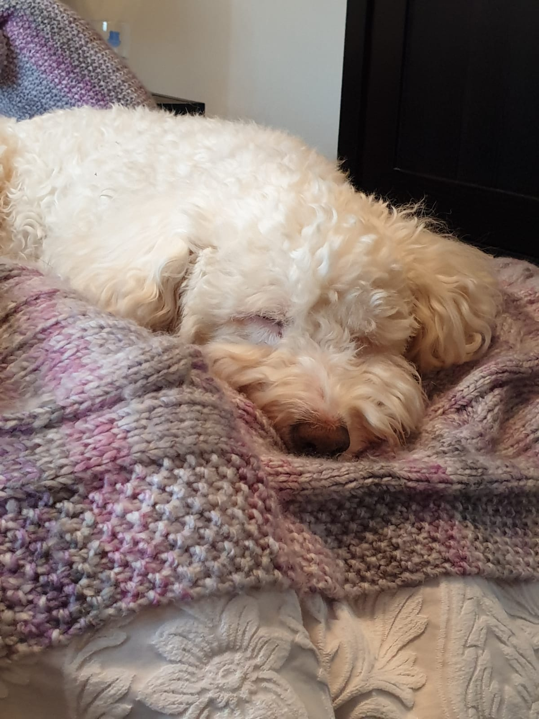
TESS THE COCKERPOO

Slide 96
WISE ACCREDITATION - WHAT IS WISE?
WISE (WIRRAL, INDIVIDUAL, SAFE CARE, EVERY TIME) IS AN AUDIT TOOL DEVELOPED BY WUTH AS A WAY OF MONITORING AND ASSESSING CLINCIAL AREAS COMPLIANCE IN REALTION TO SPECIFIC KEY AREAS. IT IS BASED ON A MODEL USED IN OTHER HOSPITALS BUT ENCOMPASSES ADDITIONAL ELEMENTS TO ENSURE LOCAL POLICIES ARE ACCURATELY REFERENCED.
THERE ARE 15 DIFFERENT ELEMENTS TO THE ED WISE AUDIT WHICH INCLUDES: PRESSURE ULCER CARE, SAFEGUARDING, IPC, MEDICATIONS MANAGEMENT, CORRIDOR CARE AND FALLS.
ACCORDING TO THE SCORING MATRIX - LEVEL 1 = RED, LEVEL 2 = AMBER AND LEVEL 3 = GREEN.

Slide 97
IDENTIFYING THE PROBLEM - WISE ACCREDITATION SCORE JUNE 2023
WHY HAD ED SCORED 56.2 % IN RELATION TO FALLS?
WITH REGARDS TO FALLS IN ED, IF A FALLS ASSESSMENT IS NOT COMPLETED WITHIN 4 HOURS THIS WOULD BE CLASSED AS A FAIL.
BED RAIL ASSESSMENTS TO BE COMPLETED ON ADMISSION
APPROPRIATE ACTION TAKEN IF A PATIENT DEEMED TO BE A FALLS RISK.

Slide 98
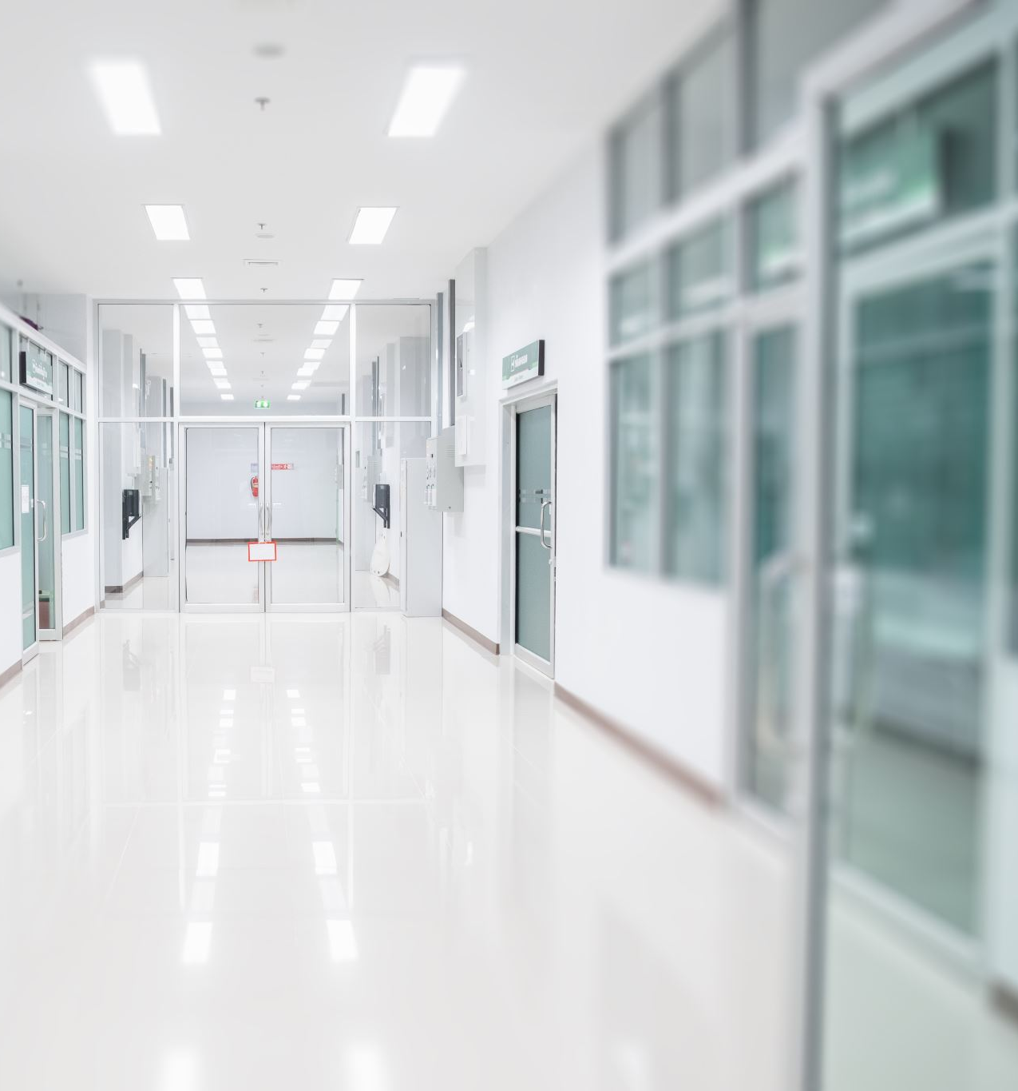
BARRIERS TO FALLS SAFETY IN ED
HIGH VOLUME OF PATIENTS
CORRIDOR CARE
WAITING ROOM PATIENTS
STAFFING – OFTEN RELY ON WARD/AGENCY NURSES TO SUPPORT
LOTS OF NEWLY RECRUITED NURSES IN THE DEPARTMENT WHO STILL NEED SUPPORT/EDUCATION
LONG LENGHTHS OF STAY IN THE DEPARTMENT
COMPLEX PATIENTS WITH COMPLEX NEEDS
PRIORITY OF CARE

Slide 99
FIRST STEPS
I MET WITH THE SISTERS AND MATRONS OF WARDS WHO HAD SCORED GREEN
I MET WITH THE FALLS LEAD FOR THE TRUST
I MET WITH THE ED MATRONS AND ASKED FOR INFORMATION AROUND FALLS TO BE PUT INTO THE DAILY STAFF SAFETY HUDDLES
I EMAILED ALL MEMBERS OF STAFF NOTIFYING THEM THAT I WOULD BE WORKING ON AN IMPROVEMENT PROJECT AROUND FALLS ASKING FOR AS MUCH FEEDBACK/INVOLVEMENT AS POSSIBLE
I SPENT TIME ON THE FLOOR, TALKING TO STAFF ABOUT ANY ISSUES THAT THEY HAD WITH FALLS AND IF THEY HAD ANY IDEAS ABOUT WHAT COULD BE DONE TO IMPROVE PATIENT SAFETY
I CREATED A FALLS PREVENTION POSTER
I MET WITH MY ADN TO ORDER THE APPROPRIATE EQUIPMENT
I HAD REGULAR COACHING SESSIONS TO FEEDBACK MY IDEAS AND TO HELP ME THINK OF ALTERNATIVES

Slide 100
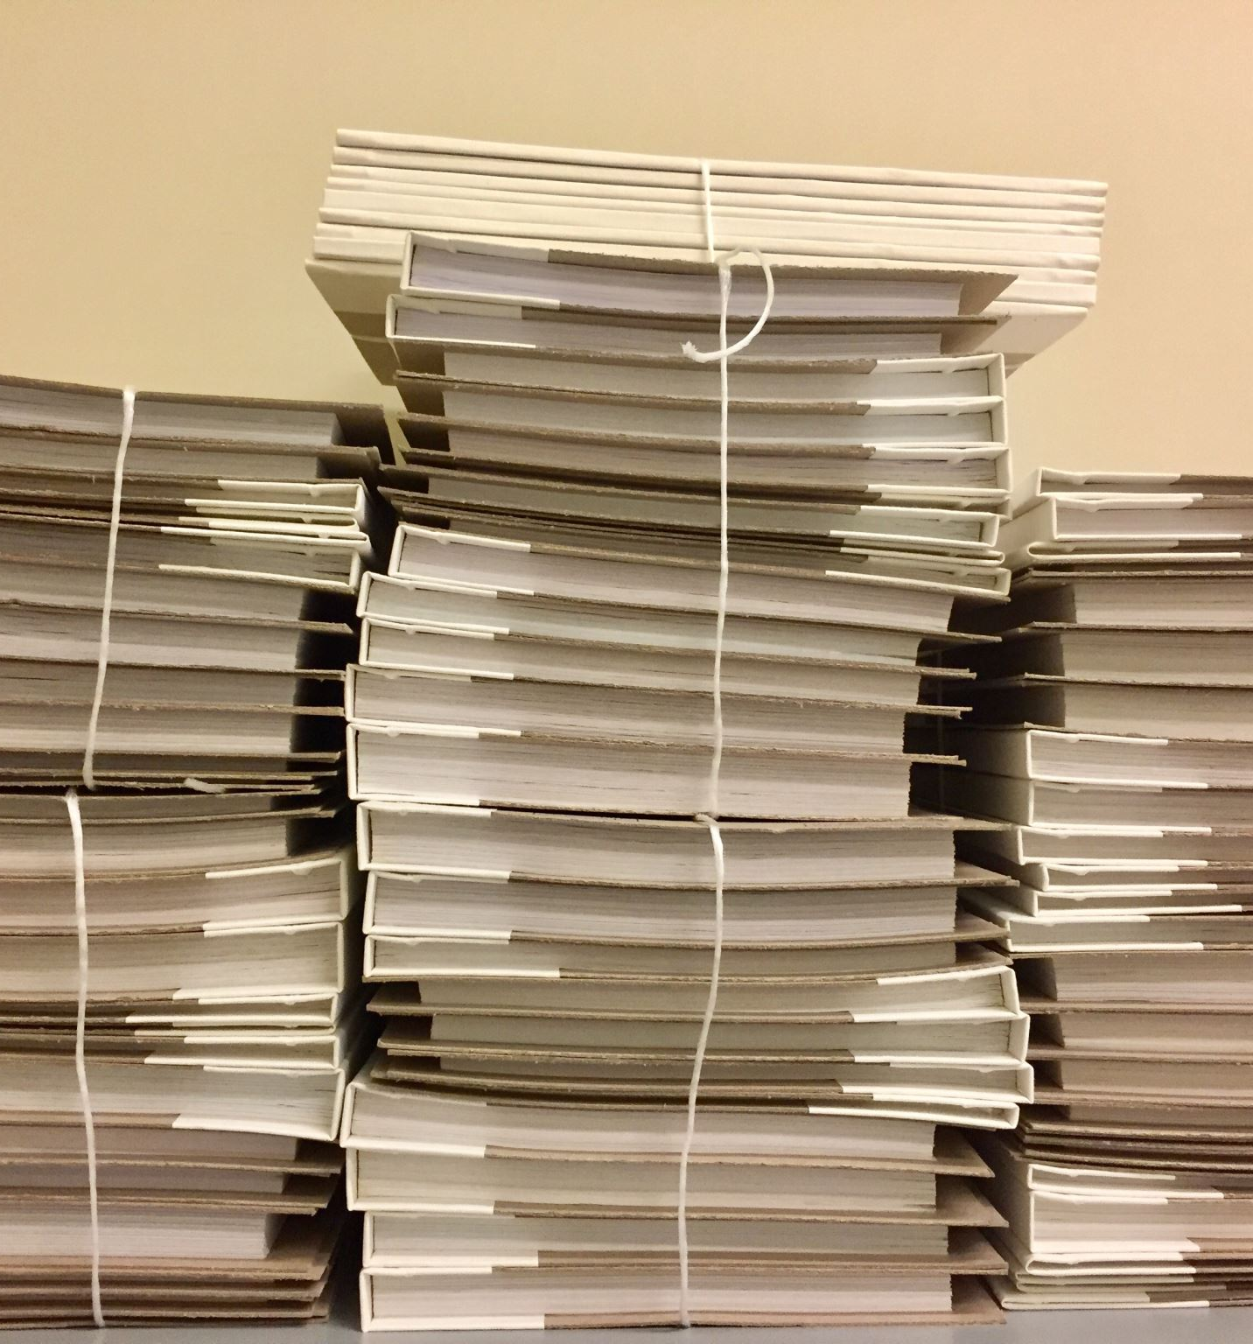
PROBLEMS FACED
DELAY IN RAMBLEGUARD FALLS MATS BEING DELIVERED.
I WANTED TO IMPLEMENT A STANDARDIZED APPROACH TO FALLS SAFETY THAT WAS EASY FOR STAFF TO FOLLOW. THE WARDS USE A DOLS SYSTEM WHICH BY LAW IS NOT PERMITTED IN ED ALONG WITH OTHER SECTIONS OF THE MENTAL HEALTH ACT.
I EXPLORED THE OPTION OF BAY TAGGING WITH MY MANAGERS, IT WAS DECIDED THAT THIS WOULD NOT BE POSSIBLE IN AN ED ENVIRONMENT.
ED PRESSURES WORSENED AS WE ENTER OUR BUSIEST PERIOD

Slide 101
IMPLEMENTING THE CHANGE
ARRIVAL OF THE RAMBLEGUARD FALLS MATS
ASKED THE ED MATRONS TO RELAY THE INFORMATION TO STAFF IN OUR DAILY SAFETY HUDDLE
SPENT TIME ON THE FLOOR, WITH STAFF EDUCATING THEM ON HOW TO USE THE MATS AND THE IMPORTANCE OF EARLY FALLS RISK RECOGNITION.

Slide 102
RESULTS
WISE ACCREDITATION SCORE HAS IMPROVED FROM RED TO AMBER! (HURRAY!)
STILL AWAITING FORMAL DATA TO BE SENT THROUGH WITH AN ACTION PLAN

Slide 103
NEXT STEPS…..
LOOK AT THE DATA AND USE AUDIT TO ANALYSE THE NUMBER OF FALLS SINCE THE INTRODUCTION OF THE MATS
FINE TUNE THE PROCESS AND SEE WHAT FURTHER IMPROVMEENT COULD BE MADE IN ORDER TO KEEP OUR PATIENTS SAFE.
DAILY ED HARMS AUDITS AND QUARTLY REVIEWS
CONTINUE WITH WISE ACCREDITATION REVIEW
CONTINUE TO WORK WITH THE STAFF AND TEACH THEM TO BE PROACTIVE AND NOT REACTIVE.

Slide 104
WHAT I’VE LEARNED AS A LEADER
FIRST BECAME INTERESTED IN LEADERSHIP AS A TOPIC DURING MY POST GRAD STUDIES BUT REALSIED THAT I HAD PROBABLY BEEN INTERESTED IN LEADERSHIP FOR MUCH LONGER THAN THIS
NO ONE SIZE FITS ALL APPROACH
LEARN FROM WATCHING THOSE AROUND ME AND THEN DEVELOPING MY OWN STYLE
ATTENDED MULTIPLE LEADERSHIP MASTERCLASSES THAT WUTH HAVE PROVIDED
POST PANDEMIC, THIS HAS BEEN THE RIGHT TIME FOR ME TO COMMIT TO FURTHERING MY LEARNING
ENJOYED THAT THE COURSE PUSHED ME OUT OF MY COMFORT ZONE
360 FEEDBACK LET ME KNOW THAT I’M ON THE RIGHT TRACK
HAVING A PROJECT TO WORK ON HELPED TO PUT ANY THEORY LEARNED INTO PRACTICE
THE COURSE HAS GIVEN ME FURTEHR INSIGHT INTO MYSELF AND THOSE AROUND ME IN LEADERSHIP POSITIONS
I HAVE APPLIED FOR A PROFESSIONAL NURSE ADVOCATE COURSE NEXT YEAR TO CONTINUE MY LEARNING

Slide 105
Thank You!

Slide 106
IMPROVING THE DELIVERY OF CARE FOR PATIENTS WITH MENTAL HEALTH ISSUES
MATRON HALE

Slide 107
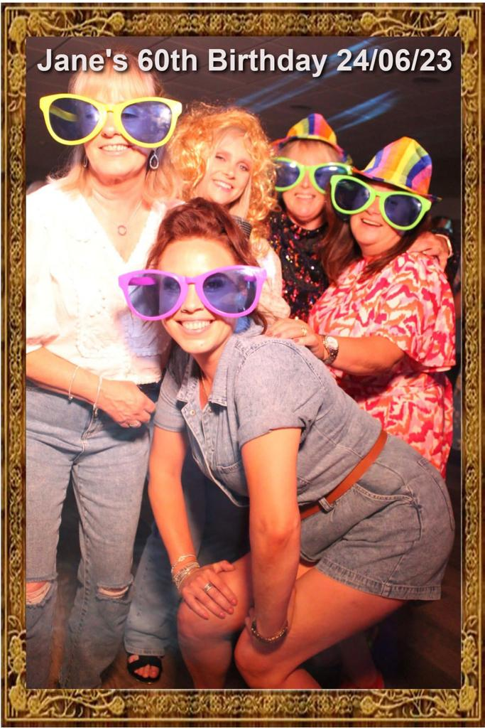
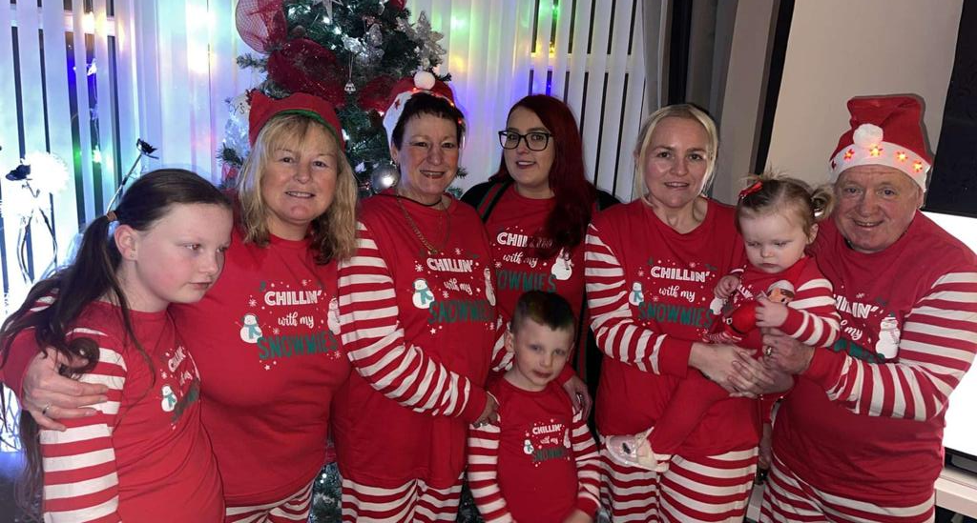
My family, my world

Slide 108
Team Members (Enabling People)
Matron Hale
CN Kinner
SR Nicholls
CSW Edmunds

Slide 109
Reason for choosing this as my project:
Currently the process for Mental Health Patients is.....
Care Quality Commissions, they have highlighted issues with the Mental Health Unit stating that they do not comply with the Psychiatric Liaison accreditation network.
1 in 4 people experience Mental Health (MHFA, 2020)
Mental Health cost 34.9 Billion a year (MHFA, 2020), there was 602,000 cases of work-related stress report in the UK from 2018/2019, (MHFA, 2020).
792 Million people are affected by Mental Health issues worldwide, (MHFA, 2020).
This is also in line with the compassionate and inclusive element of the framework – everyone should have person centred care.

Slide 110
What are we hoping to achieve
Assure our ED Nurses are competent and confident when dealing with patients with Mental Health.
Expanding our knowledge and understanding Mental Health.
Ongoing training, Educating staff, improve Facilities in our Mental Health Rooms.
Better outcomes for our Patients.
Appropriate Environment for our patients
Reduced length of stay
Ongoing support for our staff (health and being)

Slide 111
What has already been implemented..
Checklists for section 136 patients
Better relationship with Mental Health Nurses/EDT/Police/Safeguarding
Flow charts for patients
Information file for staff – retain/progression

Slide 112
Conclusion
I believe that the actions that we have put in place so far will help improve the service for our patients with Mental Health ,ensuring that they receive a high level of care and that all their needs are met .
Educating the staff and giving them the relevant support can help reduce staff anxiety and stress at work.
Working closer with professionals to get patients the right support in the community to prevent ED admissions.

