Slide 1




People Strategy
2022 - 2026

Slide 2

Foreword
I am so pleased to welcome you to our People Strategy, one of seven enabling strategies that underpins the overall Trust Strategy. This is an ambitious and exciting strategy that sets out a four-year vision of how we will support our people (our staff members, temporary workers, volunteers and students) to be the best they can be and to provide the best possible care to our patients and communities.
Over the past two years, all of our people have worked incredibly hard to support the delivery of care to our patients during the COVID-19 pandemic. We know how challenging that has been and that is why every element of this strategy is focused on providing the best experience and support for our people, both now and for the future.
Ensuring that everyone’s voice is represented is a key component of this strategy. It has been developed by talking to our people about what is important to them. I would like to thank everyone who has contributed to the development of this document.
As we move forward with the delivery of the strategy over the next four years, we will continue to talk with and listen to our people about how we best achieve our aims. We will also work hard to ensure that each element is delivered in line with our Trust values of Respect, Teamwork, Improvement and Caring, and that inclusion and wellbeing are at the heart of everything we do.
I am looking forward to working with you all to deliver this exciting and dynamic People Strategy.
Deborah Smith
Chief People Officer

Slide 3
Contents
Contents | Page | Contents | Page
Introduction | 4 | Belonging at WUTH | 16
Background | 5 | Transforming Ways of Working | 17
Our 2021-2026 Objectives and Priorities | 6 | Shaping Our Future | 18
Strategic Framework | 7 | Next Steps | 19
Developing our People Strategy | 8 | Appendices | 20
Our People Journey | 9 | Glossary of Terms | 21
Engagement with Our People | 10 | Key Actions: Looking After Ourselves and Each Other | 22
The Four Principles of Our People Strategy | 11 | Key Actions: Belonging at WUTH | 23
How This Strategy Will be Used | 12 | Key Actions: Transforming Ways of Working | 24
Achieving Outcomes | 13 | Key Actions: Shaping Our Future | 25
People Strategy Key Priorities | 14 | Strategic Alignment | 26
Looking After Ourselves and Each Other | 15

Slide 4

Introduction
Our journey to be a great place to work
Our People Strategy forms one of seven enabling strategies, through which Our 2021-2026 Strategy will be delivered.
Our People Strategy consists of four principles, aligned to Our 2021-2026 Strategy Compassionate Workforce strategic objective, and the NHS People Plan: Looking after ourselves and each other, Belonging at WUTH, Transforming ways of working, and Shaping our future.
Our People Strategy has been developed through a series of engagement workshops with our people. This approach has enabled us to gain a clear understanding of our current situation and our priorities over the next few years.
This document assesses where we are now, outlines where we want to be through the development of priorities for each principle, and details how we are going to get there within the next steps section.
This strategy promises that we will lead with compassion and inclusivity, and put the health and wellbeing of our people at the heart of everything we do.
We will ensure that our people feel a sense of belonging, and that we will have the plans in place to attract and retain the best people. We will embrace new ways of working to deliver the best care for our patients.
Underpinned by existing national and regional priorities, this strategy was developed by listening to staff across the organisation and hearing what would make WUTH a great place to work and receive care.

Slide 5
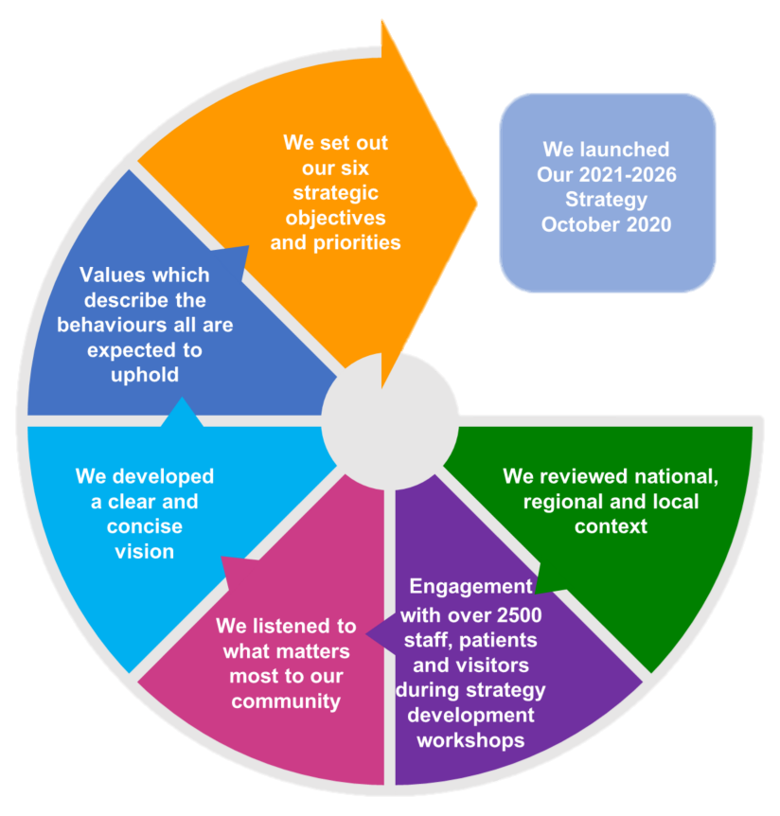
Background
Developing Our 2021 – 2026 Strategy
Our previous strategic focus was upon our top three priorities: patient flow, outpatients and peri-operative medicine. Our Clinical Divisions aligned their operational plans to support improvements in each of these three areas. However, clear strategic objectives for all to work towards, aimed to ultimately deliver our vision were not defined. Therefore, our Trust Board decided further work was needed to create a new, clear and meaningful strategic direction.
Our journey to develop our new strategic direction began early 2020, through a robust process of research and engagement as described.
Our 2021-2026 Strategy launched October 2020 outlining our intensions and setting out our specific strategic objectives to focus progress over the next five years.

Slide 6
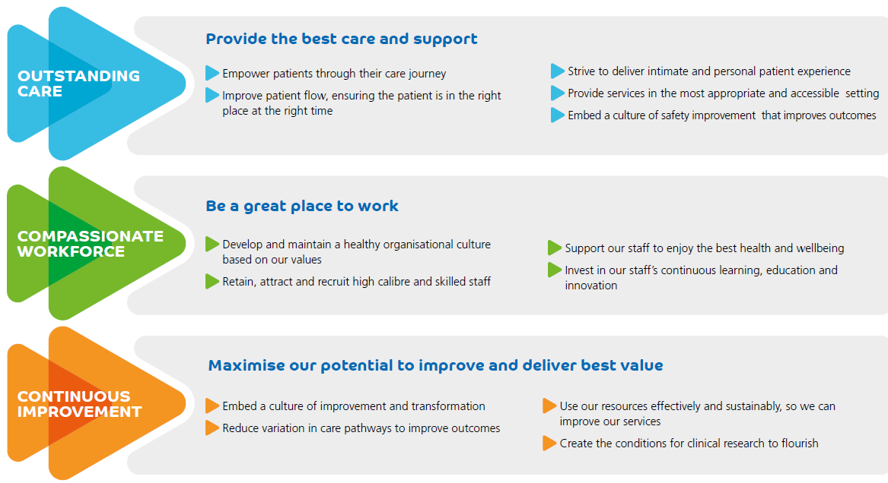
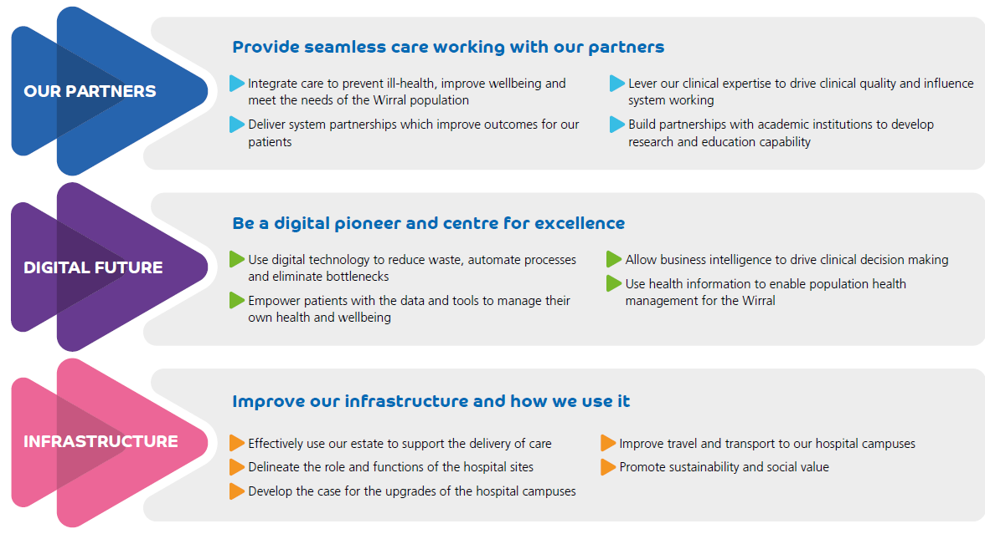
Our 2021-2026 Objectives and Priorities
Our six strategic objectives and priorities demonstrate our intension to provide outstanding care across the Wirral through our hospital sites and units, as a lead provider within the Wirral system. We will be a Hospital Trust that patients, families and carers recommend and staff are proud to be part of.

Slide 7
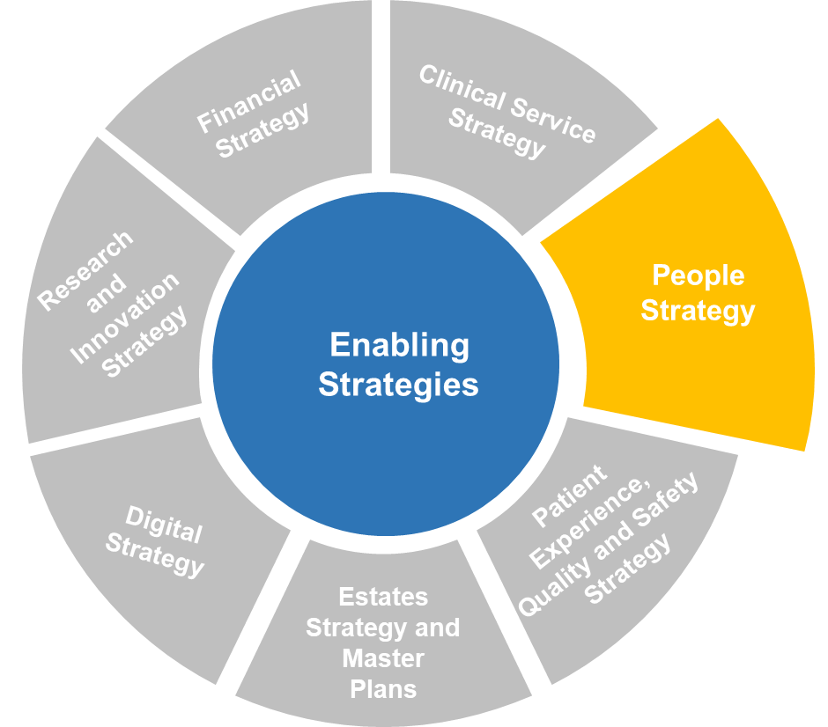
Strategic Framework
Our Enabling Strategies
Our 2021-2026 Strategy will be delivered through seven enabling strategies as shown. Our People strategy is one of the seven enabling strategies, it was originally titled ‘Workforce and Education Strategy’ and is referred to as this in previously developed enabling strategies. This strategy will set out our road map of people priorities for the next four years aligned to our People Strategy will be aligned to our Compassionate Workforce strategic objective and underpinning priorities to ensure we are all working towards the same goal in delivering Our 2021-2026 Strategy.
Collectively we, ‘Our People’ will determine whether we are successful in delivering this strategy. Our Workforce and Education Strategy will ensure we have the right number of staff with the required skills to be successful, through effective recruitment, retention, education, recognition and reward.
The People Strategy will be integrated with the other enabling strategies as an enabler to wider transformation, including our Research and Innovation Strategy, Finance Strategy and Estates Strategy. Compassionate Workforce objective priorities developed by our clinical teams will also be drawn out of our Clinical Service Strategy 2021-2026 to inform our People Strategy.

Slide 8
Developing our
People Strategy

Slide 9
Our People Journey
Where we are now and where we want to be
In July 2020 the NHS published the NHS People Plan, alongside a People Promise for the NHS. People Plans for the North West and Cheshire & Merseyside were also produced. In addition, WUTH regularly carries out engagement activities such as the staff survey and the voice of our staff can be heard through staff networks and various other staff forums.
The core components of the national and regional documents, plus existing WUTH materials, were used to shape a series of draft visions and strategic priorities. These were then used in a series of workshops with members of WUTH staff to develop and refine them in to the principles, visions and priorities in this strategy.
The four principles of our People Strategy, which are introduced within this section of the document, encompass all required elements to enable us to progress from where we are now to where we want to be over the lifespan of this strategy, through alignment to our Compassionate Workforce objective and our Clinical Service Strategy 2021-2026 priorities.

Slide 10
Engagement with Our People
Our People Strategy is broken down into four principles aligned to the NHS People Plan: Looking after ourselves and each other, Belonging at WUTH, Transforming ways of working, and Shaping our future.
Over 100 people attended the workshops, with a wide variety of services and departments represented.
Our People Strategy will shape operational and strategic plans over the next four years and help our people to be the best they can be and to provide the best possible care to our patients and communities.
Specific people groups were invited to individual workshops, but they were also open for all staff members to attend, publicised via all-staff e-mails
Two additional sessions were held with our executive team and non-executive directors to share the visions and priorities of the four principles
Outputs from the engagement sessions, plus the national and regional people documents were used to directly shape the four principles and priorities within the strategy
Eleven staff engagement workshops have been undertaken. Each workshop lasted up to two hours and was focussed on the four principles included in this strategy.
Initial meeting to define the approach to developing our People Strategy
During the workshops a SWOT analysis was completed to assess our current position in terms of our people. Our strategic foundations model of getting the basics right, better and best was then used to help map out our priorities over the next four years.
Our executive and non-executive teams were taken through the engagement process, the background to the strategy and the principles and priorities within the strategy. There was then an opportunity for them to provide feedback.
January 2022
April 2022

Slide 11
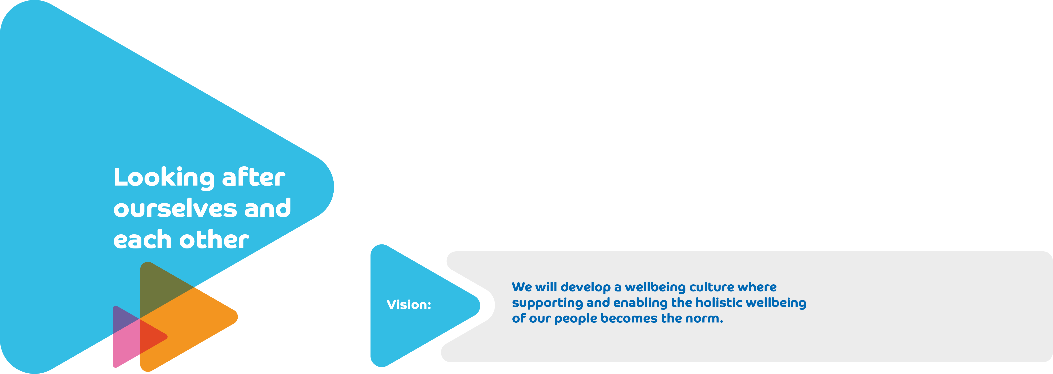







The Four Principles of Our People Strategy
Developing our People Strategy 2022- 2026
We have shaped our People Strategy around four key principles, each with a vision, strategic priorities and the actions required to realise change.
2
3
4
We will develop a wellbeing culture where supporting and enabling the holistic wellbeing of our people becomes the norm
We will improve outcomes across Wirral for health, employment and wellbeing by working with our partners to be the best place to work
We will develop an inclusive culture where everyone’s voice is represented
We will embrace new ways of working and create opportunities to enable our people to achieve their potential

Slide 12
How This Strategy Will be Used
How we get to where we want to be: Setting visions and priorities
The visions and strategic priorities in this strategy set out a framework for us to achieve our ‘Compassionate Workforce’ strategic objective over the lifespan of this strategy.
In addition to the strategic priorities, a set of key actions have been drafted in order to ensure we achieve the outcomes we have set out for each component. These are set out in the appendix to this strategy.
An annual action planning process will take place based on these key actions.
Vision
Strategic Priorities
Yearly Action Planning

Slide 13
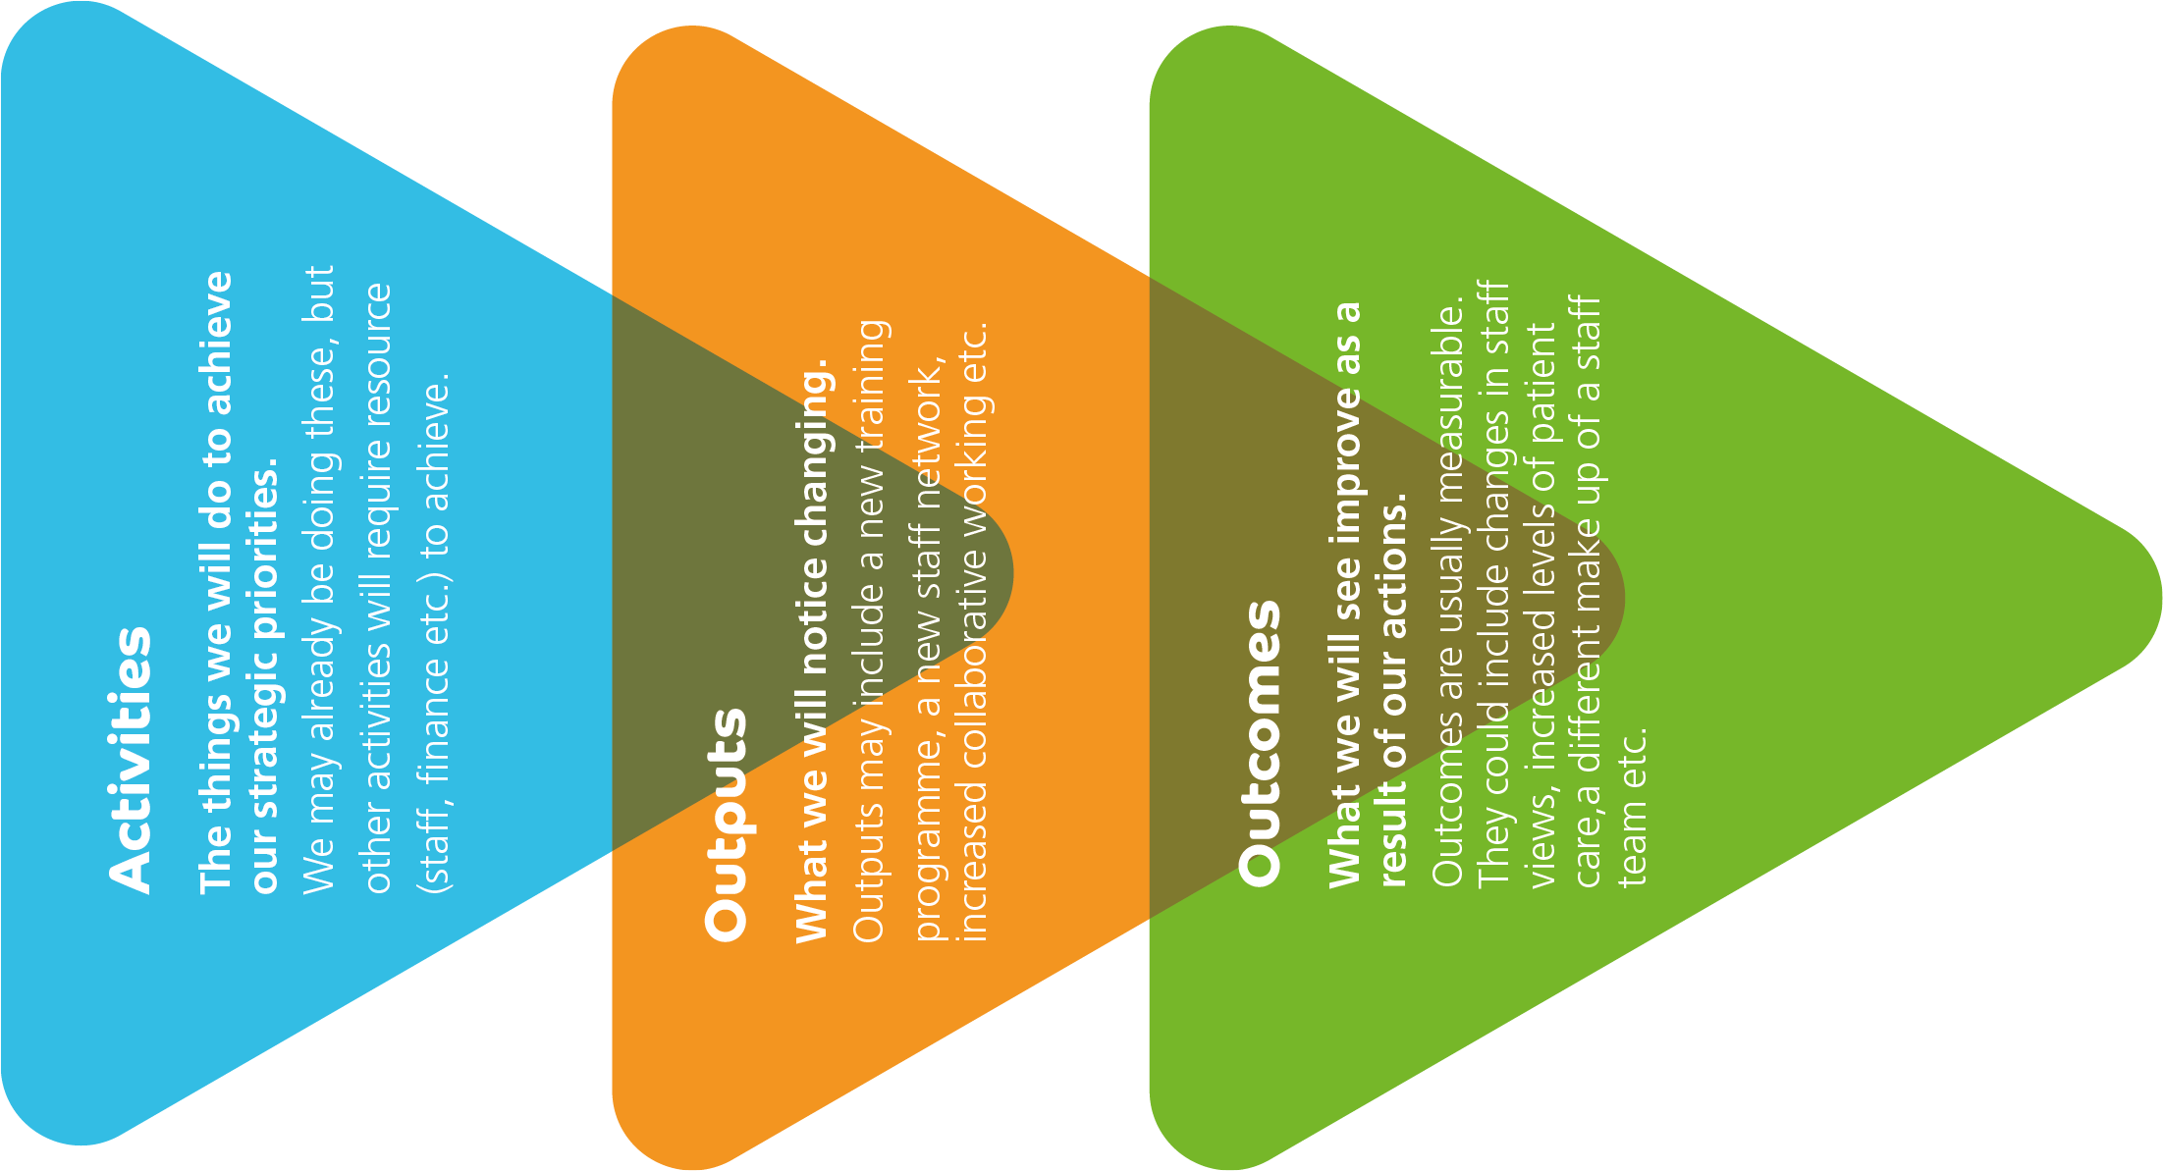
Achieving Outcomes
Strategies, and the programmes of work mobilised to achieve them, are complex. There are many interacting elements, with some pieces of work already ongoing and others that will need to be started.
We don’t know for certain that every project or initiative we commence will work, but all actions included in this strategy will be started with the belief that if we act, benefits will follow.
We have therefore developed a logical process which will:
Help us be clear WHY we’re doing something
Help us think what the EVIDENCE is for acting
Help us EVALUATE whether change has been beneficial
Each year of this strategy will see an annual planning session which will set out the activities for that year required to achieve the priorities set out.
From those activities we will see outputs and outcomes. We will measure these outcomes to assess whether we are achieving results.
On a yearly basis we will set specific outcome targets and measure success against these.

Slide 14
People Strategy
Key Priorities

Slide 15
Looking after ourselves and
each other
Vision: We will develop a wellbeing culture where supporting and enabling the holistic wellbeing of our people becomes the norm
To do this we will:
Deliver first class, innovative Occupational Health and Wellbeing Services
Equip our line managers and leaders with the knowledge, skills and tools to develop a wellbeing culture within their teams.
Fully embrace flexible working across all roles.
Create the conditions for civility and respect amongst our people.
Some key outcomes
Increased staff satisfaction rates relating to positive action on health and wellbeing.
Reduced levels of bullying and harassment
Reduced sickness absence rates
We strive to achieve outstanding levels of care for our patients, but the health and wellbeing of our people is just as important. We need to look after ourselves and each other in order to continue to deliver high quality and safe care.
We know that COVID-19 has had a physical and mental impact on our people. Many staff and volunteers have told us that they feel tired and in need of restoration and respite, and we recognise that having a wellbeing culture and proactive services to support our people is paramount.

Slide 16
Belonging at WUTH
Vision: We will develop an inclusive culture where everyone’s voice is represented
To do this we will:
Proactively increase and celebrate diversity at all levels of the organisation.
Enable a strong voice for our people throughout the Trust and recognise their contributions.
Create the environment for compassionate and inclusive leadership.
Some key outcomes
Increased diversity amongst our people
An increased number of our people report that we act fairly with regard to career progression / promotion
Organisational priorities and processes being shaped by our staff networks and increased numbers of people in our staff networks
Increased numbers of staff participating in leadership development programmes
It has never been more urgent for us to take action to create an organisational culture where everyone feels like they belong.
This principle of our People Strategy is about making a commitment to ensuring that we are a understanding, kind and inclusive organisation where there is diversity amongst our people and they feel a strong sense of belonging.

Slide 17
Transforming ways of working
Vision: We will embrace new ways of working and create opportunities to enable our people to achieve their potential
To do this we will:
Work with partners across Wirral and beyond to maximise people opportunities.
Develop our people to equip them for both current and future challenges.
Embrace technology to transform how we work.
Some key outcomes
Highly developed, motivated people who continuously strive to improve their practice and enhance patient care
An increased number of our people will work collaboratively with partner organisations to improve patient outcomes
Impact evaluation results of collaborative development activity
Achievement of NHS England levels of attainment
COVID-19 compelled us to work in new and different ways to provide patient care. We want to build on this by transforming not only the way our teams work, but also how we work innovatively in partnership with other organisations across the system.
We will do this by embedding a continuous learning culture and ensuring all of our people have the opportunity to experience exciting and innovative development and learning opportunities.
We will work more collaboratively with or partners to create opportunities for in relation to our people, with more cross-sector working and development to transform how we provide patient care. We will embrace new technologies and the opportunities they bring.

Slide 18
Shaping our future
.
Vision: We will improve outcomes across Wirral for health, employment and wellbeing by working with our partners to be the best place to work
To do this we will:
Ensure we have a thorough understanding of our people requirements and use new roles and opportunities to deliver these.
Become an employer of choice which attracts and retains the best people.
Lead the way as an ‘anchor institution’ which is rooted in our community, including implementing the NHS Ambassadors Programme.
Some key outcomes
Reduced vacancy rates
Decrease in staff turnover
Increased staff retention
We know that it’s a continual challenge to address the gaps across various roles and professional groups. We will focus on ensuring that WUTH is an organisation where people want to stay to work and develop, and that we attract new people through innovative new roles and promoting WUTH as an employer of choice.
There is a strong link between work and health. We will develop our role as an ‘anchor institution’, ensuring that local people are engaged in our organisation from an employment perspective, with a view to decreasing health inequalities as a result.

Slide 19
Next Steps
How we Get to Where we Want to Be: Implementation, Monitoring and Review
Key to the success of this strategy is the continued involvement of our people. On an on-going basis our Workforce Directorate will use the outputs of a variety of engagement events, including the annual staff survey, to inform the delivery of this strategy.
Step 1
Our Workforce Directorate will translate the People Strategy priorities into their annual operational and strategic priorities.
Step 2
The People annual operational and strategic priorities will be reviewed and approved via Trust Board. Progress in delivering the priorities will be monitored via Workforce Assurance Committee.
Step 3
People Strategy priorities will be reviewed as part of annual operational and strategic priority planning to ensure they remain relevant to our evolving needs and we maintain delivery momentum for the lifespan of this People Strategy.
Step 4

Slide 20
Appendices
Glossary of Terms
Key Actions
Strategic Alignment

Slide 21
Glossary of Terms
Anchor Institution
A large, typically non-profit, public sector organisation whose long-term sustainability is tied to the wellbeing of the populations they serve.
Partners
Local and regional organisations we will work with to provide care to our patients.
People
A term to encompass anyone who is involved in supporting patient care. Staff, volunteers etc.
Place
Otherwise known as a ‘locality’ or ‘neighbourhood’. Areas of populations within a system.
Strategy
A plan of action that provides clear direction for all to work towards.
System
Cheshire & Merseyside Health and Care Partnership is a collection of NHS, local authority, voluntary, community, faith and social enterprise organisations from across the nine local authority areas that make up Cheshire and Merseyside.

Slide 22

Key Actions: Looking after ourselves
and each other
Vision: We will develop a wellbeing culture where supporting and enabling the holistic wellbeing of our people becomes the norm.
To do this we will:
Deliver first class, innovative Occupational Health and Wellbeing Services | Equip our line managers and leaders with the knowledge, skills and tools to develop a wellbeing culture within their teams. | Fully embrace flexible working across all roles. | Create the conditions for civility and respect amongst our people.
Recognising the impact of the pandemic, continue to invest in mental health and wellbeing support. Enhance our physical wellbeing offers. Take action to expand the focus of Occupational Health and Wellbeing Service towards a holistic approach to Wellbeing, including financial, social, cultural wellbeing. Introduce new ways of working which support the development of a wellbeing culture, in line with the refreshed NHS Health and Wellbeing Framework. | Ensure that there is a wellbeing focus throughout all manager development and training. Roll out annual Wellbeing Conversations, supporting line managers to fully embrace the opportunities they present. Introduce a training package to enable line managers to hold effective and meaningful Wellbeing Conversations. Develop managers to proactively support staff when they go off sick and support their return to work. | Board members and senior leaders will proactively support and embrace flexible working. The opportunity to explore flexible working should be open to all and included in induction, Wellbeing Conversations and personal development reviews. Acknowledge the current pressure our people face and allow staff to manage their annual leave flexibility, with opportunities to carry over leave or buy back unused leave. Roll out the new working carers passport to support people with caring responsibilities, as well as working passports across other areas. | Continue the programme of work to embed Trust values and behaviours across the organisation. Utilise the NHS England and NHS Improvement Civility and Respect toolkit. Introduce a restorative approach to addressing conflict in the workplace, in line with the principles of Just and Learning Culture. Take action to prevent and tackle bullying and harassment.

Slide 23
Key Actions: Belonging at WUTH
Vision: We will develop an inclusive culture where everyone’s voice is represented
To do this we will:
Proactively increase and celebrate diversity at all levels of the organisation. | Enable a strong voice for our people throughout the Trust and recognise their contributions. | Create the environment for compassionate and inclusive leadership.
Ensure that we collect and analyse data on the diversity and characteristics of our people to enable a deep understanding of lived experiences. Proactively use data to identify and build a culture of continuous improvement. Examine recruitment processes to remove barriers and to create opportunities to proactively increase diversity. Refresh recruiting managers training to increase inclusivity of selection processes and increase diversity Implement an annual calendar of events to celebrate diversity across our organisation. | Continue to strengthen our staff networks to ensure they are embedded in our governance arrangements and able to influence our decision-making processes. Support our staff networks to look beyond the boundaries of WUTH and work with colleagues across the system and in our communities. Create a programme of work to enhance reward and recognition for our people. Continue to promote and enhance the range of opportunities for our people to raise concerns, including the development of Freedom to Speak Up Champions. Refresh our recruitment and selection training to look at proactive and innovative ways of promoting greater diversity and inclusion | Introduce a refreshed approach to leadership development, talent management and succession planning, with an emphasis on the leadership qualities, multidisciplinary development, and leadership at all levels. Create and deliver plans to proactively target leadership development in under-represented groups, identifying and removing barriers to progression. Ensure that our leaders understand that they have explicit responsibility to continuously improve equality, diversity, and inclusion for our people. Proactively support and develop our leaders to deliver on this responsibility. Continue to create a culture where all leaders are visible, accessible, and open to listening to the lived experience of our people

Slide 24
Key Actions: Transforming ways of working
Vision: We will embrace new ways of working and create opportunities to enable our people to achieve their potential.
To do this we will:
Work with partners across Wirral and beyond to maximise people opportunities | Develop our people to equip them for both the current challenges and the future. | Embrace technology to transform how we work.
Establish collaborative learning and development opportunities via partnership working. Create a culture where our teams are empowered to work across sector boundaries, with greater collaborative working with colleagues in social care and other partner organisations. Create the systems and processes to enable our people to easily work across organisational boundaries | Continued focus on developing skills and expanding capabilities to boost morale and create career progression pathways for our people. Create exciting and agile volunteer roles, supporting our volunteers to move in to paid employment should they wish to do so. Work with training and education partners to anticipate, design and commission a portfolio of learning opportunities that enhances workforce capability, clinical practice and supports the professional development of our people. Embed a Just and Learning culture that facilitates continuous learning, creates psychological safety to raise and address concerns, and focuses upon good practice that is shared and replicated within and beyond organisational boundaries. | Make effective use of the valuable contribution made by our temporary staff by having robust systems and processes for planning and control. Embrace the opportunities presented by workforce deployment systems, advancing our levels of attainment for e-rostering and e-job planning. Ensure that we have a modern and exciting approach to education and learning, empowering our people to learn in a way that best fits for them wherever possible through innovative and immersive technologies.

Slide 25
Key Actions: Shaping our future
Vision: We will improve outcomes across Wirral for health, employment and wellbeing by working with our partners to be the best place to work.
To do this we will:
Ensure we have a thorough understanding of our people requirements and utilise new roles and opportunities to deliver those requirements. | Become an employer of choice which attracts and retains the best people. | Lead the way as an ‘anchor institution’ which is rooted in our community
Develop and deliver a flexible and agile people plan that’s fit for the future and that is aligned to the national expansion of clinical roles and enables new care delivery models to become possible. Accelerate, grow and develop innovative new roles to maximise skill mix, broaden staff autonomy and improve patient care. Work with partners in Wirral and beyond to introduce new ways of working that tackle the workforce supply challenge end enable us to deliver the best quality care to our communities. Make effective use of the valuable contribution made by our temporary workforce by having robust systems and processes for planning and control. | Develop a ‘brand’ for WUTH so that those outside of our organisation understand that we are a modern, flexible and innovative employer and a great place to work. Focus on new approaches to marketing WUTH as the best place to work, targeting people from all backgrounds and under-represented groups. Focus on retaining our people by creating opportunities for engagement prior to leaving and, where staff do choose to leave, using our exit interview process to learn and improve. Continue and expand our international recruitment programme and focus on attracting, recruiting, and retaining high-quality nurses, midwifes, allied health professionals and other high-skilled people. | Build on work already underway by participating in the Health Anchors Learning Network. Explore new entry routes and continue to expand our volunteering and apprenticeship programme. Work with local partners to explore the implementation of integrated health and social care apprenticeships. Promote the NHS Health Ambassadors programme across our workforce.

Slide 26
Strategic Alignment of Our Four Principles
 | Compassionate Workforce Be a great place to work
People Strategy Principles | Support our staff to enjoy the best health and wellbeing | Develop and maintain a healthy organisational culture based on our values | Retain, attract and recruit high calibre and skilled staff | Invest in our staff’s continuous learning, education and innovation
Looking After Ourselves and Each Other |  | 
Belonging at WUTH |  |  |  | 
Transforming Ways of Working |  |  |  | 
Shaping Our Future |  |  |  | 
The People Strategy principles are aligned to delivering the Compassionate Workforce priorities specifically, but it will also support the delivery of all trust strategic objectives.

