Slide 1
Annual Members’ Meeting
Monday 18th October 2021

Slide 2
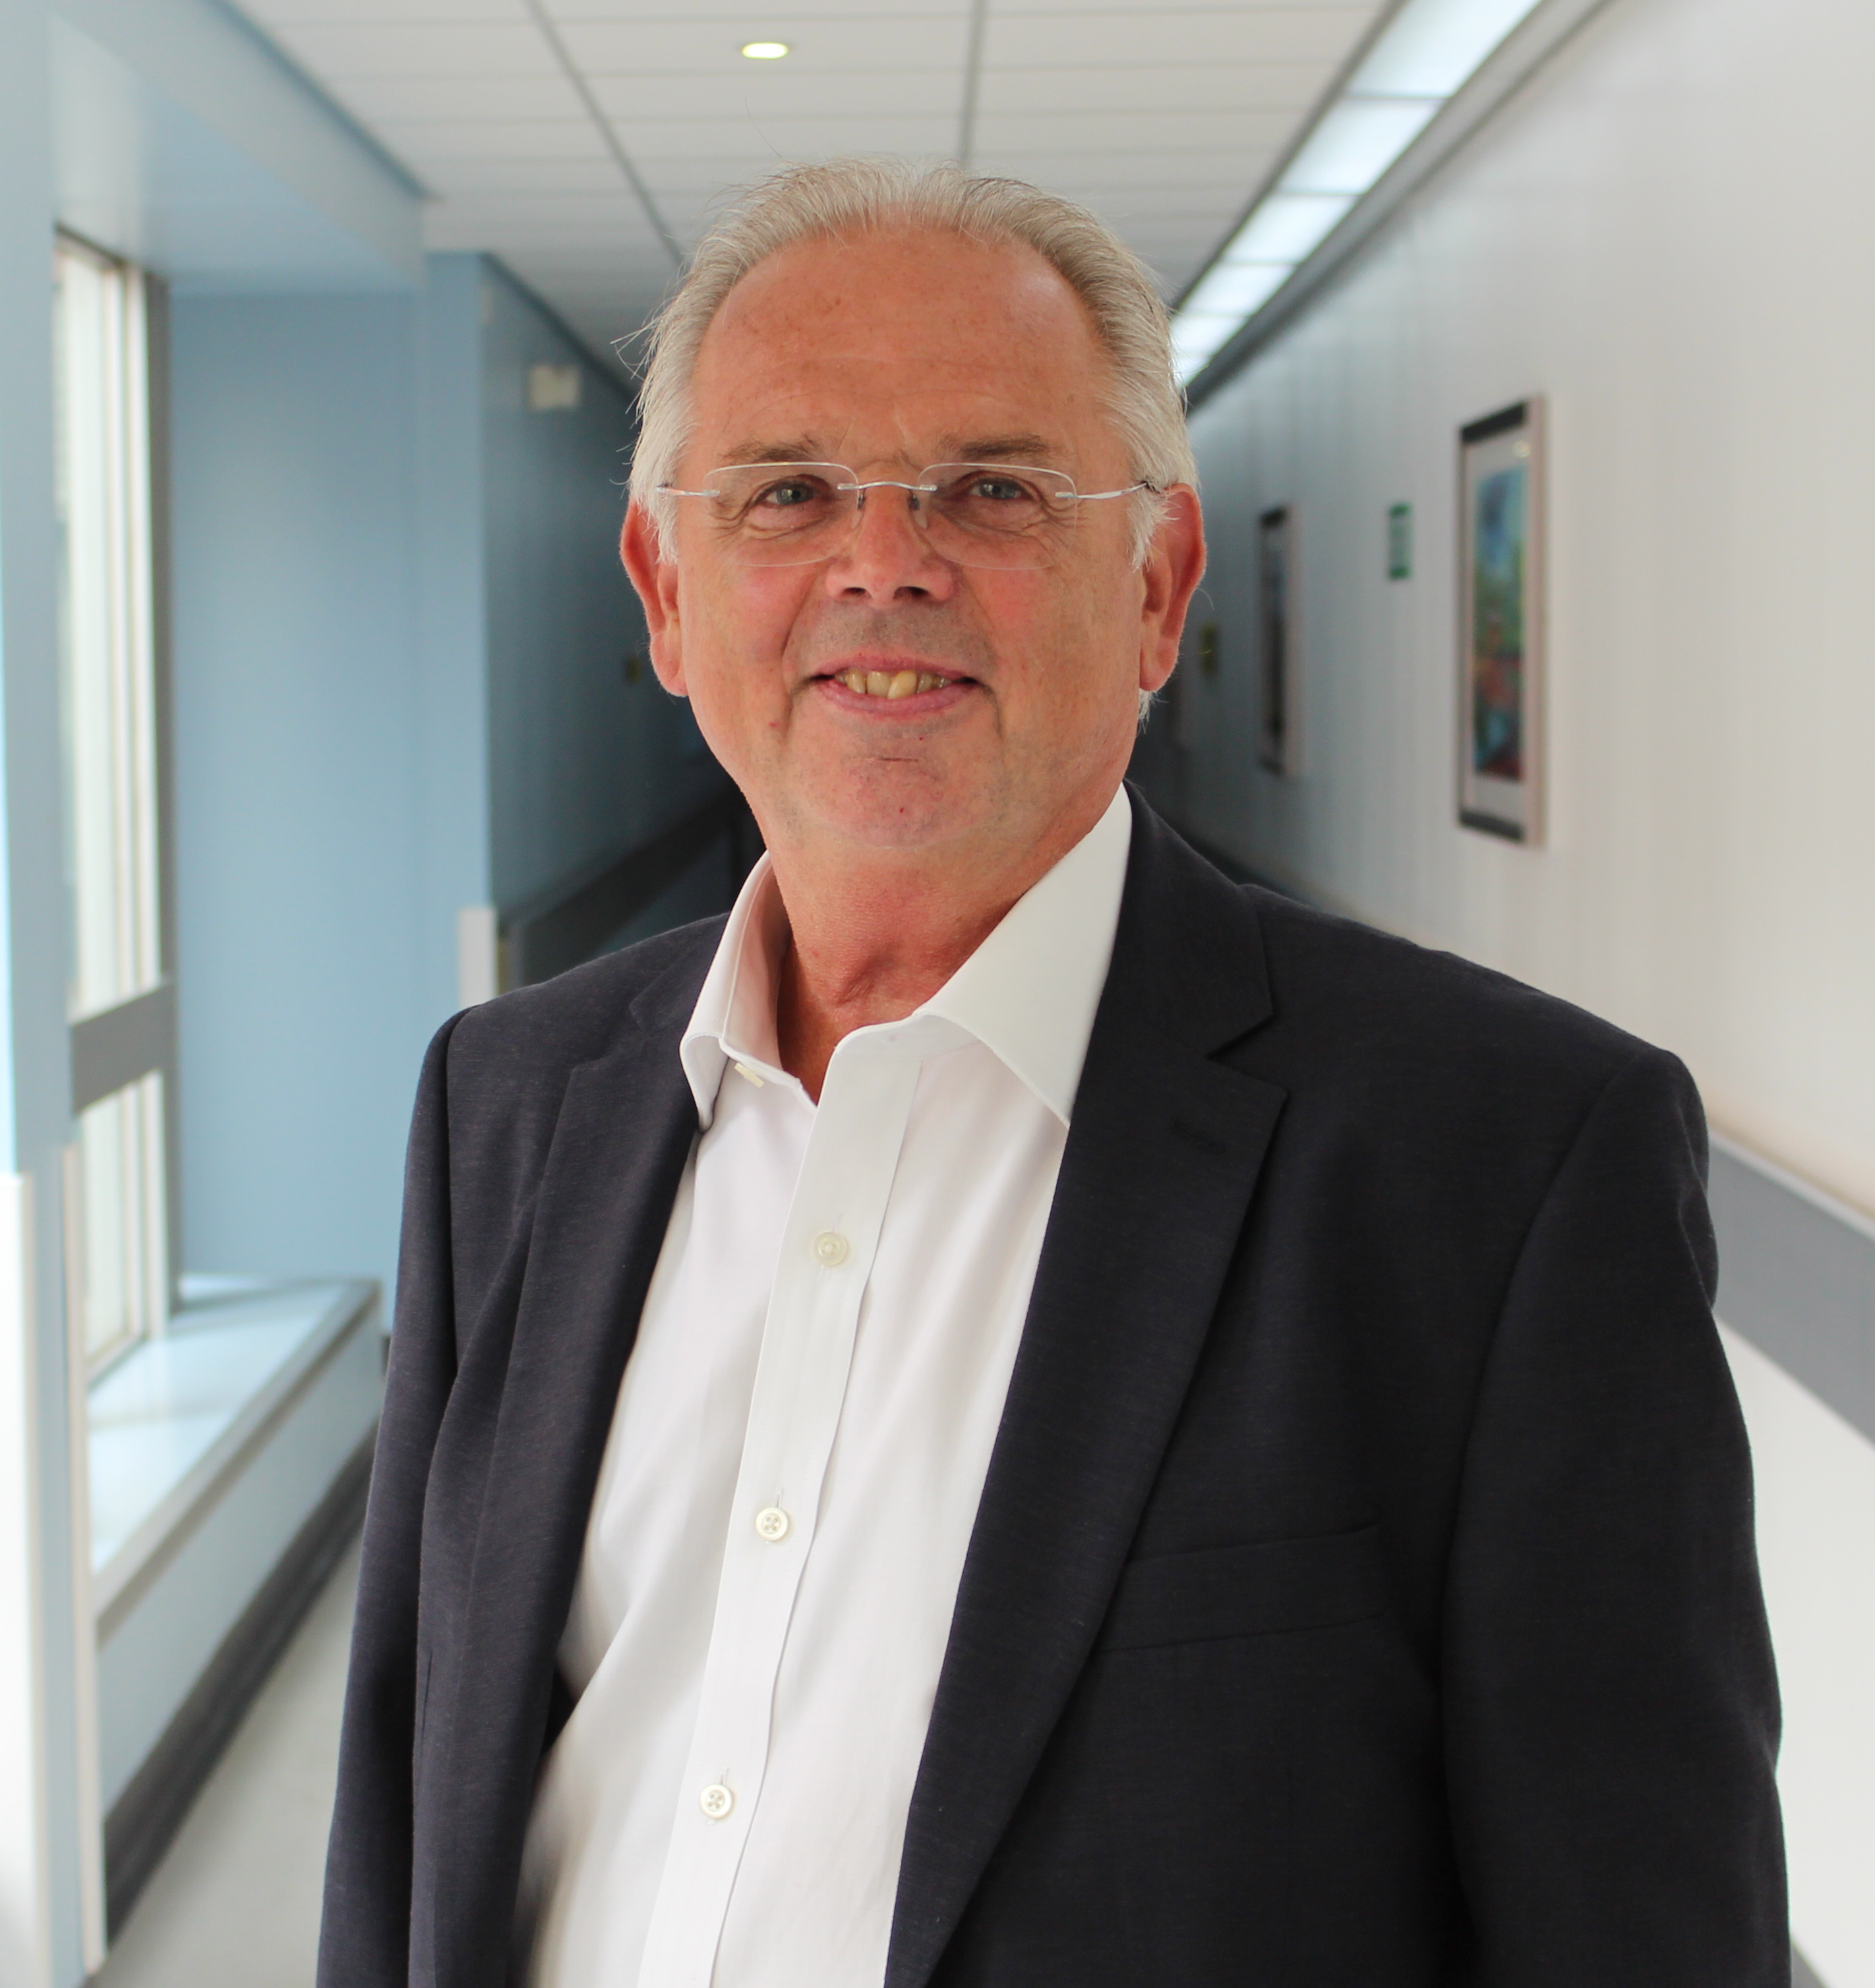
Welcome
Sir David Henshaw, Chair

Slide 3

Running the meeting
Please set your Teams to ‘Mute’ if not speaking.
Questions have been submitted in advance and there is also a question slot at the end.
The meeting is being recorded.
Thank you for your patience and co-operation.

Slide 4
18th October 2021
Annual Members Meeting
Agenda
Time | Corporate Governance | Lead
17.00 | Welcome and Chair’s report | Sir David Henshaw, Board Chair
17.05 | Chief Executive’s video report | Janelle Holmes, Chief Executive
17.10 | Lead governor video presentation | Lead Governor, Angela Tindall
Clinical and Corporate Services presentations (Introduced by Medical Director Dr Nikki Stevenson)
17.15 17.30 17.45 | Respiratory Consultant Palliative Care Team Capital developments and estates investments | Respiratory Consultant and Interim Clinical Lead for Respiratory Medicine, Dr Dave Tarpey Consultant, Dr Richard Latten Matthew Swanborough,Director of Strategy and Partnerships
2020/21 Financial review and financial governance
18.00 | 2020/21 Financial review | Claire Wilson, Chief Finance Officer
18.10 | 2020/21 Auditor's Report | Chris Brown, Partner Azets
18.25 | Questions from the public | Sir David Henshaw, Board Chair
18.30 | Close of meeting | Sir David Henshaw, Board Chairman

Slide 5




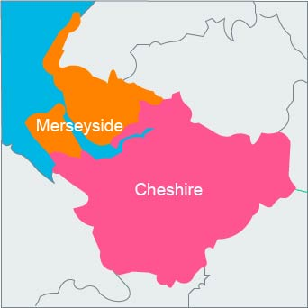
Who we are
One of the largest employers in Wirral and one of the largest and busiest Acute Trusts in the North of England.
Provide a comprehensive range of high quality services
Operate from two main sites
Serve a population of 400,000 across Wirral, Ellesmere Port, North Wales and the wider North West footprint
Provide specialist services such as Robotic Surgery / Level 3 Neonatology & Intestinal Failure to a wider population in Merseyside, Cheshire and Wales.

Slide 6
Council of Governors summary report

Slide 7

Thank you Governors
It’s been a challenging year with fewer face to face meetings.
We have greatly valued your support and commitment.
Your role is vital to support and challenge our teams and to share our vision for the people of Wirral, our patients and staff.

Slide 8
Outgoing Governors
Governor name | Constituency
Angela Tindall | North West & North Wales
Rohit Warikoo | Bidston & Caughton
Allen Peters | Leasowe, Moreton and Saughall Massie
Richard Latten | Medical and Dental
Alison Owens | Neston and Burton

Slide 9
Inauguration of our new governors
Governor Name | Constituency
Christine House | Liscard & Seacombe
Sarah Evans, | Birkenhead, Tranmere and Rock Ferry
Peter Israel Peters | ,North West & North Wales
Paul Dixon | Oxton & Prenton
Tony Cragg | Bebington and Clatterbridge
Alan Morris | Bidston and Claughton
Eileen Hume | Greasby, Frankby, Irby and Upton
Paul Ivan | Leasowe, Moreton and Saughall Massie
Andrew Tallents | West Wirral
Gitana Diana Tyson | Nurses & Midwives CBH & other sites
Ann Taylor | Nurses & Midwives (APH)
Anand Kamalantathan | Medical and Dental

Slide 10
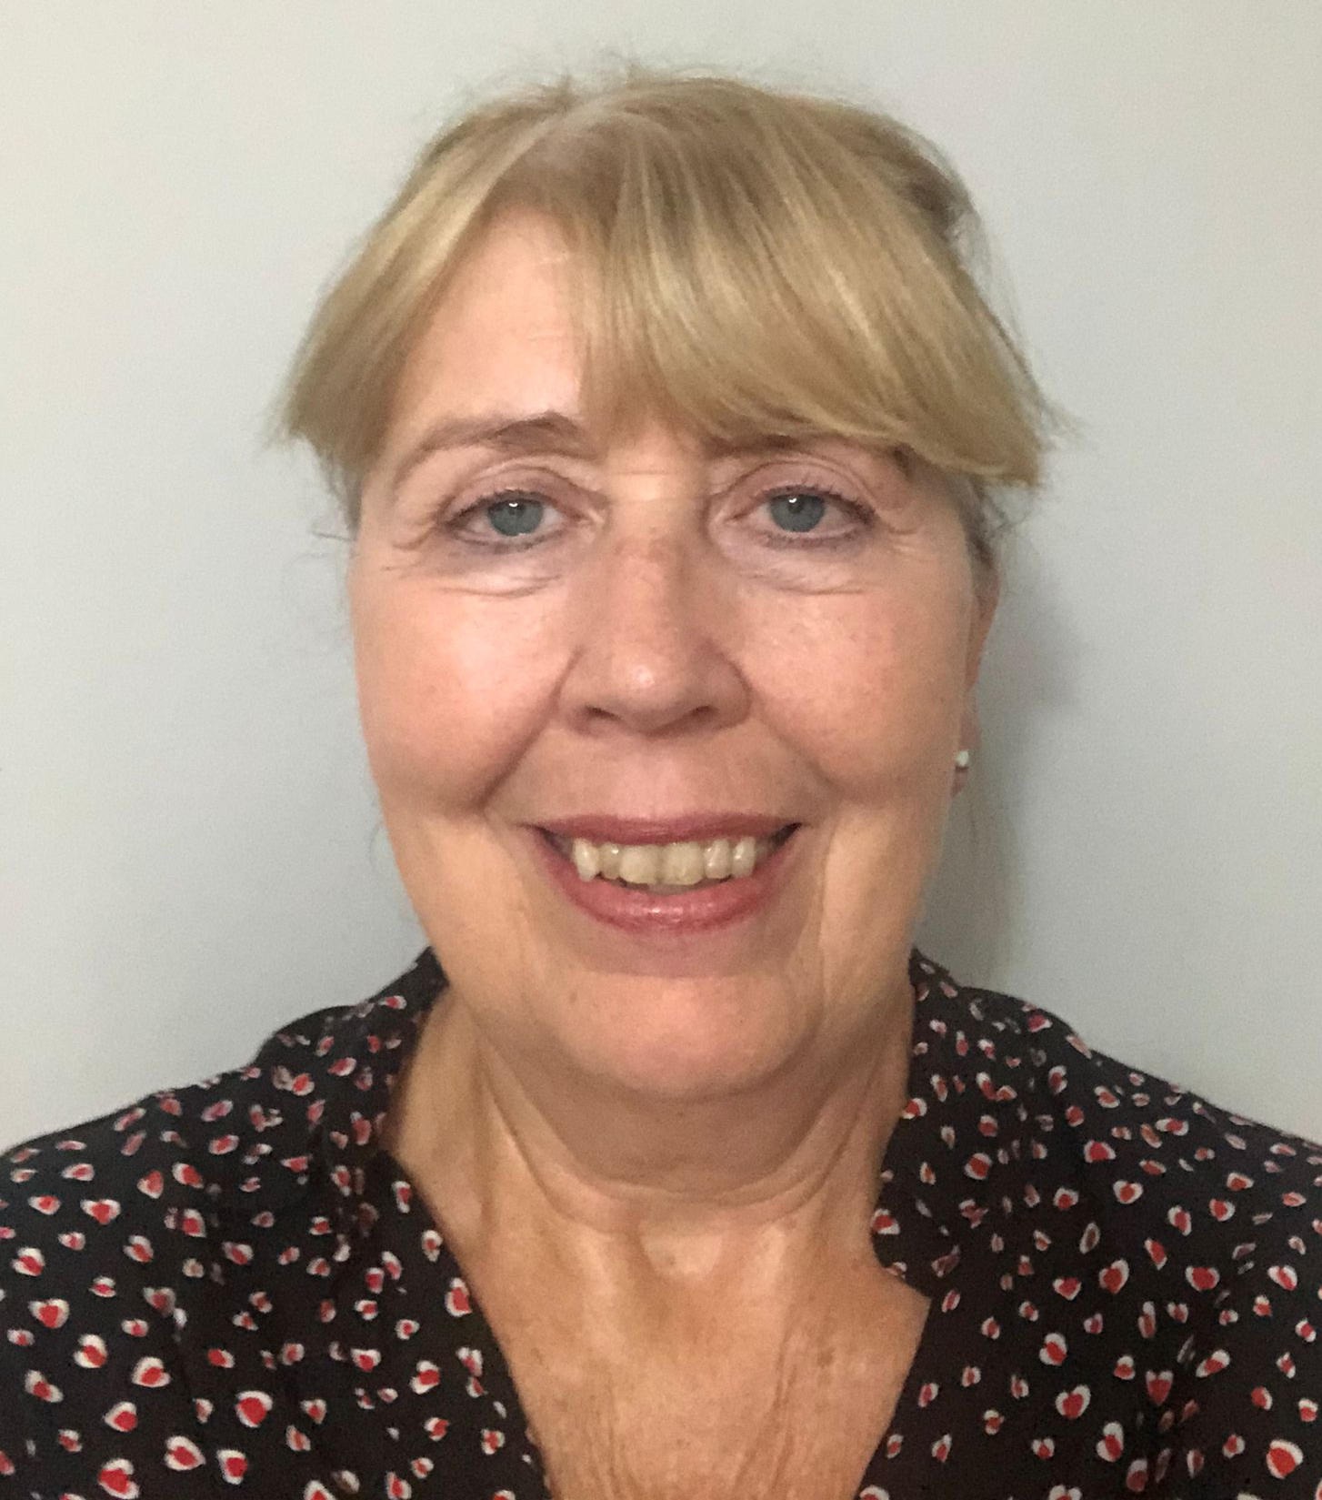
Election of Lead governor
Formal election of:
Sheila Hillhouse, New Brighton and Wallasey
Appointment term 18th October 2021- 17 October 2024

Slide 11
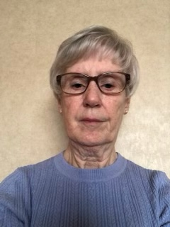
Election of Deputy Lead governor
Formal election of:
Eileen Hume, Greasby, Frankby, Irby & Upton
Appointment term 18th October 2021- 17 October 2024

Slide 12
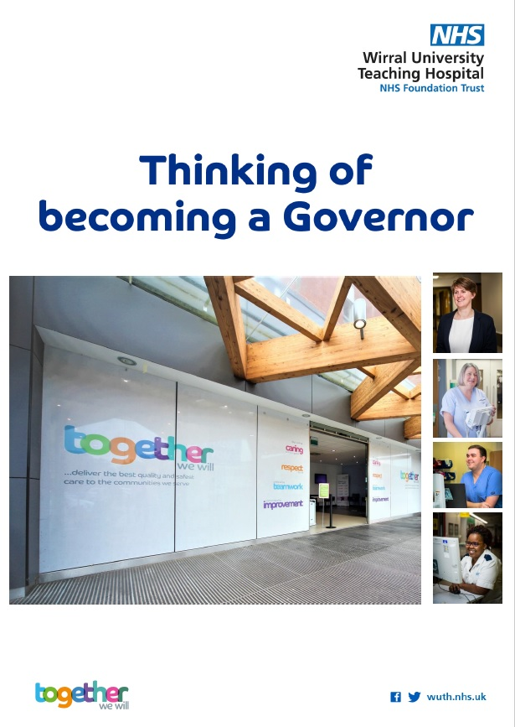
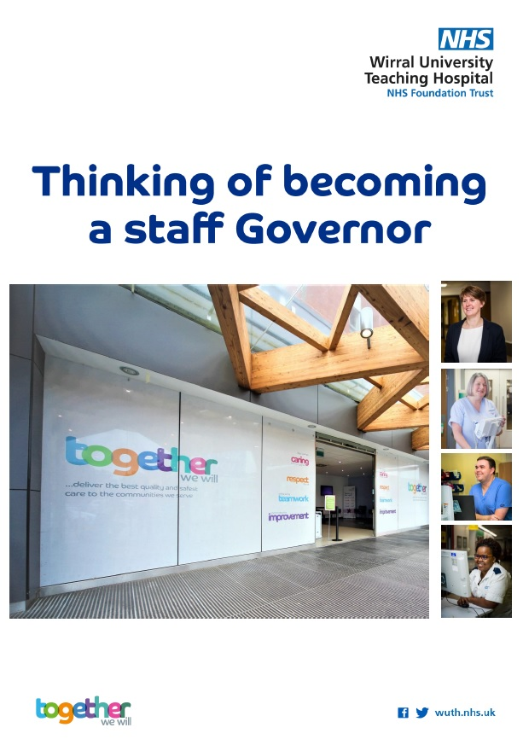
Membership Summary 2020/21
8,498
Public Members
6,106
Staff Members

Slide 13
Non Executive Director - Changes (1)
Sir David Henshaw, Chairman– term extended from February 2022- January 2025
Steve Igoe, Senior Independent Director - re-appointment for a further 3 year term, October 2021 – October 2024

Slide 14
Non Executive Director - Changes (2)
Steve Ryan, appointed on a three year term from January 2021- January 2024
Jayne Coulson and Christopher Clarkson for a second term of 3 years with effect from 1 July 2021 to 30 June 2024

Slide 15


A year to remember
The year 2021 has been a challenging year to remember. Our staff have worked extremely hard and should be very proud of everything they have achieved for our patients.
The following video gives a summary of the past year.

Slide 16
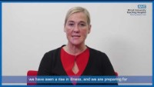
Janelle Holmes, CEO
Wirral University Teaching Hospital
An overview

Slide 17
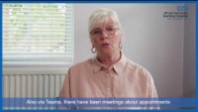
Angela Tindall,
Outgoing Governor
An overview

Slide 18
Questions

Slide 19
COVID 19-Challenges, Successes and impact on the respiratory service
Dr David Tarpey
Respiratory Consultant and Interim Clinical lead for Respiratory Medicine

Slide 20
Contents
Introduction to respiratory team
Initial challenges
Successes
Ongoing challenges
Future implications

Slide 21
Respiratory team
Medical Consultants
Nurse Consultant
Lung cancer service
Pleural service
Severe asthma service
Interstitial Lung disease service
TB service
Community Respiratory and home oxygen service
Pulmonary rehabilitation service
ANP’s
Ward nursing staff
Operational team

Slide 22
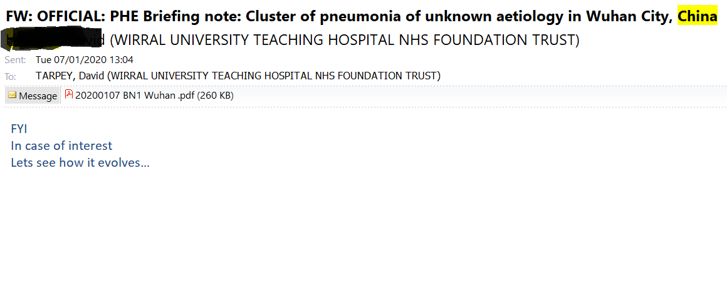
COVID 19

Slide 23
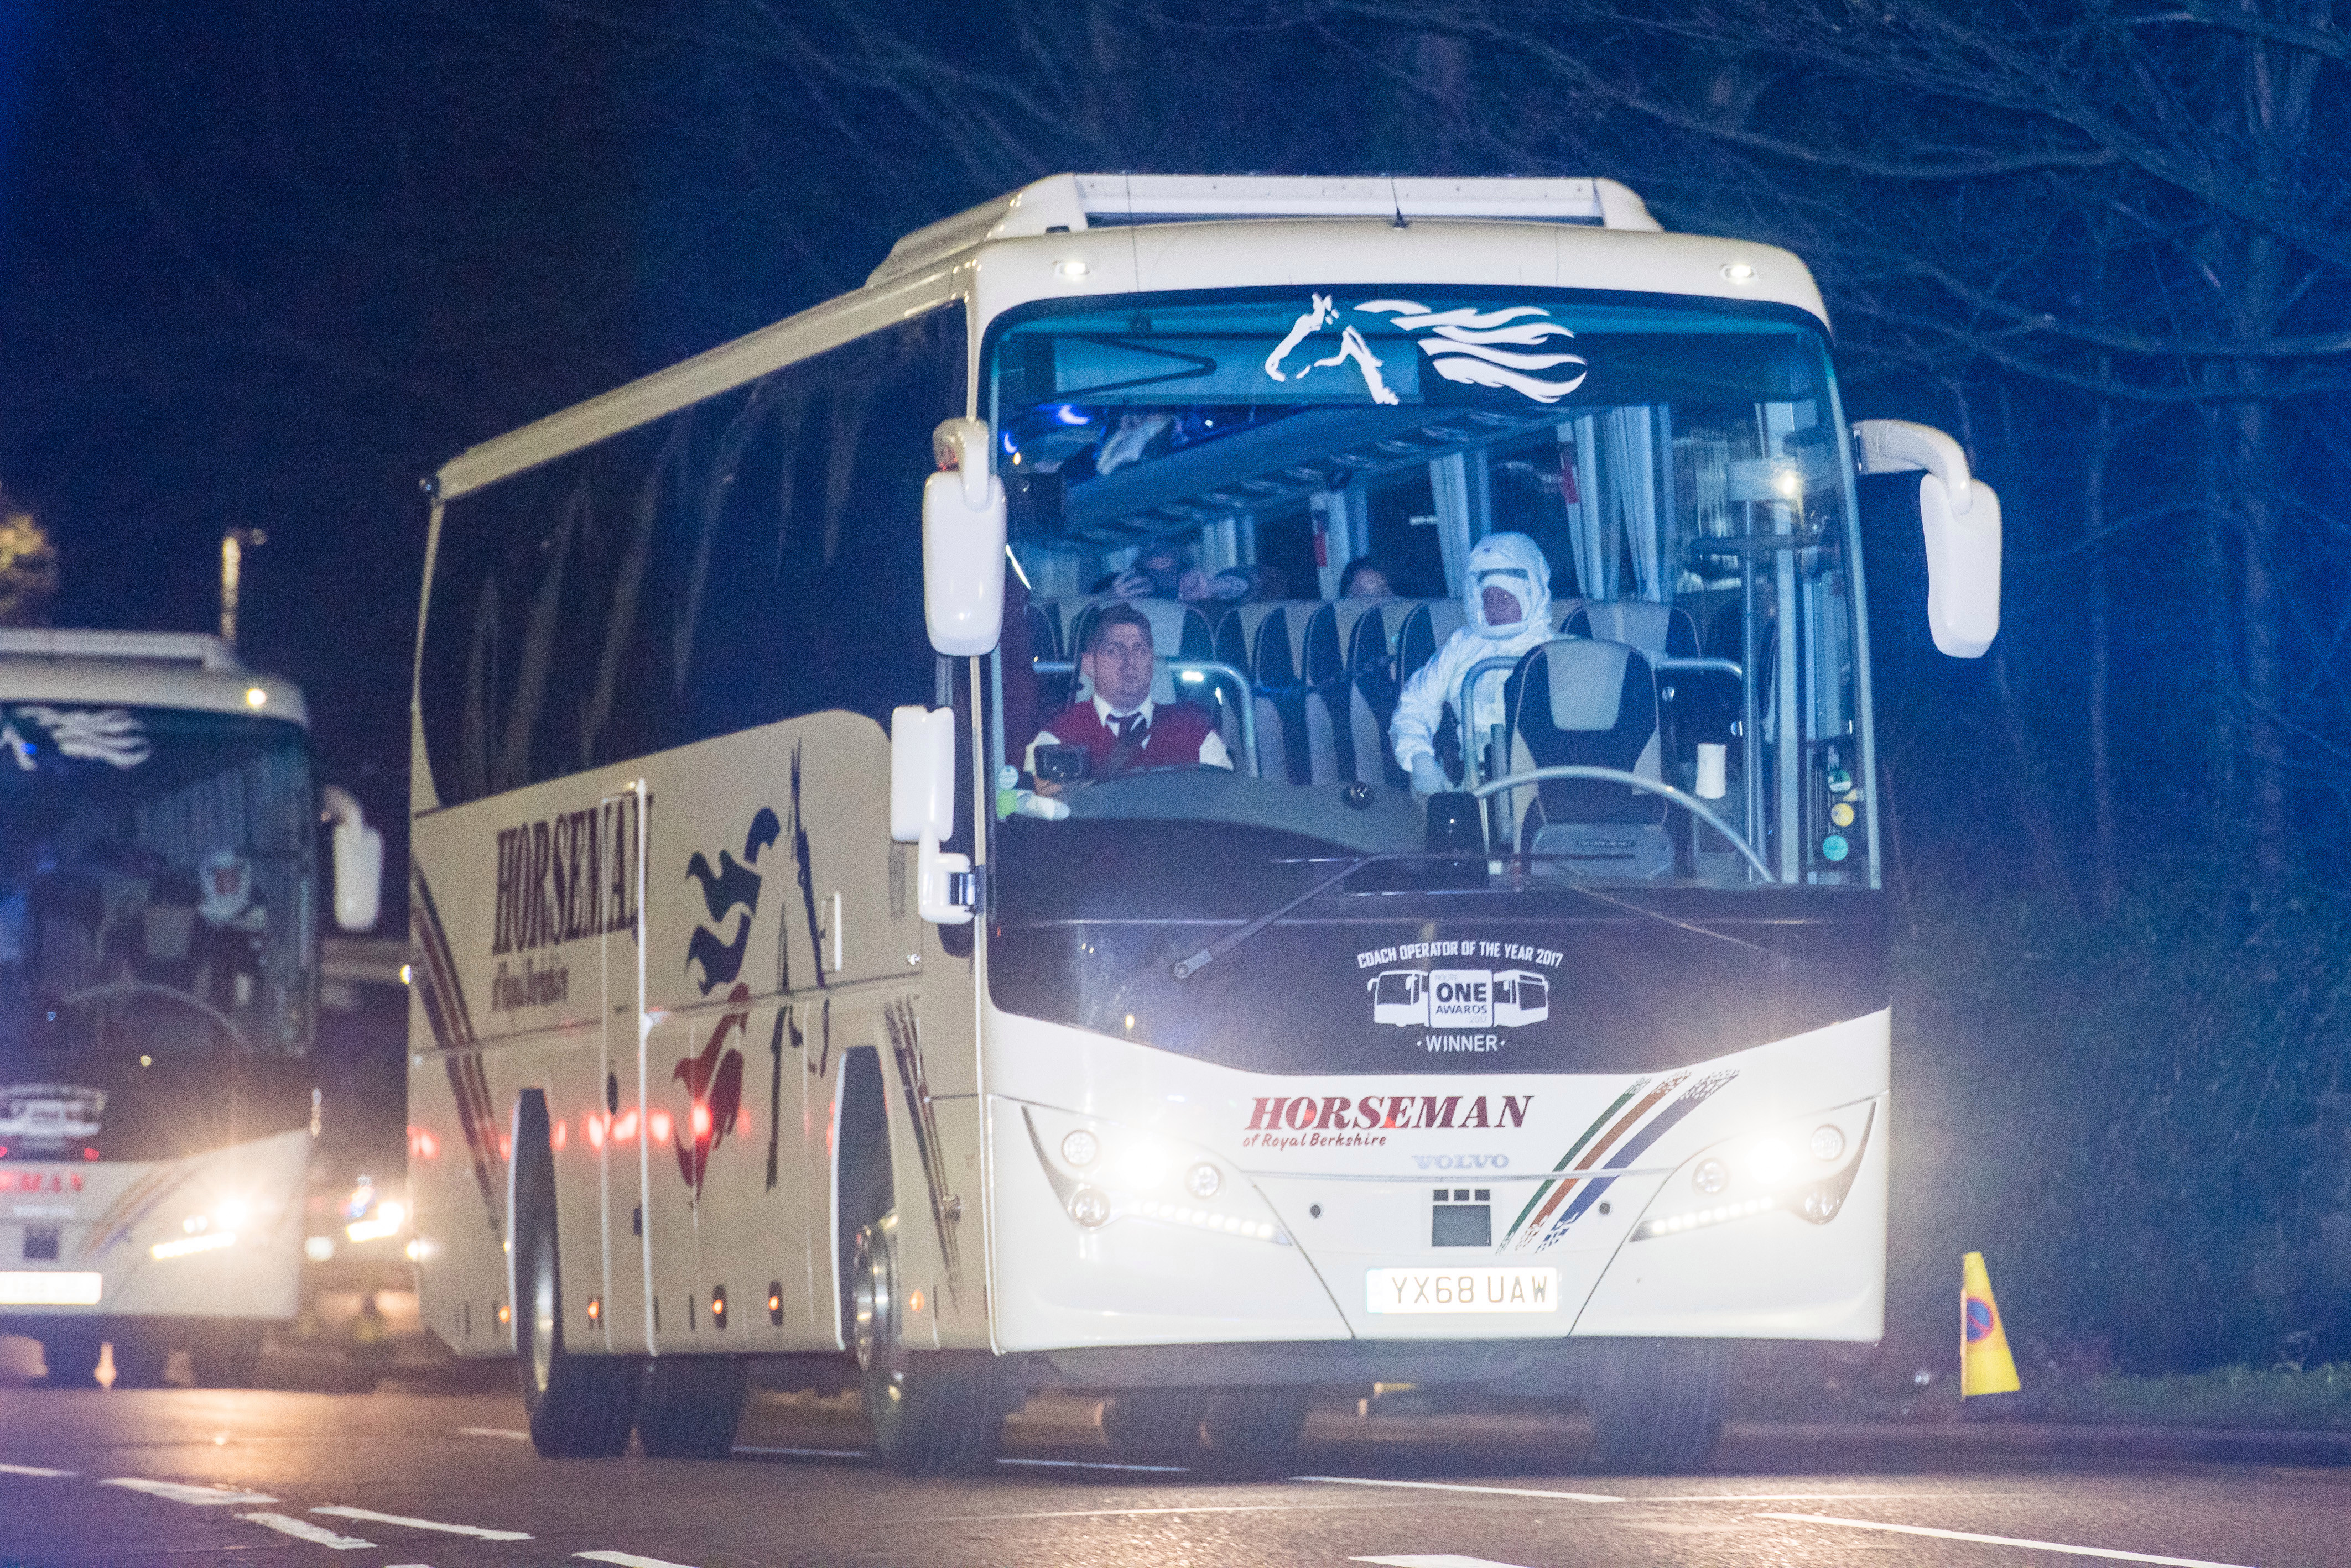
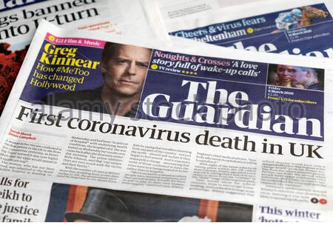

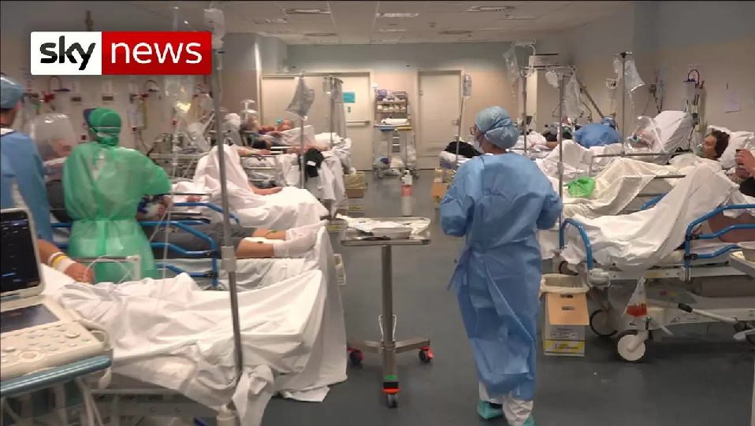
Feb-March 2020

Slide 24
Challenges- prepare for a surge
Isolation facilities
Overwhelming admissions to all parts of the hospital
No treatment options and don’t know what is the best way of supporting the patients
Discharging the patients
Staff getting sick
Normal Respiratory patients- how do we look after them- high risk

Slide 25
Isolation facilities
Moved the respiratory ward to the isolation ward
Taught a whole new way of delivering treatments such as CPAP
Created a Respiratory Support Unit before the name existed

Slide 26
Overwhelming admissions to all parts of the hospital
Developed an ITU/Respiratory MDT so that we were able to proactively plan the care of critically ill patients to prevent the services being overwhelmed
Virtually reviewed the sickest COVID patients throughout the hospital using cerner functionality
Respiratory on call 24/7, 7 days a week.

Slide 27
No treatment options and don’t know what is the best way of supporting the patients
Early adopters of the RECOVERY Trial- this led to the development of treatments such as dexamethasome
Worked closely with Palliative care team
Changed our practice as new evidence emerged- used CPAP
Education sessions for all grades to make sure we delivered standardised care

Slide 28
Discharging the patients
Used our community respiratory and oxygen team to develop discharge pathways and get people home on oxygen early
Developed a portal on BI to make sure all patients discharged got appropriate follow up
Worked with primary care to develop Long COVID pathways

Slide 29
Pulmonary rehab team
Developed a whole new rehab service
Home visits and via telephone
Exercised patients with oxygen needs they wouldn’t have done in the past
Excellent outcomes and patient satisfaction

Slide 30
Staff getting sick
Wore enhanced PPE early on
Used negative pressure rooms to minimise risk
Several staff worked on or participated in the vaccine trials at LSTM

Slide 31
Normal Respiratory patients- how do we look after them- high risk
Asthma/ILD/community respiratory team contacted our patients to tell them to isolate and reviewed them over the phone
Lung cancer and pleural team- joined the family support team and switched to telephone consultations/virtual work
Telephone clinics
TB nurses-Vaccine clinics

Slide 32
Clinical Advisory group
Chaired by MD
Wirral was ahead of the game
Allowed throughout the pandemic for us to bring the most uptodate clinical information to our patients
Provided confidence and assurance to strike our own path when needed.

Slide 33
Ongoing Challenges
Backlogs- waits for OP clinics/investigations
Social distancing- PR
Infection control
Flu and other viral respiratory illnesses
Workforce pressures
Long COVID

Slide 34
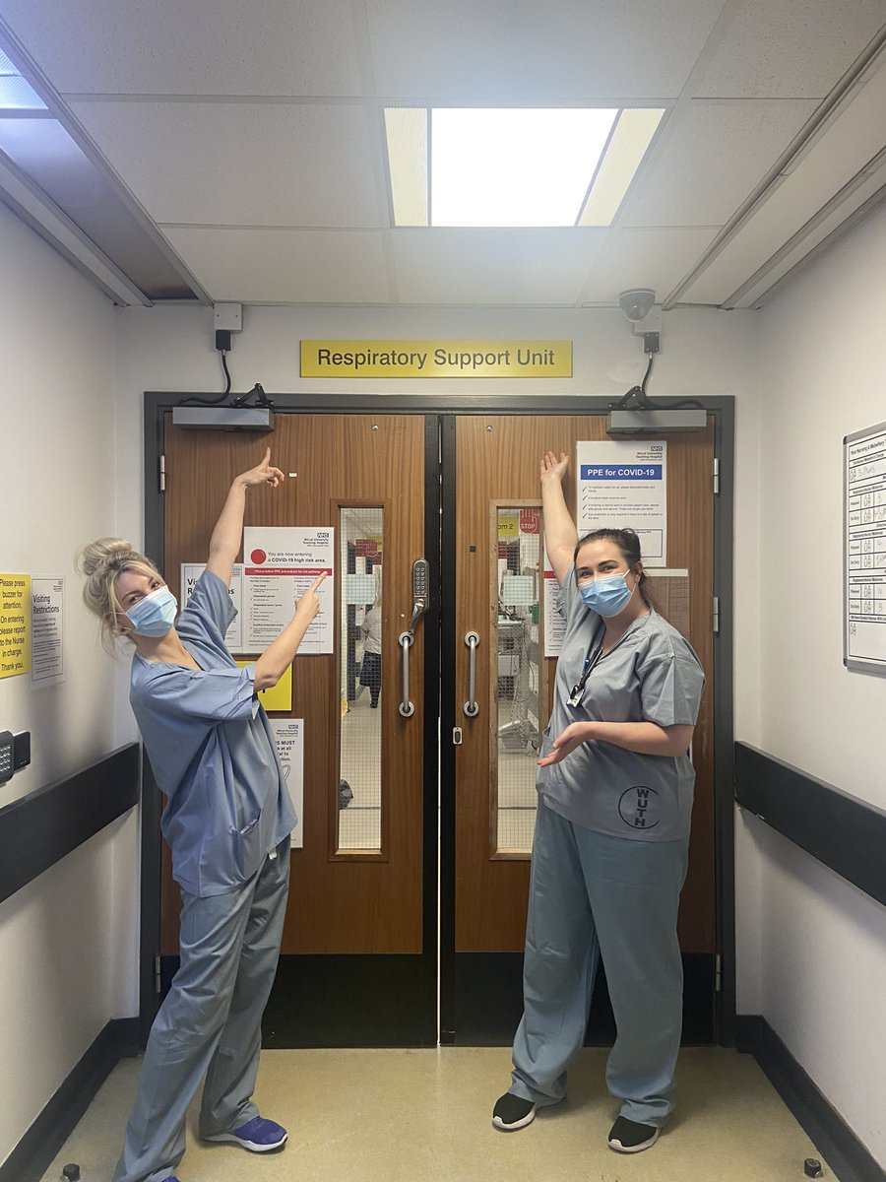
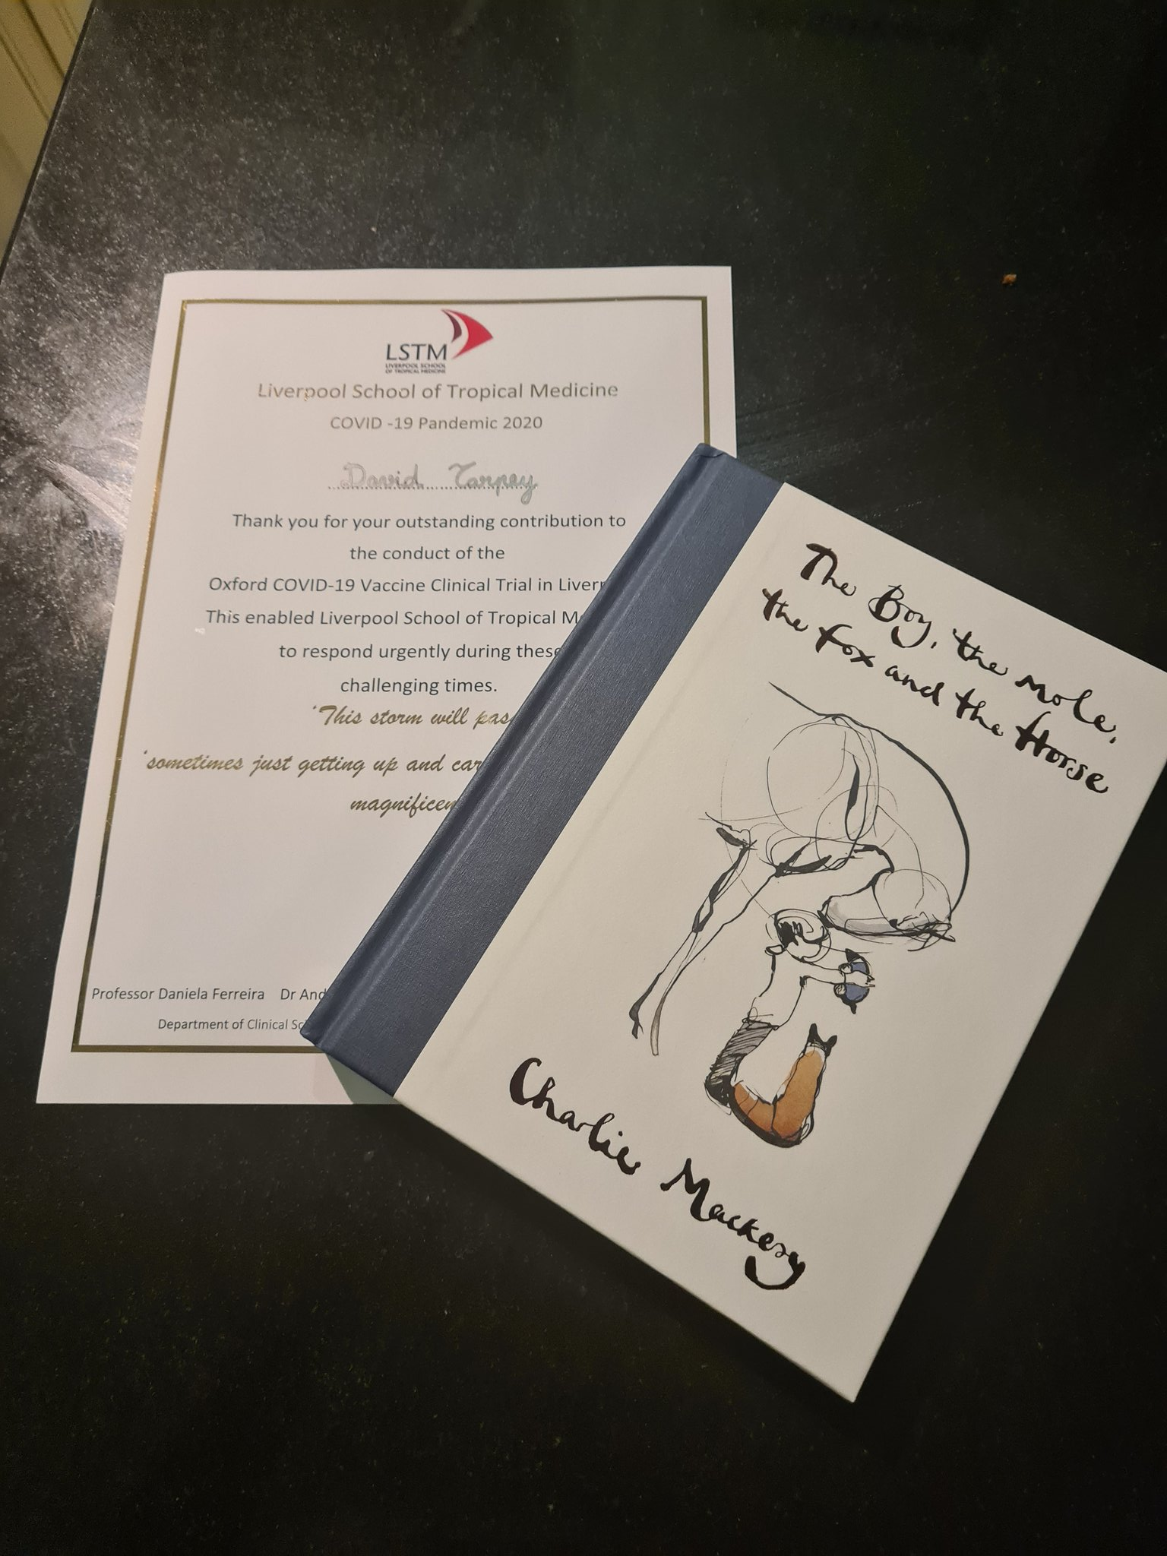
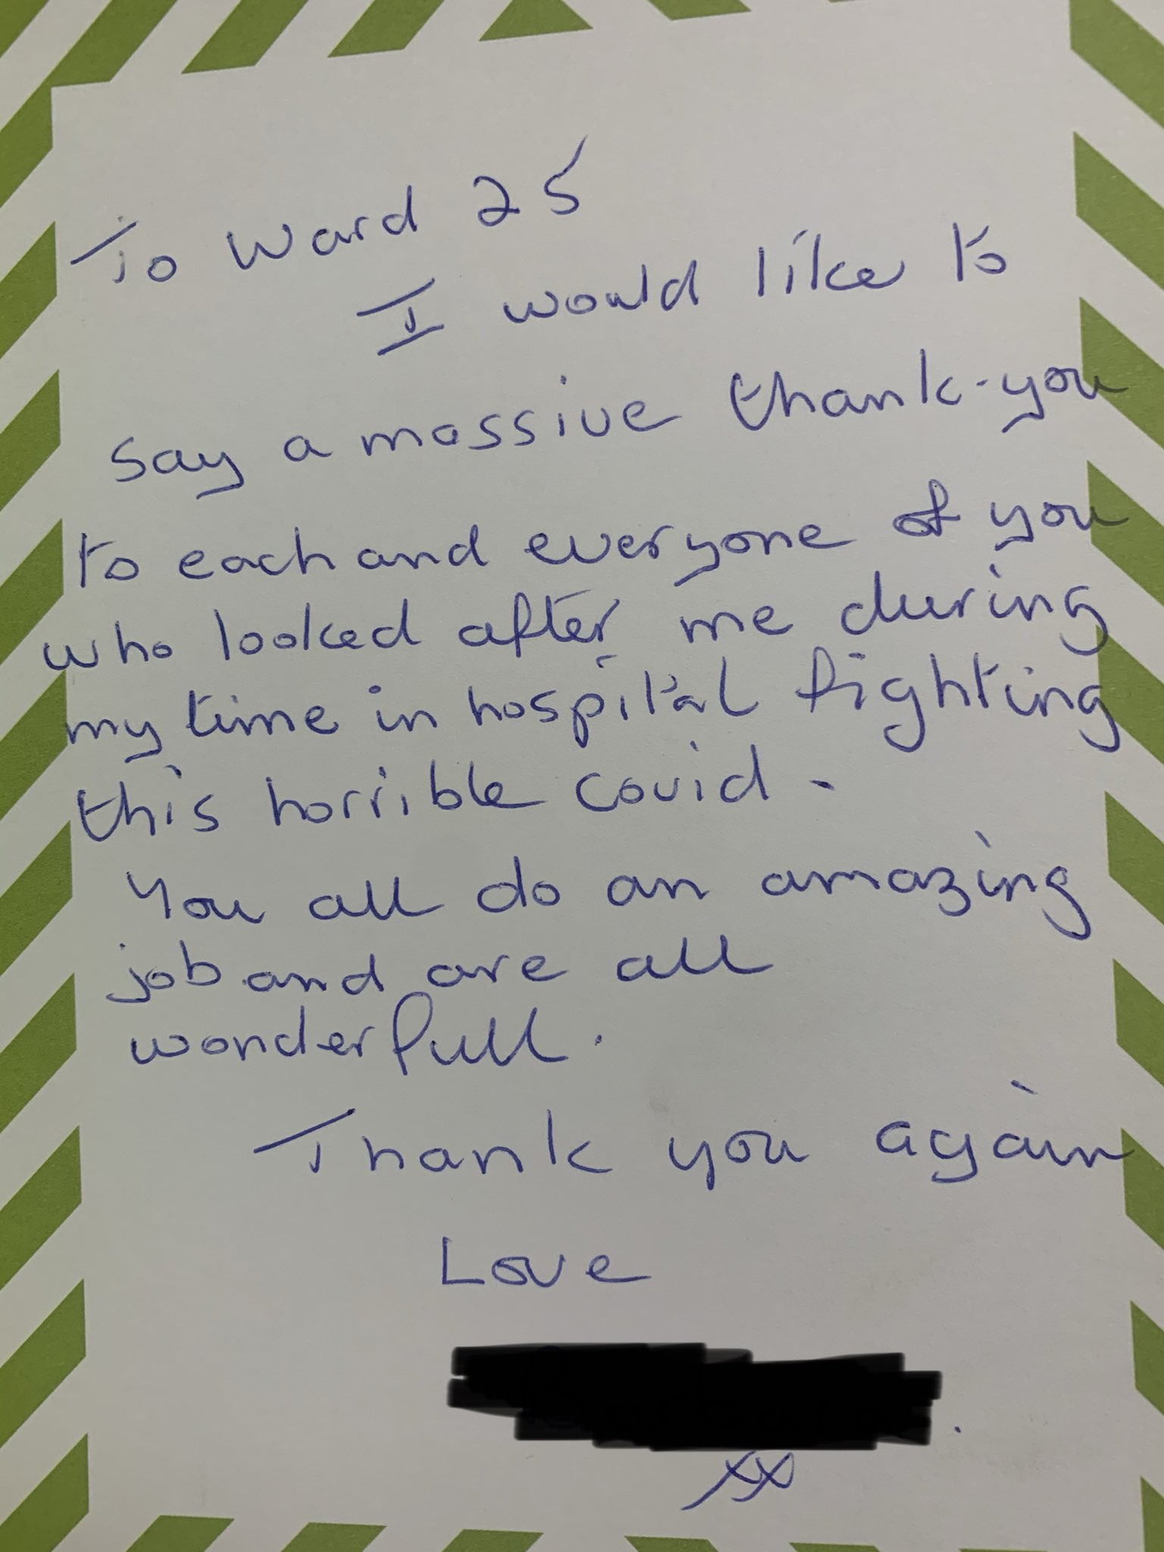
My thoughts
Incredibly challenging both personally and professionally
Very sad at times
Positives
Proud

Slide 35
Questions
Everything will be alright in the end and if it’s not alright, it’s not the end.. Indian proverb.

Slide 36
The last 12 months:
Palliative care team experiences
Dr Richard Latten, Consultant in Palliative Medicine
Annual Members’ Meeting
Monday 18th October 2021

Slide 37

What is palliative care?
‘Palliative care is an approach that improves the quality of life of patients and their families who are facing problems associated with life-threatening illness.
It prevents and relieves suffering through the early identification, correct assessment and treatment of pain and other problems, whether physical, psychosocial or spiritual.’

Slide 38
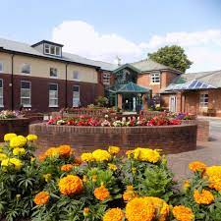
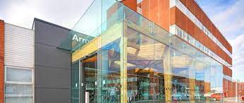
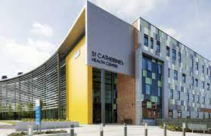
Wirral palliative care services

Slide 39

Palliative care in WUTH
Advisory Team
Provide specialist support alongside other teams & wards
Specialist nurses, physio, pharmacist, support worker & doctors
Supportive Care Unit
Inpatient beds on ward 30
Providing palliative medicine delivered care & support
‘What matters most?’ & Palliative care education

Slide 40
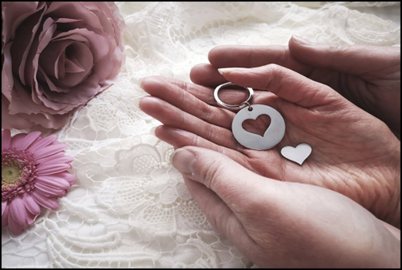
The last 12 months:
Supporting our patients & their families
Service adaptation to clinical need
Different ways of working
Communication focus
Complexity of direct & indirect pandemic effect

Slide 41

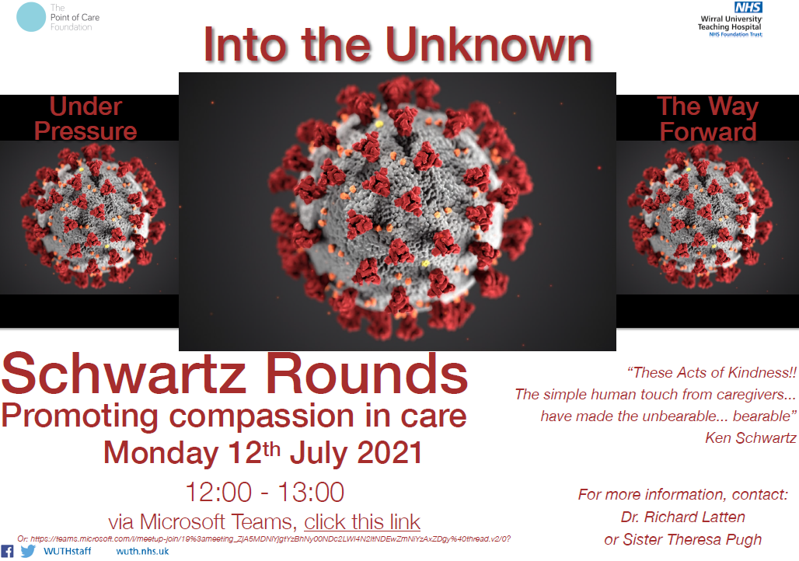
The last 12 months:
Supporting our colleagues
Pandemic impact
Working outside of comfort zone
Less familiar with palliative care situations

Slide 42
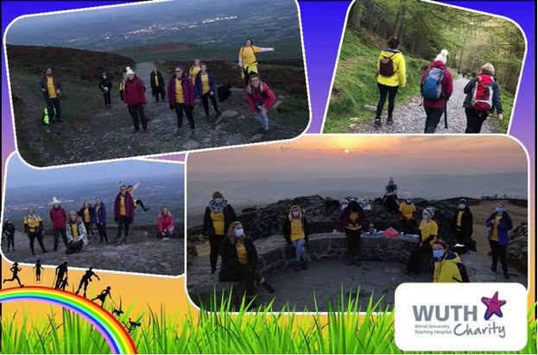
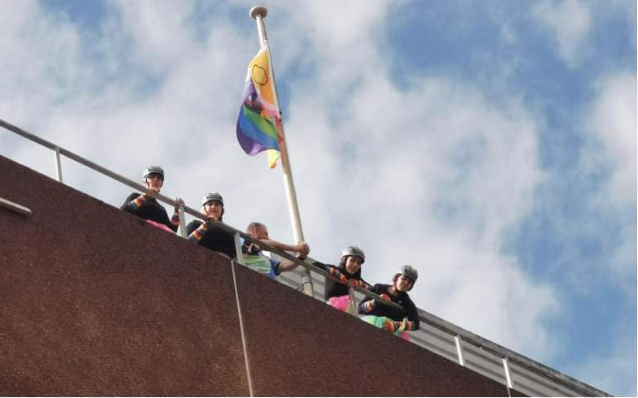
The last 12 months:
Supporting each other
Clinical supervision sessions
Fundraising:
  Hospital abseil
  ‘Active April’
Tomato growing contest

Slide 43
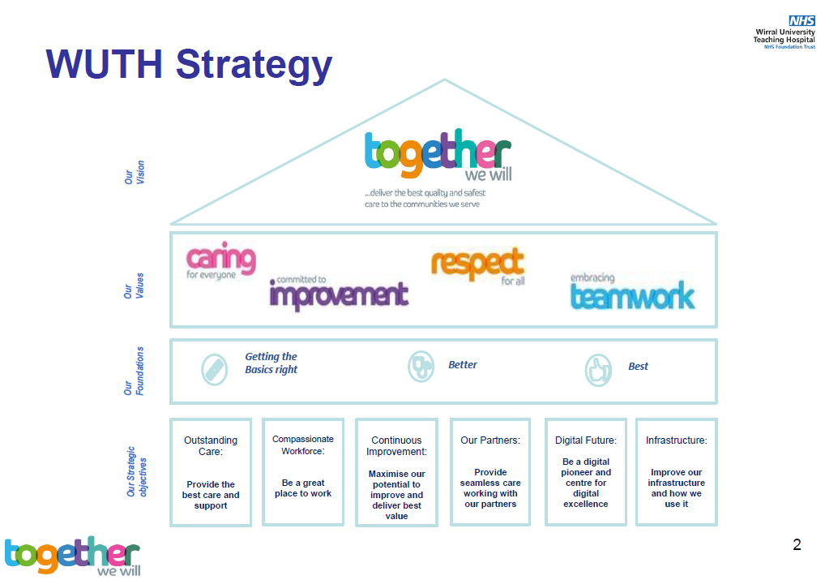

The next 12 months & beyond…

Slide 44
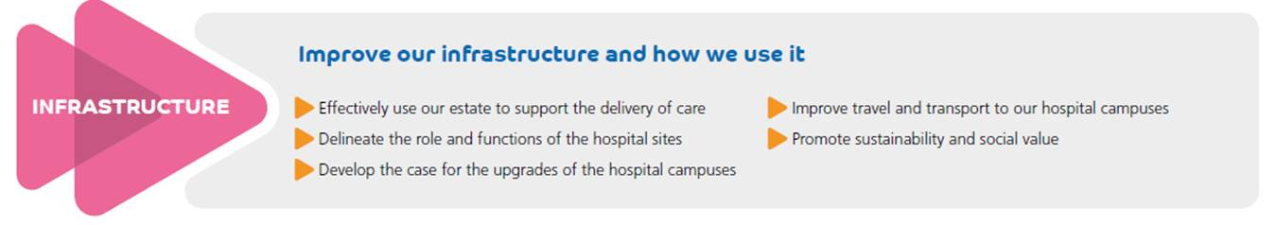
Annual Members Meeting (AMM)
Matthew Swanborough
Director of Strategy and Partnerships
18th October 2021

Slide 45
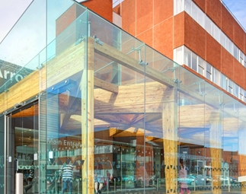
Content
Recurrent Annual Capital Investment 2019-2022
The Approach to Portfolio & Capital Management
Capital Schemes Delivered
Staff Well Being Initiatives
Improving our Wards
Urgent Emergency Care Upgrade Programme
Campus Master Planning
Questions

Slide 46
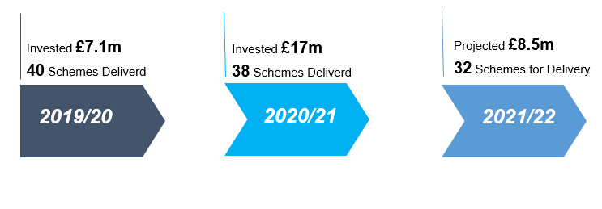
Recurrent Annual Capital (Infrastructure) Investment

Slide 47
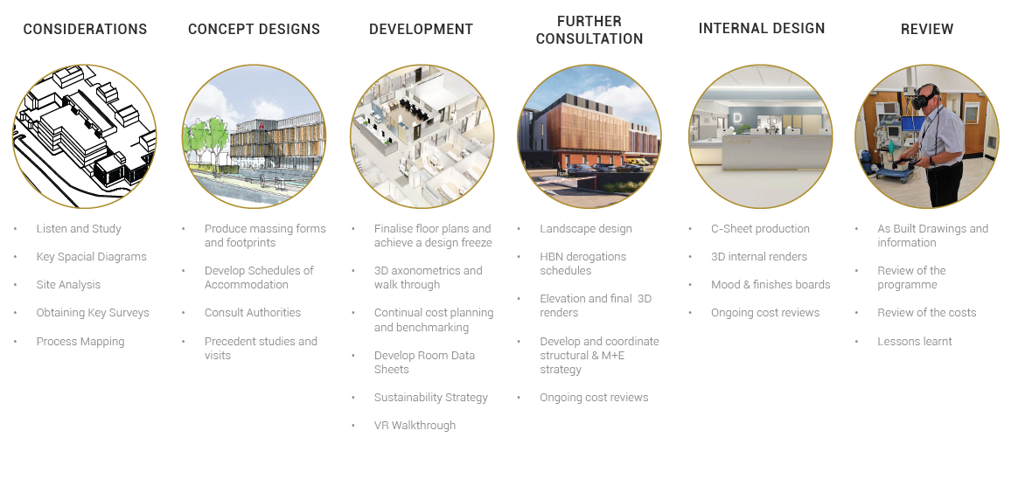
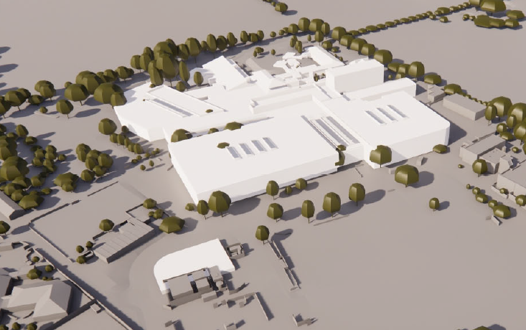
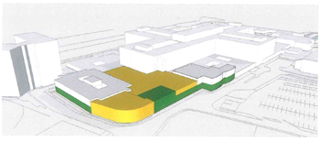
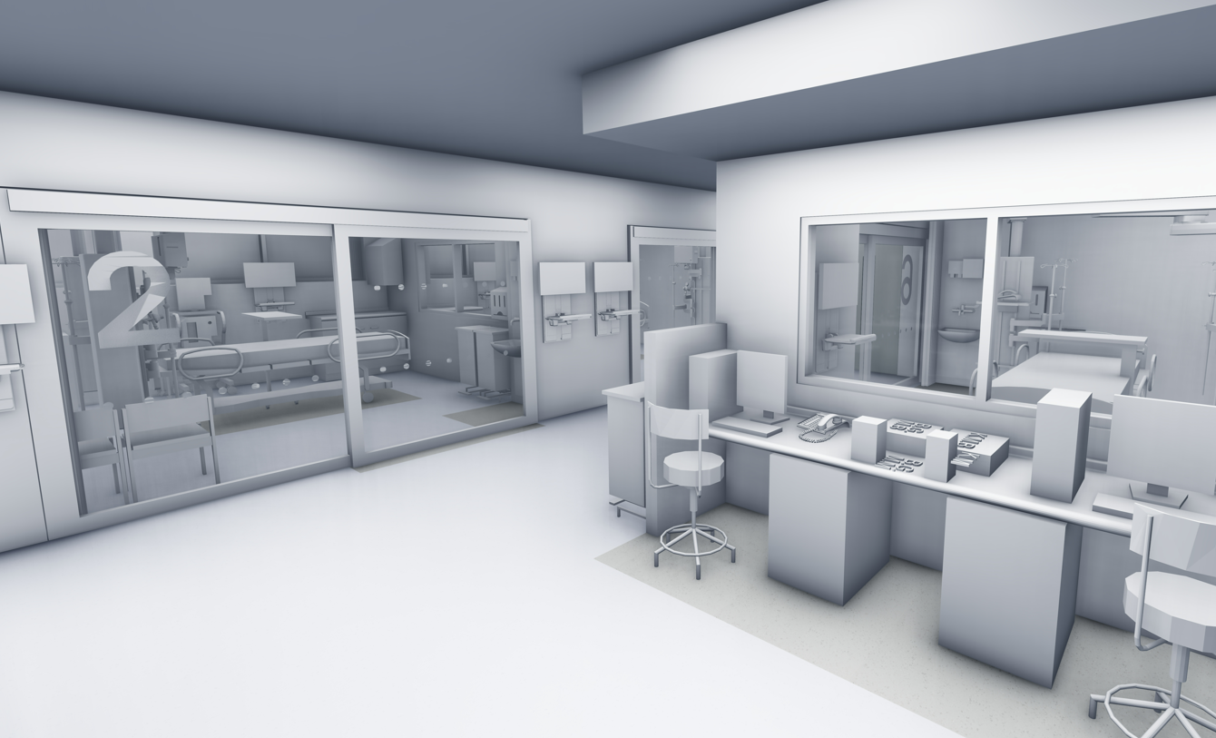
The Approach to Portfolio & Capital Management

Slide 48
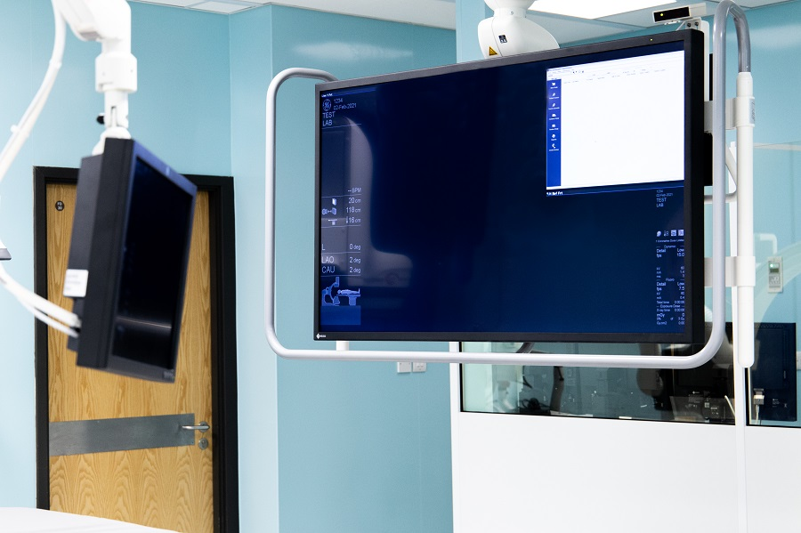
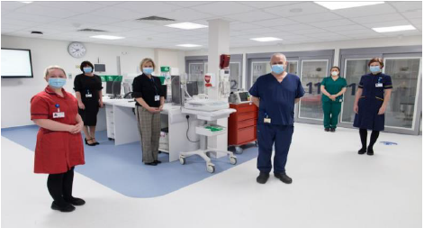
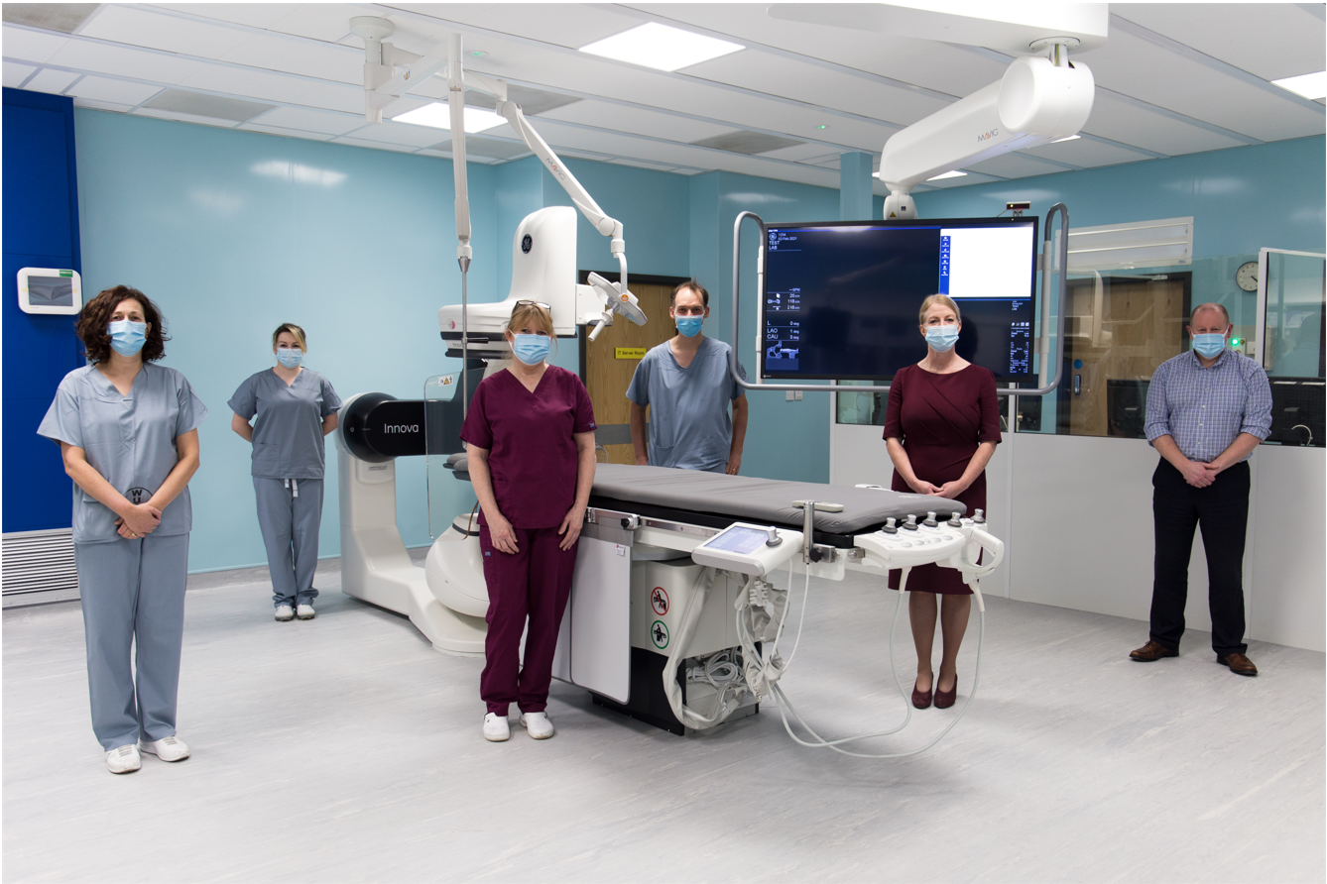
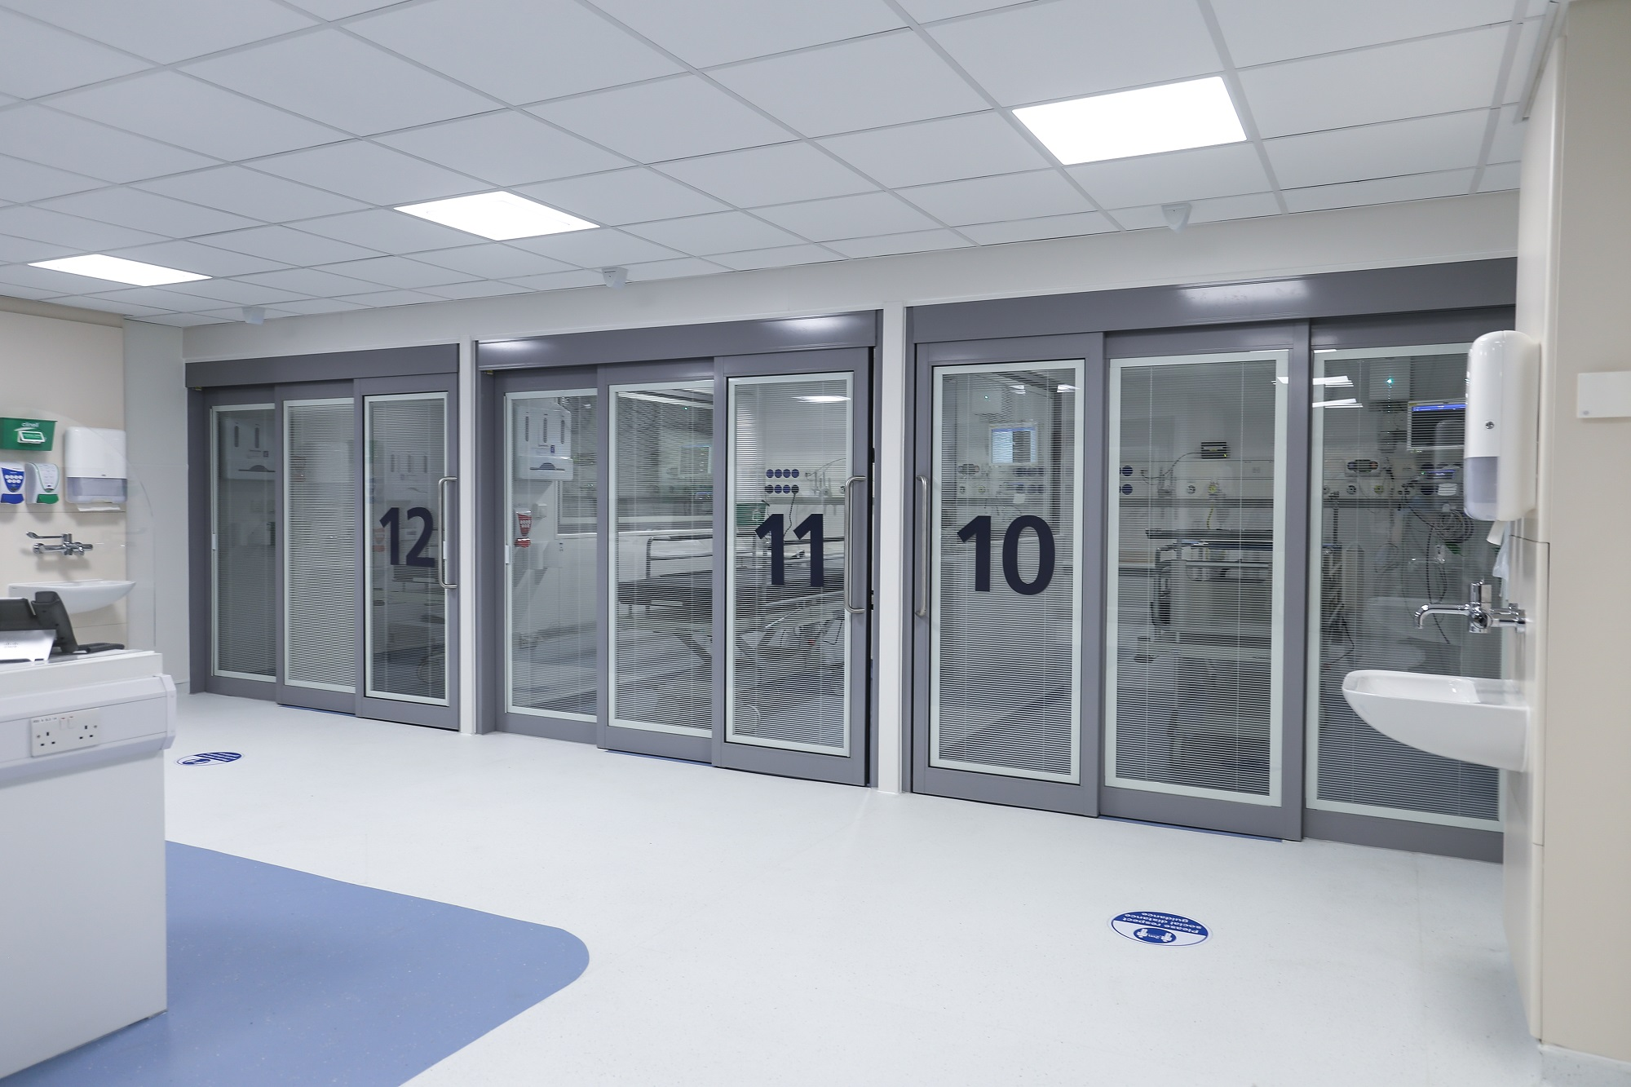
Capital Schemes Delivered 20/21
Emergency Department Upgrade
During winter, the Trust opened a brand-new area within its Emergency Department after it was awarded Government funding, which was aimed at improving emergency care for patients. The upgrade provided eight side rooms, offering greater infection prevention and control measures and enhanced patient safety in response to the COVID-19 pandemic.
Project completed March 2021.
Cost £1m
Cath Lab
In March this year, the Trust also opened a new state-of-the-art Cardiac Catheter Lab for heart patients. Around 1000 procedures, such as implantation of pacemakers, are carried out in the Cardiac Catheter Lab at Arrowe Park Hospital each year.
Project Complete March 2021.
Cost: £1.2m

Slide 49
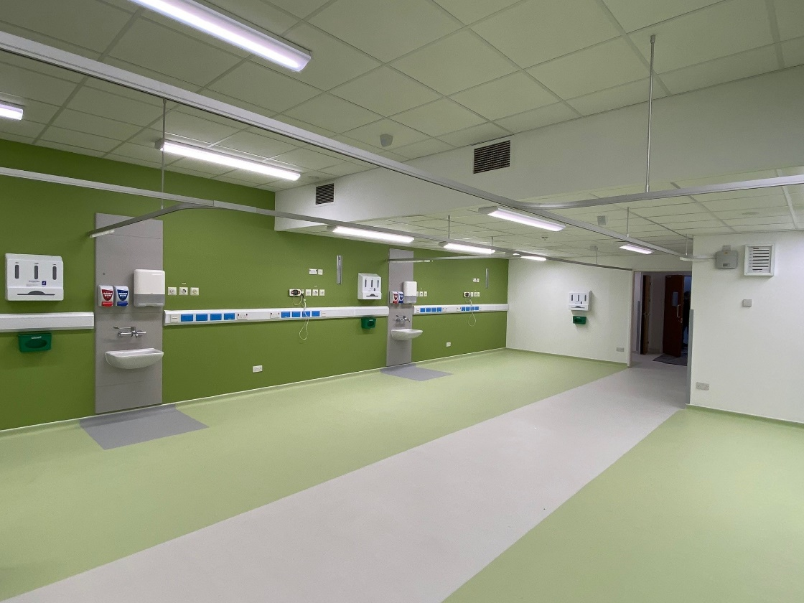
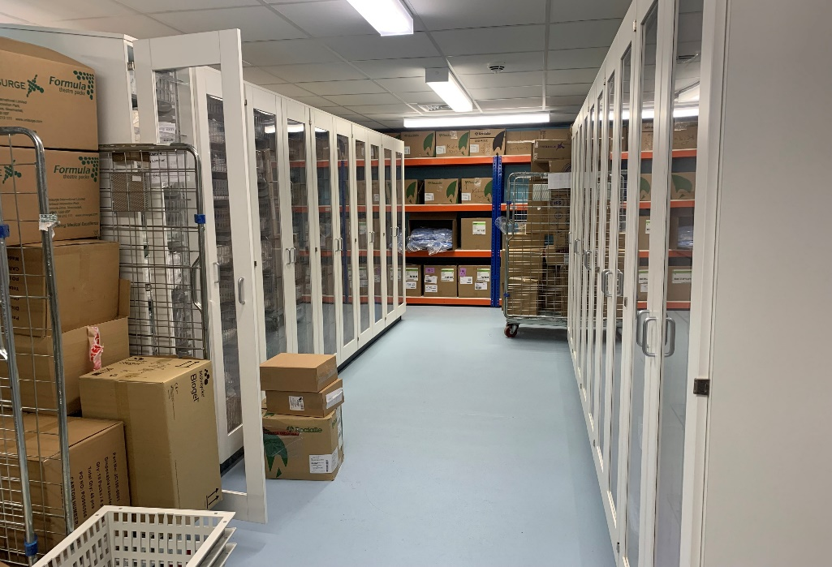
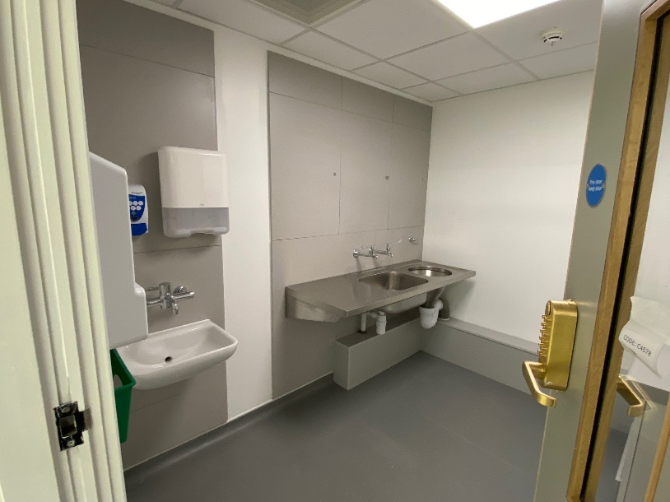
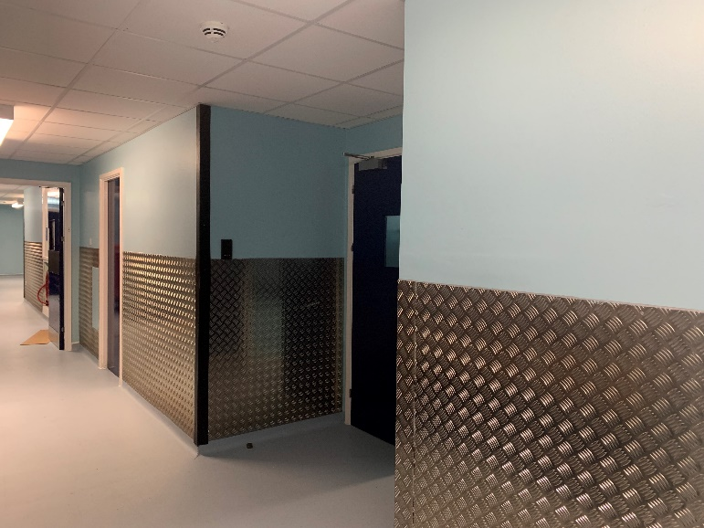
Capital Schemes Delivered 20/21
Theatre Stores
To comply with IPC requirements, the main Theatre store was refurbished. As a result stock control is more controlled and staff feel more engaged.
Significant logistical challenges had to be managed to keep delivery flowing whilst works took place.
Project completed July 2021.
Cost £222,000
HDU Contingency Suite (old gym)
The existing Physiotherapy Gym was converted into a Contingency HDU within 8weeks . This was to enable a full refurbishment of the existing HDU.
New WUTH standard materiality adopted.
Complete late April 2021.
Cost: £330,000

Slide 50
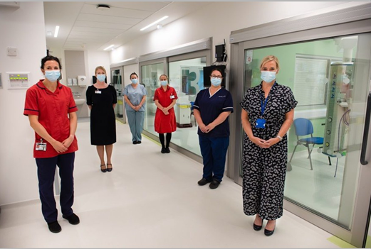
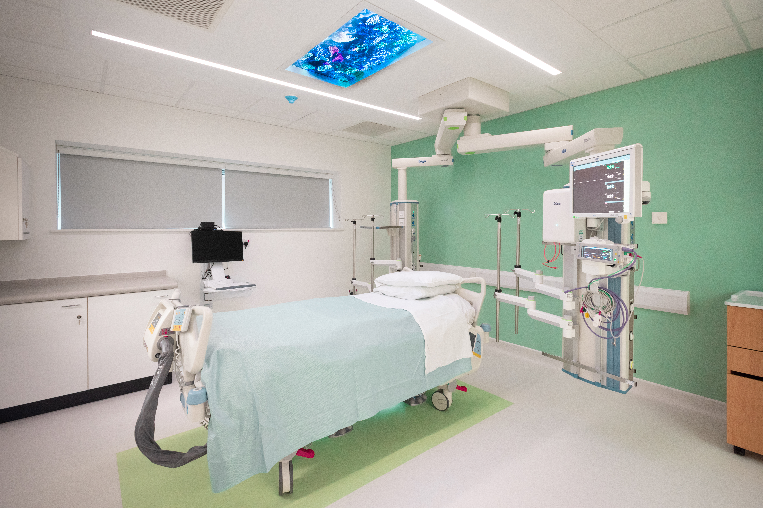
2021/22 HDU Upgrade Programme
The Trust unveiled a new £1.2million upgraded High Dependency Unit which has opened at Wirral University Teaching Hospital to enhance care for some of the our most poorly patients.
The High Dependency Unit (HDU) based at the Arrowe Park Hospital site, cares for patients who have been stepped down from intensive care but who require more extensive care than in a ward area.
Following a 12-week refurbishment, the new HDU has opened and will provide enhanced care for patients. The facility includes six specialist side rooms, improved infection prevention and control measures, as well as a new ventilation system allowing even better care, especially catering for the needs of patients with COVID-19.
Project completed Sep 2021.
Cost £1.2m
APH HDU Walk Through Video

Slide 51
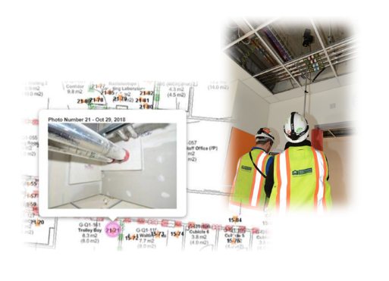
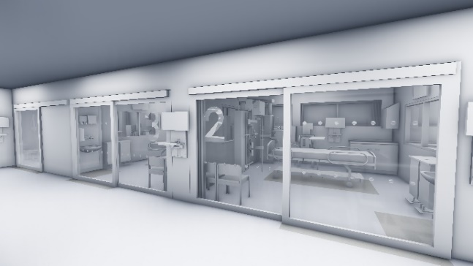
21/22 Backlog Schemes & Improvements
Projects Completed this last Quarter:
Fire Alarm upgrade – July 2021
CCTV Upgrade – July 2021
Anaesthetics and OPAU roof refurbishment – July 20121
Clatterbridge Theatres Refurbishment June 2021
Arrowe Park Theatre Refurbishments – May 2021
Additional Projects:
There is an increasing demand on the Capital team
to support divisional funded schemes circa 50 significant projects.
Examples include:
  Ward 12 urgent reconfiguration, COVID-19 related.
  Clatterbridge Diagnostic Hub – Target
  Library screening for training purposes
  Education Centre modifications
Capital Improvements
Principals Guide standards being developed and deployed.
Policy and Project Management Procedure updated.
3D walk through technology used on major schemes.
Multivista 360 degree technology for record keeping.
Control of contractors policy and procedures under review.

Slide 52
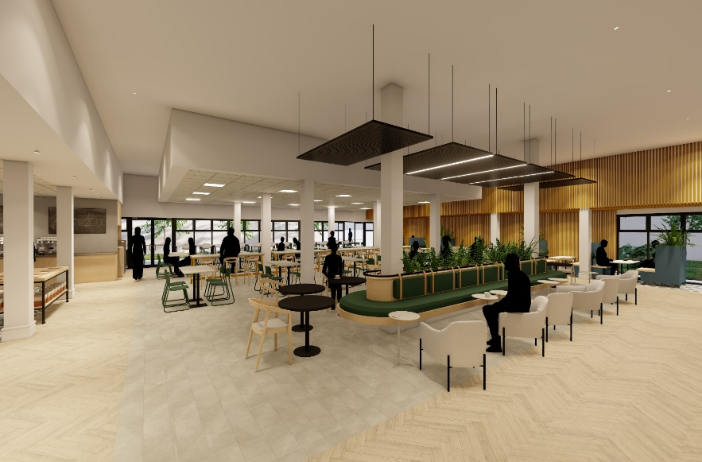
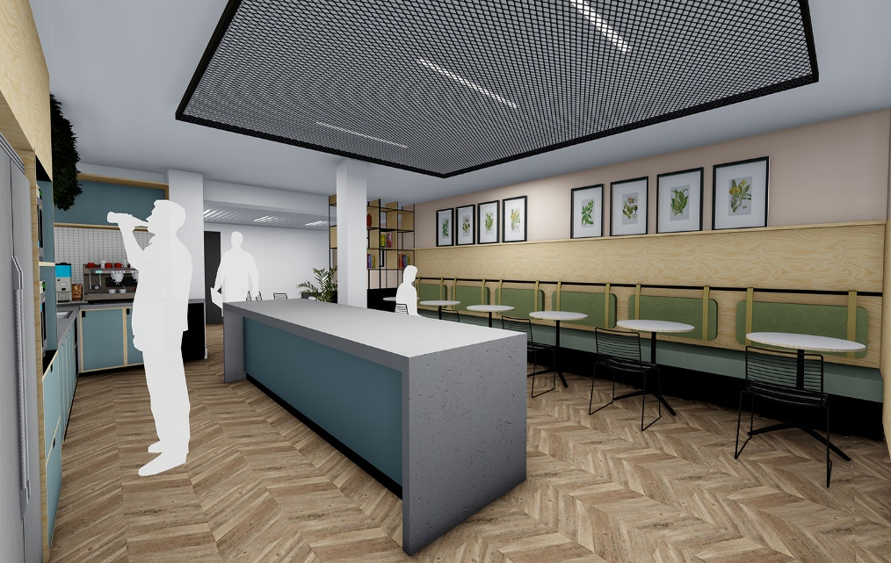
Arrowe Park- Bowmans Restaurant & staff changing facilities refurbishment
Staff Wellbeing Initiatives
The main staff restaurant and staff changing facilities are being updated, the restaurant being part funded with charity provided finance. The design philosophy is around providing stress free and functional space where staff can relax and comfortable.
An environment where wellbeing is the theme and real focus of scheme.
This facility is due to be completed in 21/22
The servery is also being modernised to allow a better distribution flow, supporting footfall at busy times.
Staff Restaurant
Staff Change

Slide 53
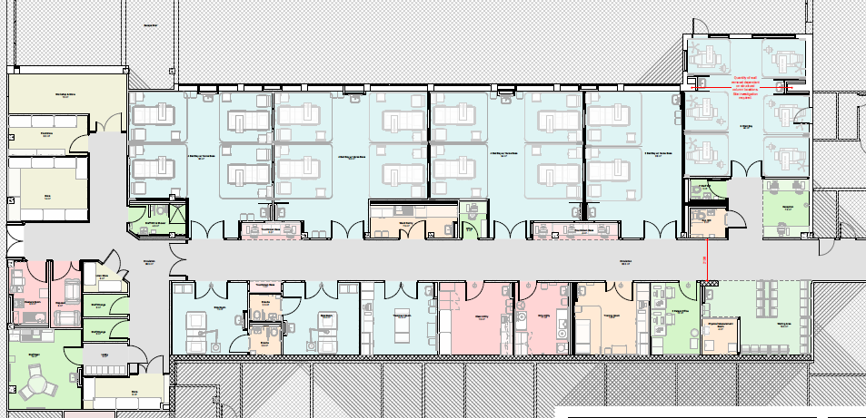
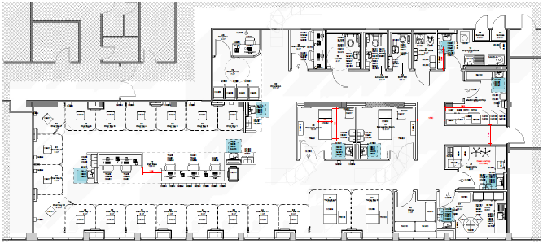
Arrowe Park Hospital Ward 1 reconfiguration and decant of Ambulatory Day Case Ward
Improving our Wards – 21/22
Renal Dialysis
The drawing on the left shows the proposed Ward 1 move to GUM clinic area. This then allows Dialysis to move into the current ward 1 area detailed below. Ward 31 dialysis will then become part of future refurbishment decamp strategy.
Currently at Design and Specification
Ambulatory Day Case

Slide 54
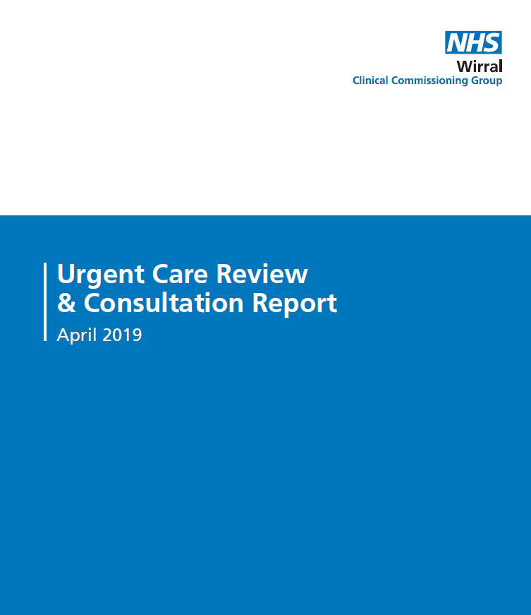

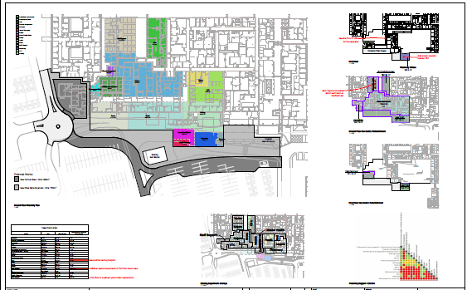
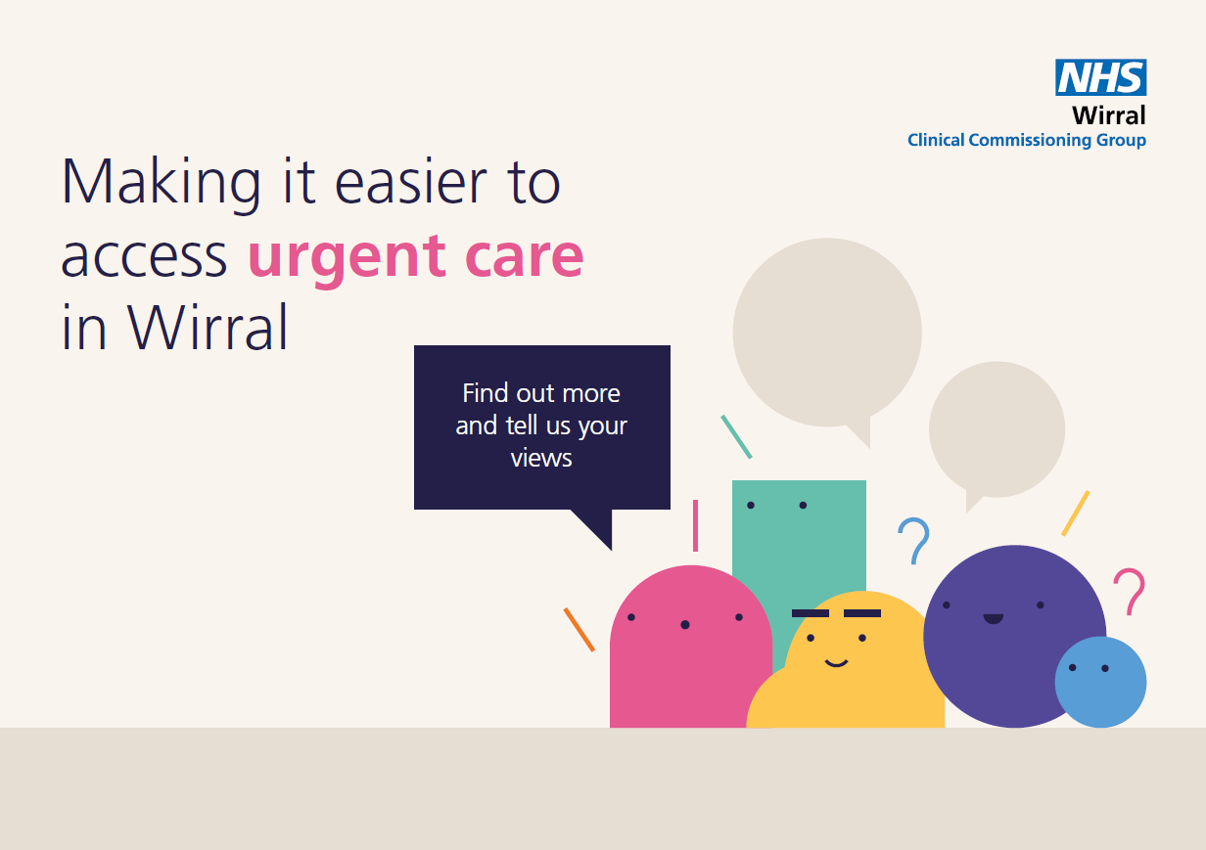
WUTH & WCHC Urgent Emergency Care Upgrade Programme (UECUP)
Extensive System Collaboration
DHSC
NHSE/I
JISC
WUTH
WCHC
Communication Teams
CCG
SEB
Partners (PSCP / Procure 22 PM)
Patients
Staff
Wirral Council
Police
Some Key Facts
£28m
£18m of Allocated System Investment
£5m Funded by WUTH
£5m Funded by Wirral Community Health and Care Trust (WCHC)
Patients at the Heart of Design
PSCP Appointed: Tilbury Douglas
GMP Approx. £19.5m
(Guaranteed Maximum Price)
3 Years of Patient Data Analysis
Strategic Principles
Total Floor Area 4,265sqm
OBC Approval July 2021
Part Refurb
Part New Build
55 Engagement Workshops
(Clinical, non clinical, IPC, Health Safety)
Developing Extensive Communication Plans
Social Value
Patient Experience Engagement
Developing FBC Jan 2022

Slide 55
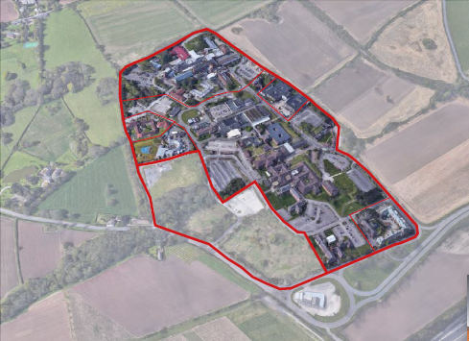


Trust Master Planning
Clatterbridge Health Park Master Planning
The Trust in conjunction with Clatterbridge Cancer Centre NHS FT undertook a commission with Partners to assist the Trust with the development of the sites master plan. This is near to completion.
A phased approached has been developed to enable an affordable scheme alongside a dual ‘expression of Interest’ process in response the Governments ‘Hospital Infrastructure Programme’
Benefits include
Modern Chemotherapy suite and Nuclear Medicine suite
Outpatient & ambulatory capacity with access to a therapy's suite
Increased elective activity through a dedicated cold site which will in turn support the Arrowe Park Hospital (APH) site acute pressures
Reduce patient waiting lists through reduction in cancelations
Provide infrastructure to support continued use of technology and virtual appointments post pandemic
Integration of campus site partners to enhance the patient journey
Reduce backlog maintenance
Address the flood risk
Stronger and greener NHS buildings
Improve staff and patient facilities supporting wellbeing for all
Efficiencies created through delineation of hospital sites

Slide 56


Trust Master Planning
Arrowe Park Hospital (APH) Master Planning
The Trust is developing an IIT Specification for the commissioning of the APH master planning exercise. The anticipated timescales for commencement is February 2022 with approximate lead times for delivery of 9 months. The master plan will seek to address Trust strategic aims, including:
Exploring opportunities under broader Wirral regeneration agendas, including the exploration of funding opportunities.
Current and future shifts in demographic clinical requirements, with an emphasis on deprivation.
Population growth and the subsequent pressures on the built environment to serve the population of Wirral.
Demonstrable backlog maintenance pressures, and to overcome the current transport and access issues at the site.
Explores and addresses future proofing the provisions now and in the future, in particular the pressures and changes associated with the COVID pandemic.

Slide 57

Annual Accounts 2020/21
Claire Wilson, Chief Finance Officer

Slide 58

Financial Headlines: 2020/21 in numbers
Temporary finance regime in place to support NHS response to COVID-19
Additional funding received to support underlying deficit and COVID-19.
Surplus of £440k
£21.3m cash balances at the end of the year.
Invested £17m in our Estate, Infrastructure and Critical Equipment.

Slide 59
.
Notes:
.

Slide 61

Capital Expenditure: £17m
The Trust made the following investments during the year:
£8m Medical equipment including:
    Radiology equipment
    Patient Monitors
    Theatre equipment
    Endoscopy equipment to support additional cancer activity
£6m Improvements to the Trust’s built estate including:
    Fire alarm upgrade
    Cath lab refurbishment
    Critical care development
    A&E development
£2m Information technology improvement schemes.
£1m Schemes to support the Trust’s response to COVID-19.

Slide 62
Forward look…
Finance Regime 2021/22
Capital Programme 2021/22
Continuation of last years finance regime to support the NHS respond to COVID-19
Funding provided to cover costs of pandemic.
Trust is currently reporting a break even financial positon
Cost Improvement programme reintroduced from September 2021
Ambitious £12m programme to enhance patient environment and replace critical equipment. Including:
  £2m ward refurbishments
  £1m replacement CT scanner
  £4m Estates infrastructure improvement
  £1m Investment in Information Technology
  £3m other medical equipment

Slide 63





Fundraising
COVID-19 Appeal - launched and supported by appeal partner the Wirral Globe
‘More than 2000 donations were made to over 200 individuals completing challenges for the appeal’
Over £150,000 raised locally
£182,000 NHS Charities Together grants
Charity Impact
Medical equipment purchased - £290k
Patient comforts and welfare - £59k
Gifts in kind distributed - < £600,000
Looking forward
Fundraising activity is resumed!

Slide 64
Questions

